Slide 1
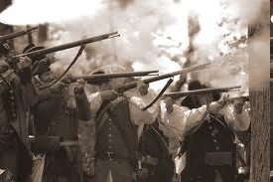
How the French Lost their Foothold in North America to the British and British-Americans

Slide 2
Written by
Edward J. Dodson, M.L.A.

Slide 3
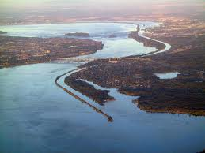
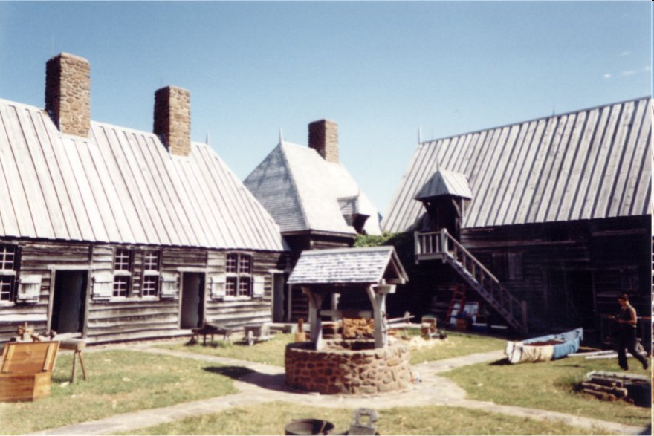
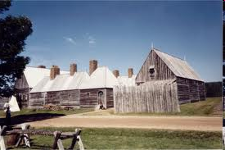
Notes:
The first French explorer to arrive on the shores of North America was Jacques Cartier, who entered the St. Lawrence River in 1534. From that point on French traders and adventurers followed slowly over the last decades of the sixteenth century.

Slide 4
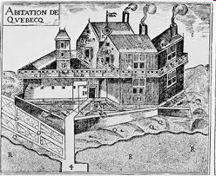
Notes:
Then, in 1608 Samuel de Champlain began construction of the settlement of Quebec and French expansion from the region of the St. Lawrence River throughout the Great Lakes.

Slide 5
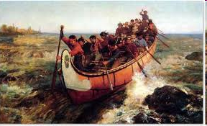
Notes:
Generations of French woodsmen spread into the wilderness to trap and hunt animals for their fur. They adopted the lifestyle of the tribal peoples they encountered and were often adopted into the tribes they traded with.

Slide 6
Notes:
The territory entered into by these Europeans was thinly populated by Amerindians, each tribe controlling a region won by conquest.

Slide 7
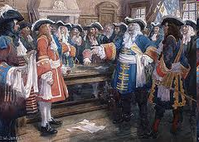
Notes:
European conflicts between France and England spilled over to North America again in 1689, following removal of Charles II from England’s throne and the arrival of William of Orange from the Netherlands.

Slide 8
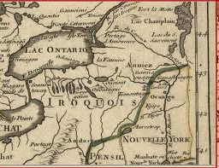
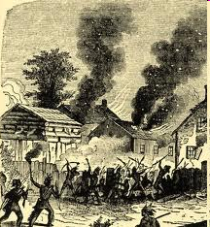
Notes:
The governor of New France responded to an escalation of Iroquois attacks by enlisting the northern tribes to attack English settlements in New England and New York.

Slide 9
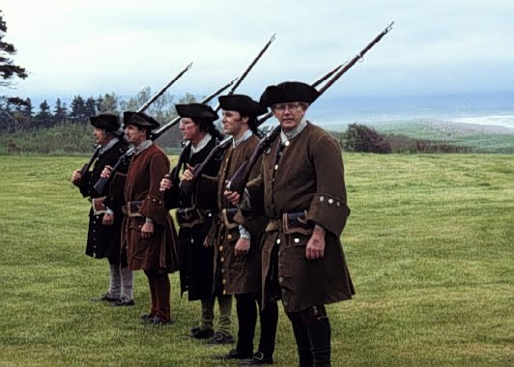
Notes:
In response, English colonial militia joined forces to attack Montreal, but the enterprise failed.

Slide 10
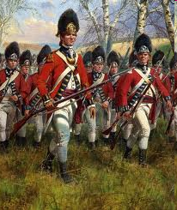
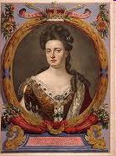
Notes:
After a few years of tense peace, in 1702 England declared war against both Spain and France. What began as a war over who would ascend to the Spanish throne, became Queen Anne’s War.

Slide 11
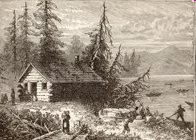
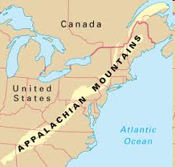
Notes:
By this time, the population of Britain’s North American colonies had reached an estimated 250,000. A small number of brave and land-hungry colonials were establishing small settlements in the wilderness as far as the eastern slopes of Appalachian Mountain chain.

Slide 12
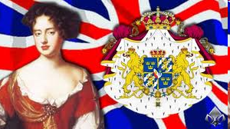
Notes:
Queen Anne’s War came to its inconclusive end and the Treaty of Utrecht was signed in 1713.

Slide 13
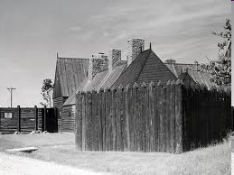
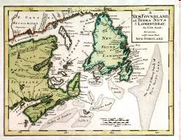

Notes:
The French relinquished control over Acadia – which the British renamed Nova Scotia – as well as Newfoundland and fur trading posts in the Hudson Bay area.

Slide 14
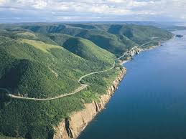
Cape Breton Island
Notes:
France managed to retain several islands in the St. Lawrence River as well as Cape Breton Island at the northeastern end of Nova Scotia.

Slide 15
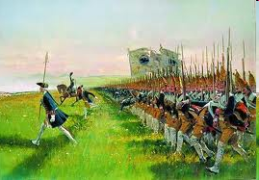
Notes:
Yet another European conflict erupted in 1740, ostensibly over who would succeed to the throne of Austria. Britain was drawn diplomatically into that conflict in 1742 as an ally of Austria against France and Prussia.

Slide 16
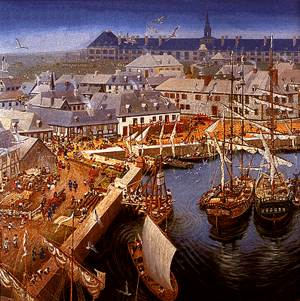
Notes:
In May of 1744, the French dispatched a strong naval force from their fortress at Louisbourg against British positions in the Grand Banks area, where fishing rights were in dispute.

Slide 17
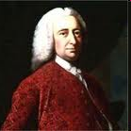
William Shirley
Notes:
Massachusetts Governor William Shirley responded the following year with an expedition that took the French fortress at Louisbourg after a six week siege.

Slide 18
Notes:
The French hold on North America was clearly weakened. One problem the French could not overcome was a more than twenty-to-one disadvantage in population.

Slide 19
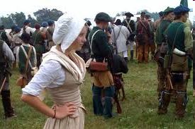
Notes:
For every English settler or family killed on the frontier, there were many others standing by -- waiting for an end to hostilities -- to return to abandoned regions.

Slide 20

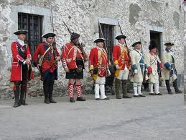
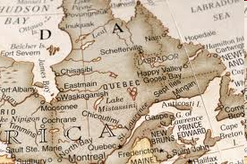
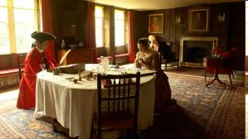
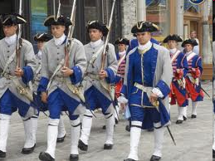
Notes:
One aspect to the French dilemma was turmoil in France caused by renewed religious fanaticism. Thousands of Huguenots were being killed or imprisoned. These and many others could be sent to populate New France to begin lives of self-sufficiency, but the King seemed oblivious to the threats either at home or in New France.

Slide 21
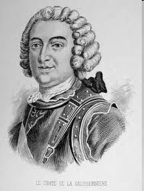
Notes:
In March of 1746, the French governor stated his position in a letter sent to the French colonial minister:

Slide 22
“… As chief representative of the American policy of France, I feel that, cost what it might, we must hold fast to Canada and link her to Louisiana not only with forts, … but, even more importantly, with no less than ten thousand settlers from the mother country. …”
Notes:
“… As chief representative of the American policy of France, I feel that, cost what it might, we must hold fast to Canada and link her to Louisiana not only with forts, … but, even more importantly, with no less than ten thousand settlers from the mother country. …”

Slide 23
“These people, from all stations in our society, should be spread to settle and multiply in the broad valleys of the interior, to hold back the British Colonies and cramp their growth by confinement within narrow limits. …”
Notes:
“These people, from all stations in our society, should be spread to settle and multiply in the broad valleys of the interior, to hold back the British Colonies and cramp their growth by confinement within narrow limits. …”

Slide 24
“Already an ominous flow of British traders, against whom our forts have little control, moves westward from the mountains, even to beyond the Mississippi River. They are alienating the natives to our cause and close on their heels are coming land speculators with an eye to future English settlement.”
Marquis de la Galissoniere, Governor of New France
Notes:
“Already an ominous flow of British traders, against whom our forts have little control, moves westward from the mountains, even to beyond the Mississippi River. They are alienating the natives to our cause and close on their heels are coming land speculators with an eye to future English settlement.”

Slide 25
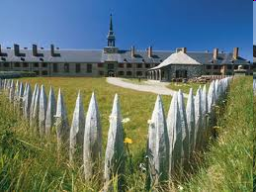
Notes:
Peace returned in 1748 with the signing of the Treaty of Aix-la-Chapelle. Britain returned the Fortress of Louisbourg to France, over the objections of colonial officials.

Slide 26
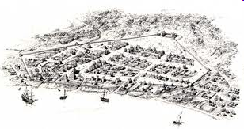
Albany, New York – late 17th century
Notes:
For all involved in the struggle for territory – English, French, Iroquois and other Amerindian tribal nations – control of the settlement of Albany, far up the Hudson River from New York was a strategic necessity.

Slide 27
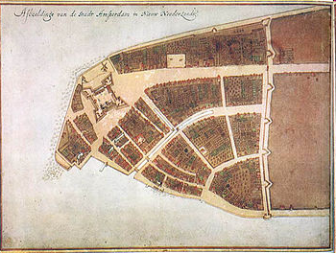
Notes:
The Dutch had arrived first to settle in the Albany area in the early-1600s. Their holdings were given over to the English in 1664 with the surrender of Fort Amsterdam on Manhattan Island. Yet, their influence as landowners remained significant.

Slide 28
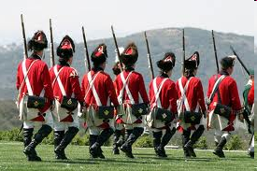
Notes:
English troops moved north to take over the Dutch fort and the rest of the colony. The main Dutch settlement, Beverwyck, was renamed Albany.

Slide 29
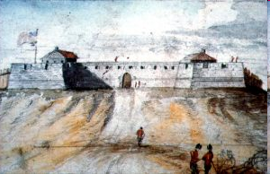
Notes:
The Dutch briefly regained control in 1673 but finally ceded all claims to the colony under the terms of peace reached the following year. To secure the region, a new fort was constructed on high ground above the settlement.

Slide 30
Notes:
Over the next four decades the population of Britain’s northern colonies continued to increase, forcing the frontier line west from Albany, north toward Lake Champlain and to the western slopes of the Appalachian Mountains.

Slide 31
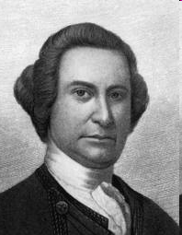
Notes:
An extraordinary asset possessed by the British and the colonials in this region was the presence of one man, William Johnson.

Slide 32
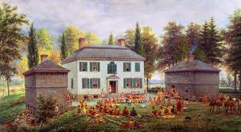
Notes:
William Johnson had come to the Mohawk Valley in 1739 from his home in Ireland to manage land granted to his uncle, a British naval officer.

Slide 33
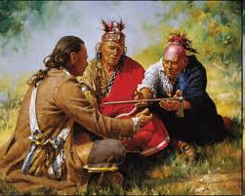
Notes:
He established himself as a trader with the local people, dealing with everyone – including the members of the Mohawk tribe – in a manner they were unaccustomed to; that is, honestly, fairly and generously.

Slide 34
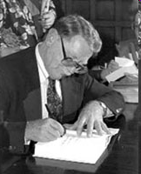
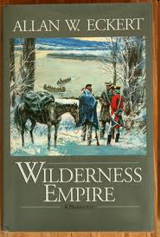
Notes:
As Historian Allan Eckert explains in Wilderness Empire:

Slide 35
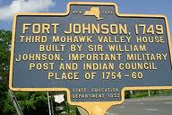
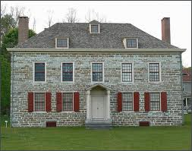
“The Indians could scarcely believe what happened when William Johnson dealt with them. As was usual in trading deals, liquor flowed in abundance, but it was there that the common custom ended. …”
Notes:
“The Indians could scarcely believe what happened when William Johnson dealt with them. As was usual in trading deals, liquor flowed in abundance, but it was there that the common custom ended. …”

Slide 36
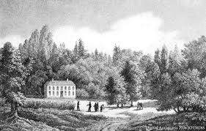
“It was normal, after drinking to excess, for the braves to fall into drunken stupor and then awaken to find their pelts mostly gone as payment for the rum that had been drunk, and not enough skins left with which to buy clothes and blankets and ammunition for them and their families in the months ahead. …”
Notes:
“It was normal, after drinking to excess, for the braves to fall into drunken stupor and then awaken to find their pelts mostly gone as payment for the rum that had been drunk, and not enough skins left with which to buy clothes and blankets and ammunition for them and their families in the months ahead. …”

Slide 37
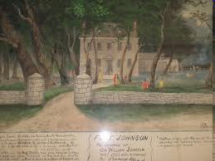
“Not so when William Johnson dealt with them. This is what astounded them: when they came groggily erect the next morning, they found that the rum they had drunk was not charged against them, that their pelt bundles were intact, and that an excellent deal awaited them in the trade.”
Notes:
“Not so when William Johnson dealt with them. This is what astounded them: when they came groggily erect the next morning, they found that the rum they had drunk was not charged against them, that their pelt bundles were intact, and that an excellent deal awaited them in the trade.”

Slide 38
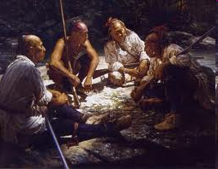
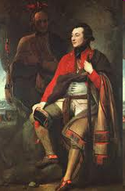
William Johnson
Notes:
In 1742 William Johnson was adopted into the Mohawk tribe and given the name Warraghiyagey – the man who undertakes great things. From this time on the English had a white man on the frontier with considerable strong influence over the allegiance of the tribes of the Iroquois confederation.

Slide 39
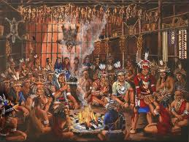
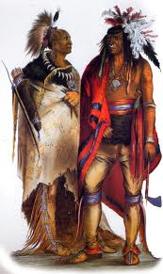
Notes:
War between France and Britain ended in 1748. Now a new problem arose on the frontier. More and more settlers were encroaching on territory the Iroquois still considered as their own. Tiyanoga, at an Iroquois grand council meeting at Onondaga, summarized their dilemma:

Slide 40
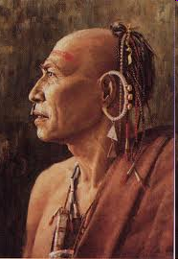
“There is now a peace between English and French and since white men are always more concerned with money than with glory, there will soon come men swarming like the white man’s honey bees, to take up land and live where their soldiers now tremble to stay. Great problems are sure to come for us.”
Notes:
“There is now a peace between English and French and since white men are always more concerned with money than with glory, there will soon come men swarming like the white man’s honey bees, to take up land and live where their soldiers now tremble to stay.”

Slide 41
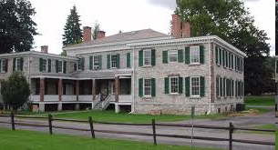
Manor house built by William Johnson, 1742
Notes:
The next years were filled with tension throughout the territory. All the while, William Johnson’s business ventures and investments in land made him a wealthy man.

Slide 42
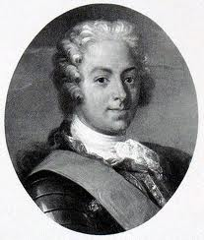
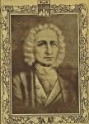
Marquis de la Galissoniere
Marquis de la Jonquiere
Notes:
In June of 1749, Galissoniere was recalled to France by Louis XV, to be replaced by the Marquis de la Jonquiere, a retired naval officer.

Slide 43
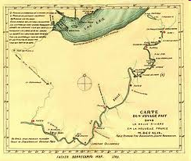

Notes:
In the interim, the Governor dispatched a company of soldiers under Pierre Joseph de Celoron down the St. Lawrence from Montreal, onto Lake Ontario to the Niagara River, across Lake Erie, then south on the Allegheny River to the Ohio River.

Slide 44

Notes:
Celoron’s expedition reached the Seneca village of Alequippa Town in August of 1749, where he warned of “designs of the English against your lands.” Monakaduto, a Seneca chief, responded:

Slide 45
“You who come to us under the name of friendship, here me. The Indians of this country – a country that no one can own, any more than a man can own the air he breathes or the water he drinks, but which is there for all to use wisely and well – these Indians need trade goods. …”
Notes:
“You who come to us under the name of friendship, here me. The Indians of this country – a country that no one can own, any more than a man can own the air he breathes or the water he drinks, but which is there for all to use wisely and well – these Indians need trade goods. ...”

Slide 46
“They have accepted the English goods over the French only because they are better, cheaper and more abundant.”
Notes:
“They have accepted the English goods over the French only because they are better, cheaper and more abundant.”

Slide 47







Notes:
Thus, although the small number of French in North America meant they were far less threatening to the way of life of the tribal peoples, these same Amerindians were already highly dependent on the goods coming from British traders, traders serving as a vanguard for land speculators and settlers.

Slide 48

Montreal in 1749
Notes:
Upon his return to Montreal late in November, Celoron reported to the new governor. At the end of his report, Celoron recorded what he had learned:

Slide 49


“Father Bonnecamp, who is a Jesuit and a great mathematician, reckons that we have traveled twelve hundred leagues; I and my officers think we have traveled more. All I can say is, that the nations of these countries are very ill-disposed towards the French, and devoted entirely to the English.”
Notes:
“Father Bonnecamp, who is a Jesuit and a great mathematician, reckons that we have traveled twelve hundred leagues; I and my officers think we have traveled more. All I can say is, that the nations of these countries are very ill-disposed towards the French, and devoted entirely to the English.”

Slide 50

Notes:
Celoron had reached his conclusions based on incomplete information, to be sure. What kept the English traders reasonably honest was competition – among themselves and with the French.

Slide 51


Notes:
Many traders were also intensely interested in gaining ownership of the land they explored. One such frontiersman was Christopher Gist, employed by the Ohio Company to map the frontier for future settlement. Approaching the Shawnee village of Pickawillany on the west bank of the Spay-lay-wi-theepi – what the English called the Ohio River – Gist recorded:

Slide 52

“This is good country, ideal for settlement. It is fine, rich, level land, well timbered with a great number of little streams and rivulets; full of beautiful natural meadows, with wild rye, blue-grass, and clover, and abounding with turkeys, elks, deer, and most sorts of game, particularly buffaloes, thirty or forty of which are frequently seen in one meadow.”
Notes:
“This is good country, ideal for settlement. It is fine, rich, level land, well timbered with a great number of little streams and rivulets; full of beautiful natural meadows, with wild rye, blue-grass, and clover, and abounding with turkeys, elks, deer, and most sorts of game, particularly buffaloes, thirty or forty of which are frequently seen in one meadow.”

Slide 53

* Ft.Niagara
*Ft. Sandoske
Notes:
From Montreal, the new Governor had been trying desperately to obtain funds to establish new forts along the shore of Lake Erie to secure the lines of communication between Montreal, forts Niagara and Detroit, and Louisiana.

Slide 54

Notes:
Governor Jonquiere was also deeply troubled by what he knew -- but could not prove -- was the systematic diversion of the crown’s resources by the intendant, Francois Bigot and other corrupt officials.

Slide 55

Notes:
William Johnson was also extremely frustrated and fearful. At the end of 1750, he resigned as Indian Agent to the Colony of New York. For too many years the legislature in Albany had ignored his advice and left him to fund his activities out of his personal assets.

Slide 56

Notes:
Without William Johnson – Warraghiyagey – to speak on their behalf, the Iroquois refused to attend any congress called by colonial officials.

Slide 57

Notes:
Despite the many risks involved, westward migration of settlers into the frontier increased with each year, pressing on the tribes, driving away game from their hunting grounds and turning forests into cabins and meadows into fields of corn and other crops.

Slide 58
Marquis Duquesne
Notes:
The situation in New France improved in some respects after the death of Governor Jonquiere in March of 1752. His replacement, the Marquis Duquesne, arrived at Montreal at the beginning of July.

Slide 59

Notes:
What Duquesne found in New France appalled him. He took swift action to impose discipline on the army, demoting many officers. He called up the militia and put them through a rigorous training program.

Slide 60

Notes:
Duquesne was determined to complete the string of French forts along the course of the Spay-lay-wi-theepi and to garrison them with forces strong enough to hold them against any attack, simultaneously preventing English traders from penetrating further into the wilderness.

Slide 61


Fort Frontenac
Notes:
In May of 1753, Mohawk runners came to the home of William Johnson, warning of a strong French force gathering at Fort Frontenac – on Lake Ontario -- to begin construction of the new forts as ordered by Governor Duquesne.

Slide 62

Governor George Clinton
Notes:
The Mohawk chiefs made their way to Albany to alert Governor George Clinton of the threat. Tyonoga took the opportunity to repeat charges that Mohawk land had been stolen and all such sales would not be honored. He declared to Clinton that from that time forward the Iroquois League would have nothing further to do with the English.

Slide 63

Notes:
Fearful the Iroquois would now align themselves with the French, the New York Assembly came to William Johnson, pleading with him to accept reappointment as the colony’s Indian Agent. They met his terms, and he went back to work to rebuild the alliance with the Iroquois.

Slide 64
Notes:
Another response to the French came from Virginia Governor Robert Dinwiddie. In October of 1753, Dinwiddie dispatched the young militia officer, George Washington, on a mission to deliver the message to French commanders that they were violating Virginia territory and must leave.

Slide 65
Notes:
Washington returned to Williamsburg in January, 1754, delivering his report to Governor Dinwiddie. The governor had Washington’s report reprinted. Newspapers also reprinted the report, and young George Washington was quickly becoming famous.

Slide 66
Gov. Robert Dinwiddie
Notes:
Governor Dinwiddie then called for volunteers to journey to the forks of the Spay-lay-wi-theepi to construct and garrison a fort there, cementing Virginia’s claim to the region. His public notice told Virginians:

Slide 67
“For the protection of your very homes and lives and the lives of your loved ones, I appeal to you to enlist in our cause, which is the cause of all Englishmen in America. The French prepare to strike us soon a crushing blow and we must be able to defend ourselves, which we cannot do without more men. …”
Notes:
“For the protection of your very homes and lives and the lives of your loved ones, I appeal to you to enlist in our cause, which is the cause of all Englishmen in America. The French prepare to strike us soon a crushing blow and we must be able to defend ourselves, which we cannot do without more men. …”

Slide 68
“As Governor of the Province of Virginia, I therefore make this offer: to those who will enlist, I offer by Proclamation some 20,000 acres of good land in the Ohio Valley, such land to be divided among the soldiers if and when the area is secured. Enlist now to help your country and yourself!”
Notes:
“As Governor of the Province of Virginia, I therefore make this offer: to those who will enlist, I offer by Proclamation some 20,000 acres of good land in the Ohio Valley, such land to be divided among the soldiers if and when the area is secured. Enlist now to help your country and yourself!”

Slide 69
Notes:
The Virginians made it to the Spay-lay-wi-theepi ahead of the French and began construction of what passed for a fortification. However, in April of 1754 a large French force appeared. The Virginians surrendered without resisting and returned home, after which the French immediately started construction of a new fort they named Fort Duquesne.

Slide 70
Notes:
With this small but important victory, French influence grew over most of the tribes from the Great Lakes region well into the valley of the Spay-lay-wi-theepi.

Slide 71

Notes:
As 1754 reached its midpoint, the Lords of Trade and Plantations issued a directive from London to do whatever was necessary to secure an alliance with the Iroquois League. A congress was organized in Albany, where Benjamin Franklin attempted, unsuccessfully, to make the case for a strong, defensive union of the thirteen colonies.

Slide 72

Edward Braddock
Notes:
In April of 1755, King George ordered Major General Edward Braddock and 1,000 troops to North America. The French countered with a force of six thousand under the command of Baron Ludwig Dieskau.

Slide 73

Marquis Pierre Rigaud de Vaudreuil
Notes:
A new Governor was also chosen for New France, the Marquis de Vaudreuil, a Canadian and former governor of Louisiana.

Slide 74
Notes:
William Johnson’s role also changed. By order of the King, he was appointed Supervisor of Indian Affairs within all the northern colonies.

Slide 75

Notes:
From the newly-constructed Fort Cumberland in Maryland, General Braddock assembled his army of twenty-two hundred men for a march against the French at Fort Duquesne. The army finally got underway in June.

Slide 76

Fort Oswego
Notes:
Another army under command of William Shirley gathered at Albany to move north to Fort Oswego at the southeastern edge of Lake Ontario, where he pushed the completion of several ships then under construction and otherwise strengthen the fort’s defenses.

Slide 77

Notes:
On the 9th of July, as Braddock’s army came within a short distance of Fort Duquesne, the French, supported by over six hundred Hurons, Ottawas and Shawnees, attacked in the dense woods where Braddock’s force could neither maneuver as their training dictated or find cover. Braddock’s army was routed, the General mortally wounded.

Slide 78

Notes:
Braddock’s war plans had fallen into French hands and were delivered to the French Governor and to Baron Dieskau in Montreal. Knowing that Fort Oswego was now reinforced, they decided to move south against Albany, its defense resting with William Johnson. With Albany taken, Fort Oswego would be cut off from supplies and eventually fall. Baron Dieskau felt extremely confident:

Slide 79

“Johnson is a fur trader, not an officer. His officers are country squires. His soldiers are farmers and nothings! We will wipe him away without our breath becoming heavy, and we will not offer quarter.”
Notes:
“Johnson is a fur trader, not an officer. His officers are country squires. His soldiers are farmers and nothings! We will wipe him away without our breath becoming heavy, and we will not offer quarter.”

Slide 80
Notes:
While William Johnson waited for his own army to assemble, he put his colonial troops through intensive training in wilderness warfare under direction of their Mohawk allies.

Slide 81

Notes:
Johnson’s force finally moved north late in August, reached Lac St. Sacrement – which he renamed Lake George -- and there waited for supplies.

Slide 82


Fort St. Frederic at Crown Point
Notes:
At the same time, Baron Dieskau was leading a force of three thousand five hundred men down Lake Champlain from Fort St. Frederic at Crown Point.

Slide 83




Notes:
On the 8th of September, an advance force of Caughnawaga warriors fighting with the French were intercepted by Mohawks under Tiyanoga. Fighting broke out, Tiyanoga was wounded and later killed in the battle. Johnson sent reinforcements forward while the advance troops executed an orderly retreat.

Slide 84

Notes:
Dieskau now ordered his troops forward to attack Johnson’s entire force. The French advance was quickly halted with heavy losses in the face of artillery and heavy rifle fire. Dieskau was wounded twice and captured. The Mohawks wanted to torture Dieskau as they asserted was their right but Johnson protected him. The defeated French withdrew and the survivors retreated north.

Slide 85

Notes:
A large French force that included a growing number of Chippewas, Ottawas, and Hurons gathered at Fort Frontenac, preparing to defend against an expected British invasion.

Slide 86

Notes:
William Shirley, in command of the British colonials at Fort Oswego was seriously short of supplies and many of his men were ill, some with smallpox. He had no choice by the end of October but to withdraw to Albany, leaving 700 men to garrison Fort Oswego.

Slide 87


Notes:
As winter arrived, William Johnson assigned Robert Rogers to lead his Rangers on scouting expeditions north to Crown Point and Ticonderoga. He reported the news that the French were constructing a strong fortress at Ticonderoga.

Slide 88

(Fort Carilllon)
Notes:
The fort was constructed where Lake St. Sacrement -- Lake George -- joins Lake Champlain by the La Chute River. Its garrison was charged with preventing the advance of British troops to Canada by way of Lake Champlain.

Slide 89

Notes:
The French began construction of Fort Carillon at Ticonderoga in October of 1755. Because of the corruption plagued supply system, the fort remained incomplete into early 1757.

Slide 90


Notes:
As a buffer between the French at Fort Carillon and the English at Albany, William Johnson ordered the construction of a new fort at the southern tip of Lake George, which he named Fort William Henry.

Slide 91
Marquis Louis Montcalm.
Notes:
After the news of the defeat of the French force under Baron Dieskau reached the Minister of War, a new commander was selected to take over all military affairs in New France, the Marquis Louis Montcalm.

Slide 92
Notes:
Upon his arrival in New France, Montcalm immediately realized the condition of the citizens was desperate and appalling. Prices for goods were extremely high, meat and other foods scarce, and the housing in very poor condition. In a letter to his wife, he told her:

Slide 93
“Everything is horribly dear in this country, and I shall find it hard to make the two ends meet, with the twenty-five thousand francs the King gives me.”
Notes:
“Everything is horribly dear in this country, and I shall find it hard to make the two ends meet, with the twenty-five thousand francs the King gives me.”

Slide 94

John Campbell
Notes:
A new British commander also arrived in August of 1756, General John Campbell, with an appointment as Governor of Virginia as well.

Slide 95
Notes:
Montcalm decided to take the offensive and marched in force against Fort Oswego on the 13th of August. Faced with the threat of heavy artillery fire, the British surrendered.

Slide 96

Notes:
As was most often the case, warriors rushed in and began killing everyone they reached. Montcalm managed eventually to stop the carnage, and Fort Oswego and two nearby fortifications were burned to the ground.

Slide 97

Notes:
Montcalm’s next priority was to see to the completion of Fort Carillon before the onset of winter. General Campbell also withdrew his British troops from the region to New York, Boston and Philadelphia to wait for spring.

Slide 98
Notes:
General Campbell then revised the British strategy, deciding to take the French fortress at Louisbourg and thereby gain strategic control over the access of shipping to the St. Lawrence River. French naval forces met them while still at sea, and the British were forced to retreat back to New York.

Slide 99
Louis Antoine de Bougainvile
Notes:
Despite all that Montcalm worked to accomplish in the field, his efforts were undermined to an extent he yet did not realize. His aid-de-camp, Louis Antoine de Bougainvile, revealed his own concerns in a letter to his mother:

Slide 100
“There must be some connection between M. de Vaudreuil and M. Bigot, for the latter engages in peculations almost openly, yet without reproval. M. Bigot … claims of himself that he is the backbone of the colony and that he is establishing what he calls the ‘Great Society’ – but its greatness has thus far been of benefit only to M. Bigot and those who are his accomplices.”
Notes:
“There must be some connection between M. de Vaudreuil and M. Bigot, for the latter engages in peculations almost openly, yet without reproval. M. Bigot … claims of himself that he is the backbone of the colony and that he is establishing what he calls the ‘Great Society’ – but its greatness has thus far been of benefit only to M. Bigot and those who are his accomplices.”

Slide 101

Notes:
Montcalm next advanced his force from Fort Carillon and took Fort William Henry. Montcalm commanded a force of over eight thousand French and Canadian troops and nearly six thousand warriors from over forty different tribes.

Slide 102

Notes:
Again, the warriors could not be controlled and slaughtered all of the sick and wounded British who remained behind after the surrender. They even opened the graves of the recent dead, scalped and mutilated their corpses.

Slide 103

Notes:
What they could not know was that their actions exposed them to smallpox. Far more Amerindians died over the months ahead in tribes throughout the upper Great Lakes than fell in battle.

Slide 104


Governor Vaudreuil
Quebec
Notes:
The victories achieved by Montcalm were overshadowed by the deprivation the people of New France were experiencing under Governor Vaudreuil and Intendant Bigot.

Slide 105
Notes:
First, horse meat replaced beef, then even horse meat could not be obtained. By the end of 1757 New France was on the verge of rebellion. Once again, Bougainville shared his observations with his mother:

Slide 106
“… the Governor of Montreal enjoys a trading post which is worth immense sums to him. This line of business, he makes quite sure, will never by known to the Minister for the colonies. …”
Notes:
“… the Governor of Montreal enjoys a trading post which is worth immense sums to him. This line of business, he makes quite sure, will never by known to the Minister for the colonies. …”

Slide 107
“On the ninth they started to issue horsemeat to the troops. The women of Montreal went and threw it at M. de Vaudreuil’s feet. …The guilt is largely with the peculators in M. Bigot’s Great Society, who have so created a monopoly that trade is dead and prices beyond what any but the extremely rich can afford to pay.”
Notes:
“On the ninth they started to issue horsemeat to the troops. The women of Montreal went and threw it at M. de Vaudreuil’s feet. …The guilt is largely with the peculators in M. Bigot’s Great Society, who have so created a monopoly that trade is dead and prices beyond what any but the extremely rich can afford to pay.”

Slide 108

General James Abercromby
Notes:
Failure on virtually every front resulted in the recall of General Campbell, replaced by James Abercromby, with orders from William Pitt to take the fortress at Louisbourg and impose a naval blockade on New France.

Slide 109

Notes:
Abercromby first dispatched a force of 11,000 men under Sir Jeffrey Amherst and Major General James Wolfe against Louisbourg. The undermanned and poorly provisioned fortress fell to the British after fifty days of continuous bombardment. The British now controlled the supply line to all of New France except by way of the Mississippi River.

Slide 110

Notes:
What occurred during this period on the New York frontier was one of the worst self-inflicted military disasters ever experienced by the British.

Slide 111

Notes:
In July of 1758 Abercromby brought an army of some 15,000 troops against Montcalm’s much smaller force at Fort Carillon. Instead of waiting for his artillery to be brought up and the fort destroyed, Abercromby ordered his troops to make not one but four frontal attacks. Two thousand men were killed, and Abercromby simply withdrew from the field.

Slide 112


Notes:
Late in September, a British force under Colonel John Bradstreet surprised the French garrison at Fort Frontenac as well as the French fleet anchored on Lake Ontario. A huge stockpile of provisions, ammunition and artillery pieces were captured. The fort and ships were burned, and much of the plunder distributed to the Iroquois warriors attached to Bradstreet’s army.

Slide 113

Notes:
Morale among the French in New France had fallen to a low point. Hunger was widespread, worsened by the effectiveness of the British blockade of the St. Lawrence River. Commenting on the desperate situation, Montcalm’s quartermaster general wrote to the minister of war:

Slide 114
“Rapacity, folly, intrigue, falsehood, will soon ruin this colony which has cost the King so dear. We must not flatter ourselves with vain hope; Canada is lost if we do not have peace this winter. It has been saved by miracle in these past three years; nothing but peace can save it now in spite of all the efforts and the talents of M. de Montcalm.”
Notes:
“Rapacity, folly, intrigue, falsehood, will soon ruin this colony which has cost the King so dear. We must not flatter ourselves with vain hope; Canada is lost if we do not have peace this winter. It has been saved by miracle in these past three years; nothing but peace can save it now in spite of all the efforts and the talents of M. de Montcalm.”

Slide 115

Notes:
In the Spring of 1759 the British began preparations for the final invasion of New France. Major General Jeffrey Amherst replaced Abercromby as commander, and a British fleet advanced up the St. Lawrence to strike at Quebec.

Slide 116


Notes:
Amherst marched against Fort Carillon, Fort St. Frederic and then on to Montreal. Another force marched to Fort Duquesne, then north to take Fort Ontario.

Slide 117

Notes:
On July 26, 1759 Fort Niagara fell to a large force commanded by Sir William Johnson. The French burned and abandoned three additional forts before Johnson could mount an attack.

Slide 118



Notes:
After a siege lasting nearly three months, Quebec was taken. During the battle both commanders – the Marquis de Montcalm and General James Wolfe were mortally wounded.

Slide 119

Notes:
After yet another harsh winter, the British forces made their way to Montreal, the last major French stronghold. By early September some 17,000 British troops surrounded the city, and the French capitulated.

Slide 120
Notes:
For the thousands of Amerindians who had fought against the British, and even most of the Iroquois who had remained neutral during the war, the prospects for the future were less than encouraging. They were now fully dependent upon the British and English traders for all of the goods they had become accustomed to but could not produce for themselves.

Slide 121

Notes:
New and stronger forts arose throughout the frontier. Traders and settlers were not far behind.

Slide 122

Fort de Chartres
Notes:
Capitulation did not bring an end to the war, only an end to the French ability to meet the British in the field. The French still retained control over their distant posts and of Fort de Chartres on the Mississippi River.

Slide 123
Notes:
Denied access to firearms and ammunition by Sir Jeffrey Amherst’s decree, and no longer as skilled at hunting with the bow, a growing number of Amerindians faced great hardships and even starvation. Increasingly, settlers were moving into their territory to clear the land for farming.

Slide 124

Obwandiyag (Pontiac)
Notes:
All the tribes needed was a leader to bring them together to take back what they rightfully knew to be theirs and to drive the English from their land. They found such a leader in the Ottawa war chief Obwandiyag.

Slide 125


Notes:
And, just as the frontier was about to erupt, the Treaty of Paris was signed officially ending the Seven Years’ War. France ceded to Britain all claims to territory in North America east of the Mississippi River.

Slide 126


Notes:
In May Obwandiyag unleashed simultaneous attacks on British posts, on supply trains and on settlers throughout the frontier. He was fooled into believing a large French army would quickly join him to lay siege to the fort at Detroit.

Slide 127

Notes:
In the end, the overwhelming superiority in manpower and the goods required to conduct war forced Obwandiyag and his allies to withdraw and seek a peace agreement that left them with very little.

Slide 128

Notes:
Another severe winter and a widespread outbreak of smallbox broke the back of Amerindian resistance. Obwandiyag then did his best to find new allies among the more western tribes – the Osages, Kansas, Missouris, Mandans and Dakotahs.

Slide 129

Notes:
The victorious British faced two immediate problems in the vast territory won from the French.

Slide 130


Notes:
There were more than 60,000 French-speaking people to govern. They were also seriously outnumbered by the Amerindians.

Slide 131


