Slide 1
The State of the United States
ECONOMY and SOCIETY
Part 2
Part 2

Slide 2
What Do We Make In America?
Notes:
There is a widespread belief in this country that we are no longer the world’s leader in manufacturing. To be sure, this sector of the global economy is extremely competitive. Companies based in the United States no longer hold significant advantages in societal infrastructure, in the superiority of our workforce, in managerial talent or in research and development.

Slide 3
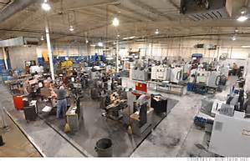
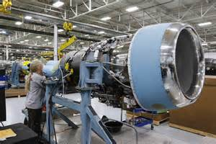
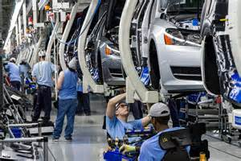
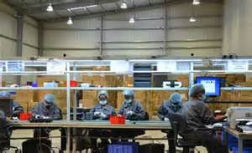
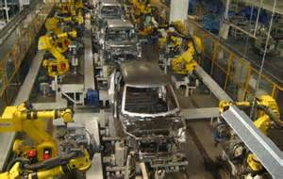
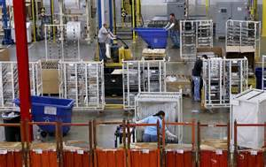
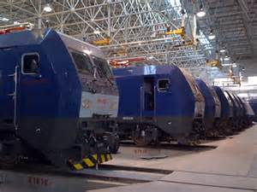
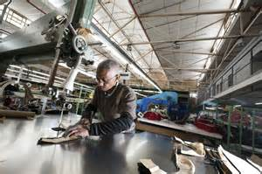
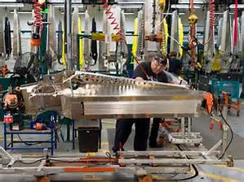
Notes:
3
That said, we still have a vibrant and growing manufacturing sector.

Slide 4
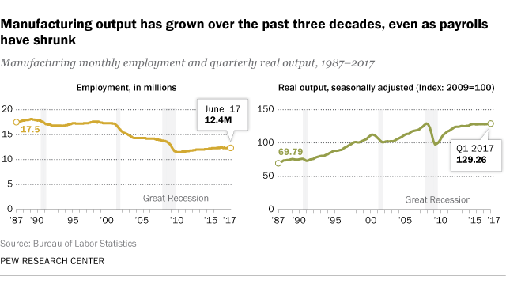
Notes:
4
What is worrying to us as a society is that while manufacturing output has actually doubled over the last three decades, this has been accomplished with fewer and fewer persons employed. Manufacturing employed around 14.66 million persons in 2017, rising slowly each year since the bottom of the last recession, but turning downward again during 2017.

Slide 5
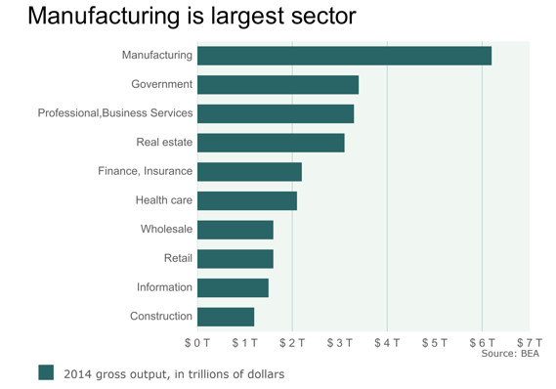
Notes:
5
Over the past 35 years, manufacturers have shed more than seven million jobs while increasing output every year. According to the Economic Policy Institute, U.S. manufacturing had gross output of $5.9 trillion in 2013, more than one-third of the U.S. GDP for that year. Manufacturing continues to employ more persons than any other sector of the economy. [Source: “The Manufacturing Footprint and the Importance of U.S. Manufacturing Jobs,” Economic Policy Institute]

Slide 6
Notes:
6
A legitimate public policy concern is what will result from the new restraints on trade imposed on China and other countries. Ann Harrison, at the Wharton School concludes as follows:

Slide 7
“Eighty percent of lost jobs were not replaced by workers in China, but by machines and automation. That is the first problem if you slap on tariffs. What you discover is that American companies are likely to replace the more expensive workers with machines.”
Notes:
7
“Eighty percent of lost jobs were not replaced by workers in China, but by machines and automation. That is the first problem if you slap on tariffs. What you discover is that American companies are likely to replace the more expensive workers with machines.” [Source: Unsigned article, “Can Trump – or Anyone – Bring Back American Manufacturing?” Knowledge @t Wharton, 30 November, 2016]

Slide 8
Notes:
8
The Editorial Board of the New York Times had this to say about the administration’s decision to impose tariffs on solar energy cells and panels and on washing machines:

Slide 9
“Tariffs will not be high enough to create new manufacturing jobs because the cost of production in countries like Malaysia and South Korea will remain significantly lower than in the United States. Also, American factories would probably be highly automated and require far fewer workers. Meanwhile, the higher tariffs – and thus higher prices – for solar cells and panels will reduce demand from residential customers, businesses and utilities. …The Solar Energy Industries Association estimates that the tariffs could cost that industry 23,000 jobs.”
Notes:
9
“Tariffs will not be high enough to create new manufacturing jobs because the cost of production in countries like Malaysia and South Korea will remain significantly lower than in the United States. Also, American factories would probably be highly automated and require far fewer workers. Meanwhile, the higher tariffs – and thus higher prices – for solar cells and panels will reduce demand from residential customers, businesses and utilities. …The Solar Energy Industries Association estimates that the tariffs could cost that industry 23,000 jobs.” [Source: “Mr. Trump’s Tariffs Will Not Bring Back Manufacturing Jobs,” The New York Times, 23 January, 2018]

Slide 10
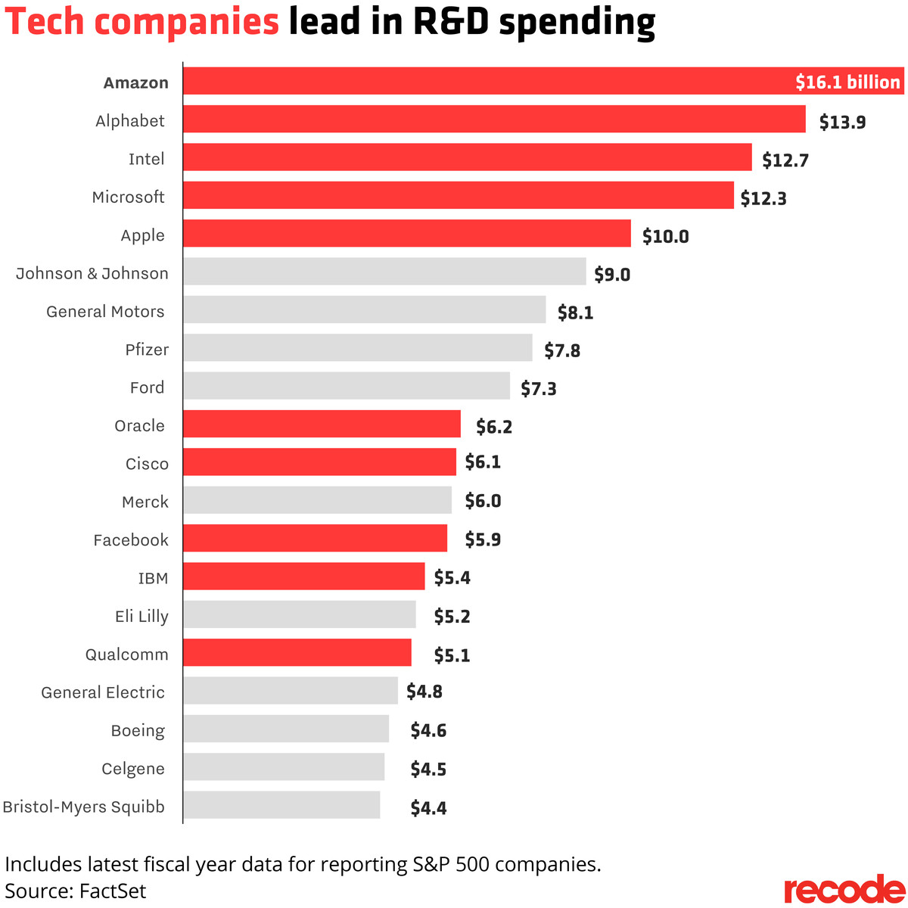
Notes:
10
Overall corporate spending on research and development is showing a steady increase. Bloomberg reported in 2014 that 18 firms in the Standard & Poor’s 500 Index had increased R&D spending by 25 percent or more over 2013. Amazon led all other companies in 2017, spending $16.1 billion on R&D. Microsoft was sixth at $12 billion, and Apple came in ninth at $10 billion. As indicated here, half of the companies in the top twenty were not based in the United States.

Slide 11
Which Corporations are American?
Notes:
Examine the consolidated financial statements of the largest corporations, and it becomes quite clear that many companies we think of as “American” are really “Multi-national.” A meaningful measurement of just how American specific companies are is the percentage of employees who work full-time out of a location in the United States.

Slide 12
TOTAL
EMPLOYEES
2,300,000
443,000
406,000
380,300
375,000
U.S.
EMPLOYEES
1,300,000
443,000
349,160
n/a
n/a
RANK
1
2
3
4
5
COMPANY
Walmart
Kroger
Home Depot
IBM
McDonald’s
Notes:
12
Not listed here is the largest employer in the country: government, which employs 22.3 million people.

Slide 13
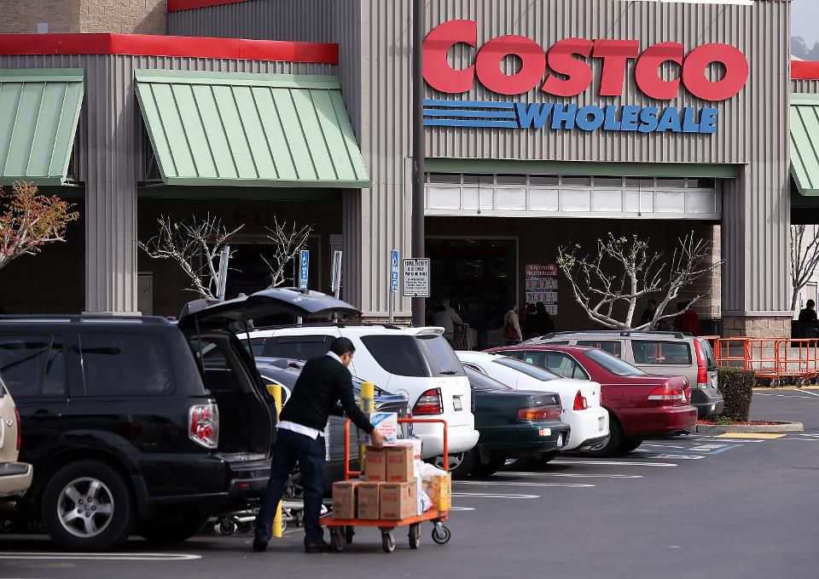
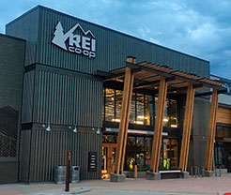
Notes:
13
A survey of 30,000 Americans by Statista in mid-2017 ranked Costco as the best liked employer, with 143,000 employees in the United States. Google came in second, with 72,000 employees. And, REI, the outdoor gear retailer was ranked third.

Slide 14
Notes:
14
An ongoing concern is the number of jobs lost to outsourcing of activities to companies domiciled outside of the United States. However, comprehensive data on overseas outsourcing practices are not easy to obtain because there are no government reporting requirements.

Slide 15
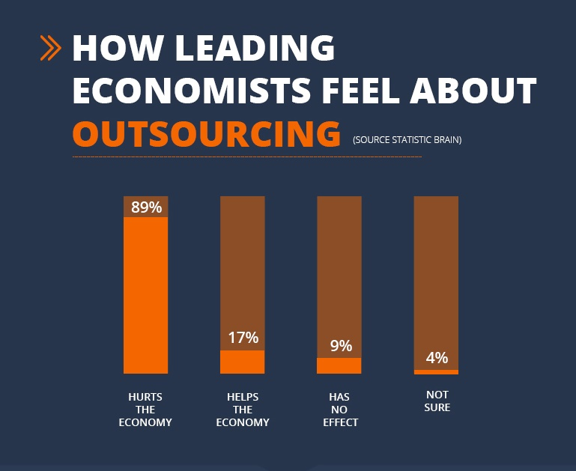
Notes:
15
Data from the U.S. Department of Commerce indicates that during the 2000s the nation’s major employers reduced employment in the United States by 2.9 million persons. At the same time they increased employment overseas by 2.4 million. By 2013 U.S. overseas affiliates employed 14 million workers. The business sectors most affected are technology, call centers, human resources and manufacturing. As this chart indicates, almost nine out of ten economists conclude that outsourcing is harmful to the U.S. economy. [Source: “Activities of U.S. Multinational Enterprises in 2013,” U.S. Bureau of Economic Analysis]

Slide 16
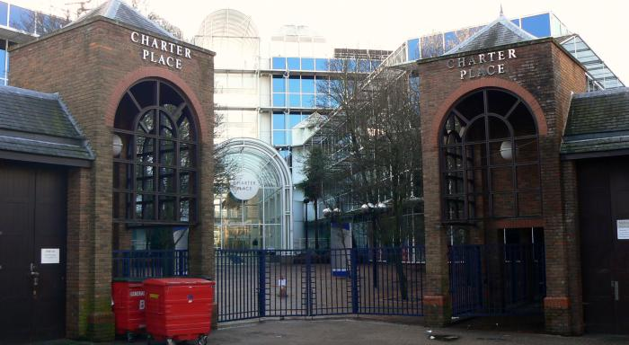
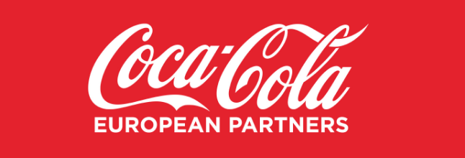
Notes:
16
In 2016 one of the most American of American companies, Coca-Cola, established a new corporate entity called Coca-Cola European Partners, with its headquarters in London. A main reason for their decision, and that of many other companies, has been to shift their tax bases abroad to locations where the taxation of business profits is more favorable. One of the hopes of the administration’s new tax cuts is that the United States will compete in the tax arena on a more level playing field.

Slide 17
Notes:
17
The Institute on Taxation and Economic Policy issued an analysis in March of 2017 showing that over the eight-year period from 2008 to 2015, the average effective rate of taxation on business profits was just 21.25, far below the previous statutory 35% tax rate. Eighteen corporations out of 258 examined paid no federal business profit tax during this period, and one-fifth of the total paid less than 10 percent.

Slide 18
Notes:
18
A research economists at the Tax Foundation, Gavin Ekins, examined the implication of the new tax bill and concluded there are provisions that actually encourage companies to invest outside the United States. His findings were summarized in a CNBC report before the bill was approved:

Slide 19
“A company could decide to avoid paying taxes on its above normal, ‘super’ foreign profits if it were instead to invest in a new foreign plant or other tangible asset, which would result in greater tangible depreciable assets. This would provide a bigger base of assets against which profits would be taxed, possibly making the tax hit smaller.”
Notes:
19
“A company could decide to avoid paying taxes on its above normal, ‘super’ foreign profits if it were instead to invest in a new foreign plant or other tangible asset, which would result in greater tangible depreciable assets. This would provide a bigger base of assets against which profits would be taxed, possibly making the tax hit smaller.” [Source: Patti Domm. “Tax bill includes an incentive for US companies to invest in foreign manufacturing,” CNBC Market Insider, 19 December, 2017]

Slide 20
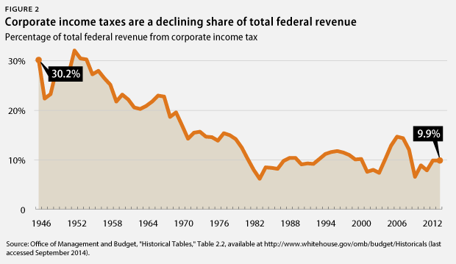
Notes:
20
A 2012 survey by Duke University’s Fuqua School of Business found that labor costs are the main reason corporations send jobs overseas; however, this is misleading when one factors in land acquisition costs or costs of leasing space in buildings owned by others, as well as the costs absorbed in payment of local, state and federal taxes.

Slide 21
Notes:
21
Here in the United States, the State of Delaware is the legal address for over one million entities, including 63 percent of Fortune 500 companies. Over 145,000 new Delaware entities were established. Between 2002 and 2012 corporations reduced the taxes paid to other states by an estimated $9.5 billion.

Slide 22
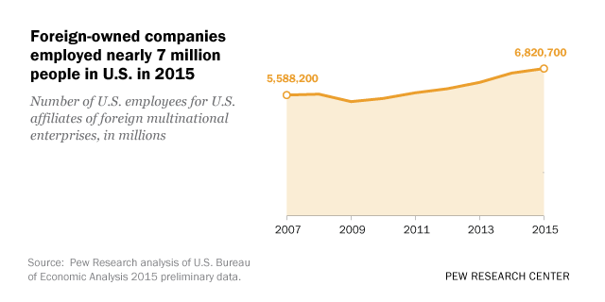
Notes:
22
For many reasons, foreign companies are locating operations in the United States. The number of U.S. citizens working for foreign firms has risen from 5.9 million in 2011 to nearly 7 million in 2015, based on data published by the U.S. Bureau of Economic Analysis. British companies lead with 1.1 million employees, followed by Japanese firms with around 856,000. French, German and Canadian firms follow with 600,000 each.

Slide 23
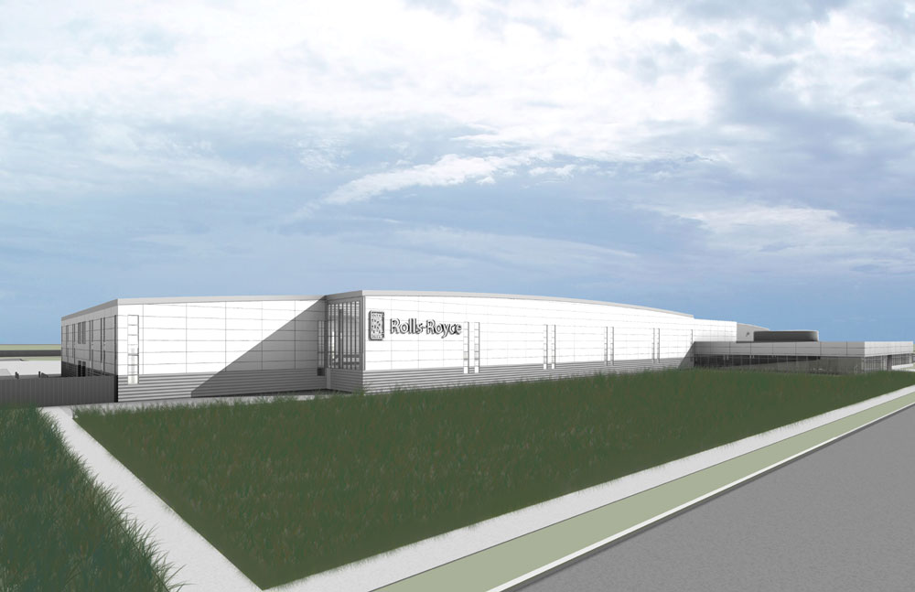
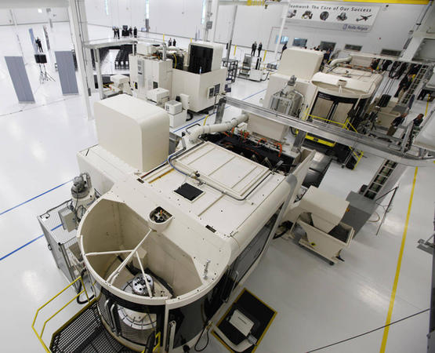
Notes:
23
Foreign companies, like their U.S. counterparts, need locations and facilities. Their investment has had an important effect on real estate prices and sales in certain parts of the United States. A good example of this is the Rolls-Royce factory in Virginia that manufactures jet engine discs, shipping them back across the Atlantic rather than expanding plants in the U.K. A major reason was to be close to one of its major customers – Boeing, which is building aircraft in Charleston, S.C. and in Mobile, Alabama. The Rolls-Royce factory cost $170 million to construct, but as a high-technology manufacturing operation the facility employs just 100 people.

Slide 24
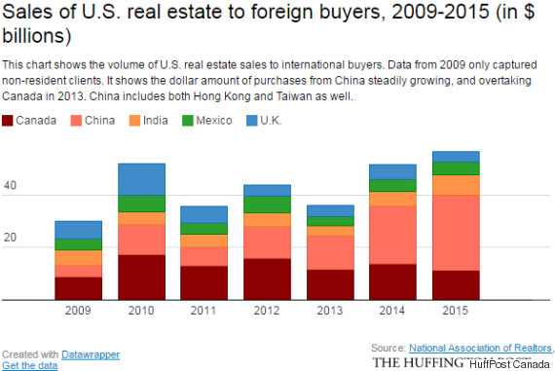
Notes:
24
Between 2009 and 2015 foreign purchases of U.S. real estate totaled around $300 billion. However, one consideration of foreign buyers of a residential property in the United States is the 40 percent inheritance tax on the value of any asset owned by a non-U.S. resident over $60,000 at the time of the owner’s death.

Slide 25
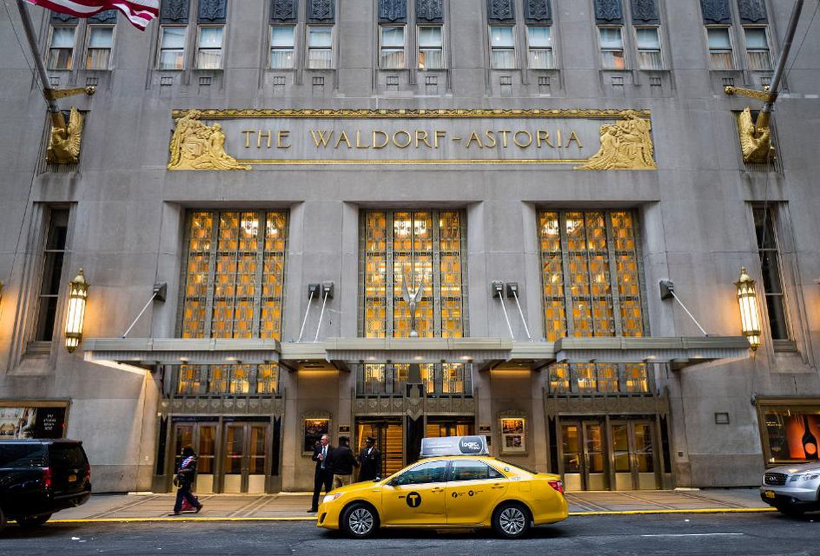
Notes:
25
During 2016, Chinese investors spent $19.2 billion on U.S. commercial real estate, up from $17.3 billion in 2015. Canadian investors were the next largest at $13.1 billion. Nearly half of all Chinese acquisitions were in New York City. [Source: Ellen Sheng. “Chinese Now The Largest Group of Foreign Investors In U.S. Commercial Real Estate,” Forbes. 13 March, 2017]

Slide 26
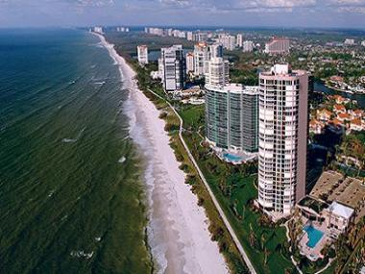
Notes:
26
Chinese buyers continue to acquire an increasing number of residential properties in the United States, with closings totaling $153 billion for the year ending March 2017, a 49 percent increase over the previous year. Foreign buyers accounted for one in ten property sales by dollar volume and 5 percent by number of properties. These transactions were concentrated in just three states: Florida, California and Texas. [Source: National Association of Realtors]

Slide 27
Notes:
27
An important observation related to economic growth is the fact that the sale of existing real estate generates fee income for a long list of participants but creates no new capital goods, although many buildings are renovated and modernized to improve attractiveness to potential corporate tenants. Sellers of these properties are recording capital gains, but the gains are actually coming from rising land prices, causing a transfer of financial resources between the parties.

Slide 28
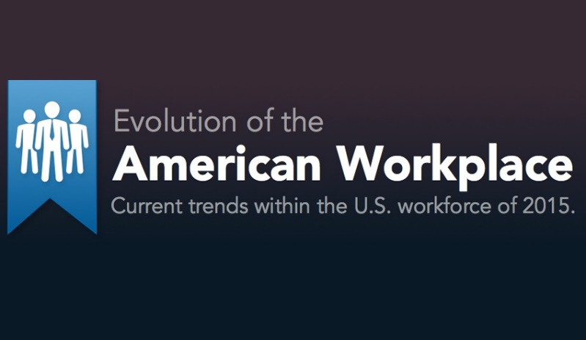
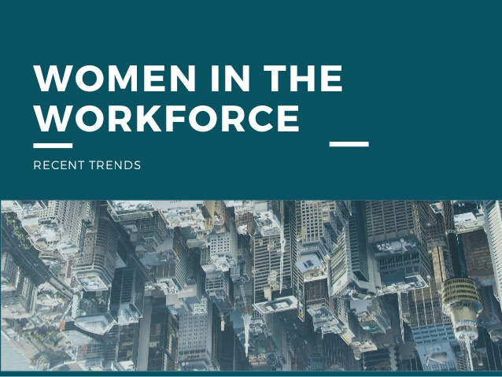
Notes:
28
Next, we will examine the state of our workforce and trends affecting employment across the nation.

Slide 29
End of Part 2

