Slide 1
The State of the United States
ECONOMY and SOCIETY
Part 9

Slide 2
Can We Feed Everyone?
Notes:
Most of us live in towns and cities. We are totally dependent on others to produce the food we require. Yet, there are significant threats to our food supply. Climate change, conversion of agricultural land to other uses, and the high cost of agricultural land each requires a public policy response that will result in sustainability of our essential land resources.

Slide 3
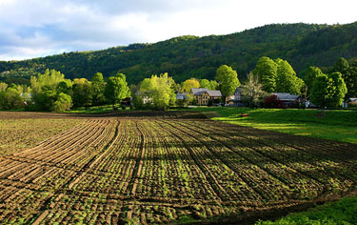
Notes:
3
About 920 million acres of land across the United States is dedicated to agriculture.

Slide 4
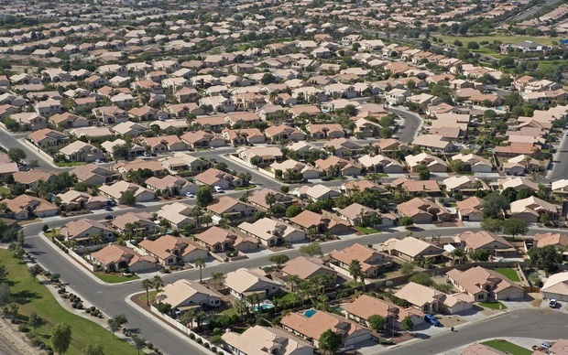
Notes:
4
Some of the best land is under increasing pressure from sprawling development. One consequence is to drive up land prices to a level that prevents younger adults who would like to enter farming from acquiring or even leasing sufficient acreage to be profitable.

Slide 5
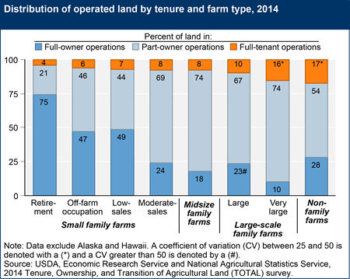
Notes:
5
The U.S. Department of Agriculture estimates that at least 30 percent of U.S. farmland is owned by non-operators who lease land out to actual farmers. For investors, farmland has outperformed most other asset classes for the last two decades, delivering an average return of 12 percent per year. Roughly 25 million acres, or about 2 percent of the 930 million agricultural acres are in foreign hands.

Slide 6
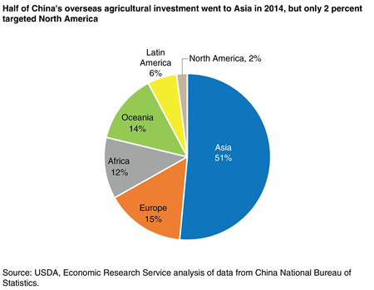
Notes:
6
Chinese investors now own over 400 U.S. farms totaling 100,000 acres. These acquisitions are part of a broad global strategy to gain greater control over the supply chain for imported agricultural products.

Slide 7
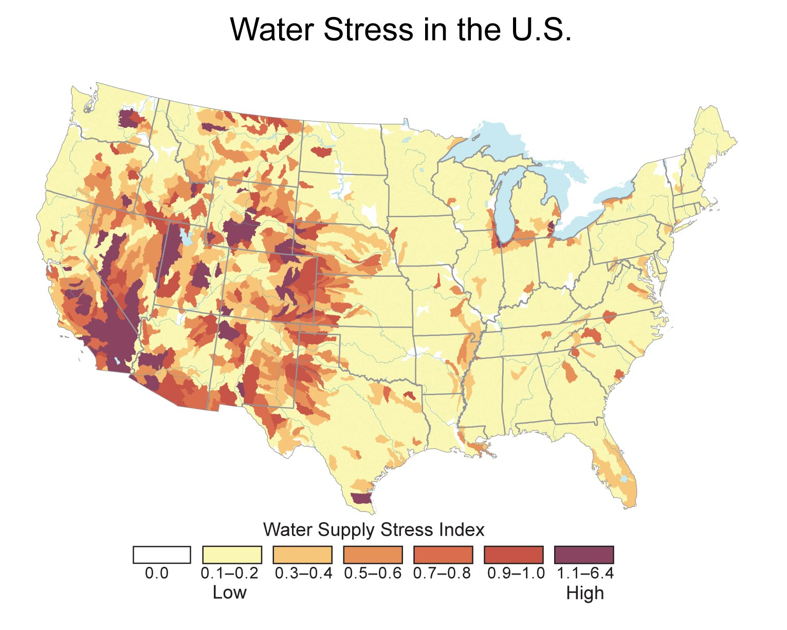
Notes:
7
Without doubt, the greatest natural threat to agricultural production is declining rainfall in many parts of the country. The nation’s primary aquifers are also in decline, with the result that wide areas of land in arid regions may eventually no longer be able to rely on irrigation for cultivation of crops.

Slide 8
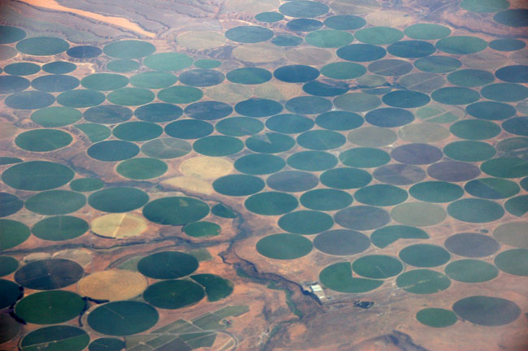
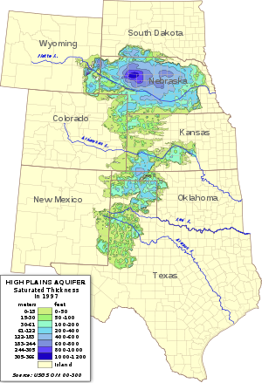
Notes:
8
The Ogallala Aquifer, whose total water storage is about equal to that of Lake Huron in the Midwest, is the single most important source of water in the High Plains region, providing nearly all the water for residential, industrial, and agricultural use. The disappearance of this supply of water would cause the value of land in the region to fall dramatically and, potentially, a great migration of people from the region.

Slide 9
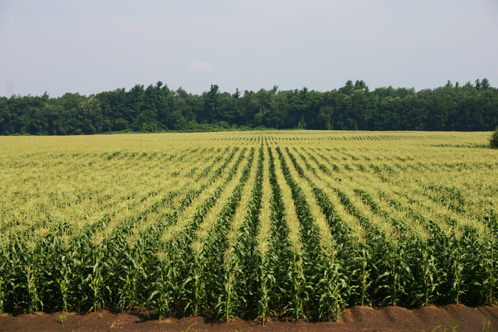
Notes:
9
The Aquifer supports nearly one-fifth of the wheat, corn, cotton, and cattle produced in the United States. Crops provide grains and hay for confined feeding of cattle and hogs and for dairies. The cattle feedlots support a large meatpacking industry. All this is threatened by the loss of access to water, but conservation efforts are hampered by counter-productive subsidies that drive wasteful water consumption.

Slide 10
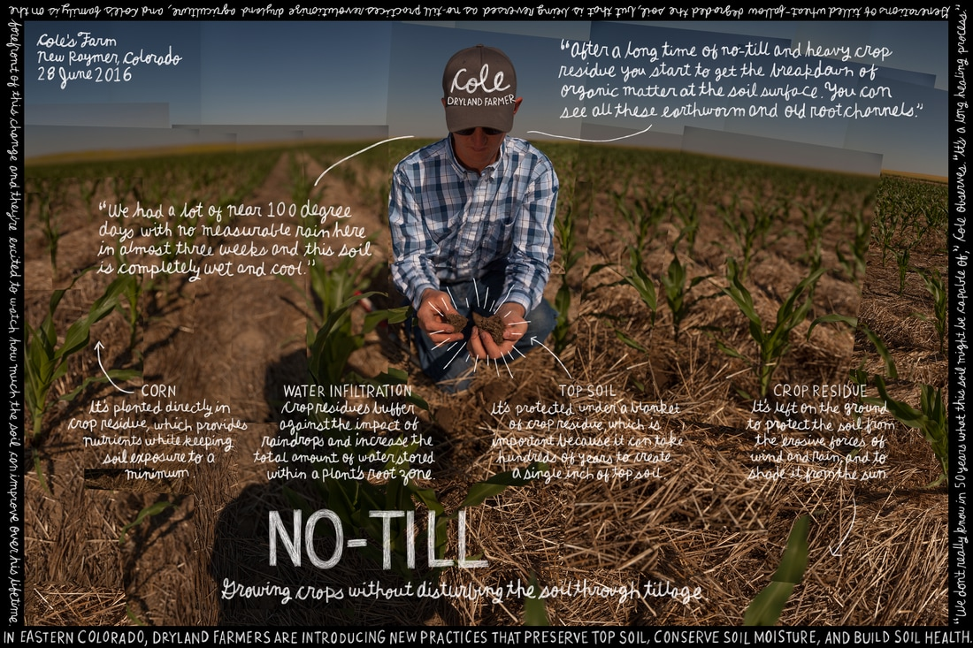
Notes:
10
Some far-sighted farmers are responding to these challenges. Even as they pursue efficiencies in irrigation, many are shifting from water-intense crops like cotton to wheat. Still, others, notably in west Texas, are converting back to non-irrigated dryland agriculture -- a recognition of the stark limitations of irrigation dependency.

Slide 11
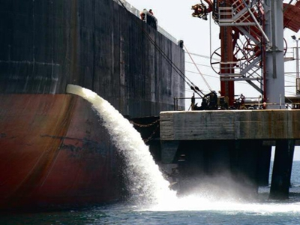
Notes:
11
Despite the economic importance of agricultural production, the preservation of water resources has not been addressed by the states that share and are dependent upon the aquifer.

Slide 12
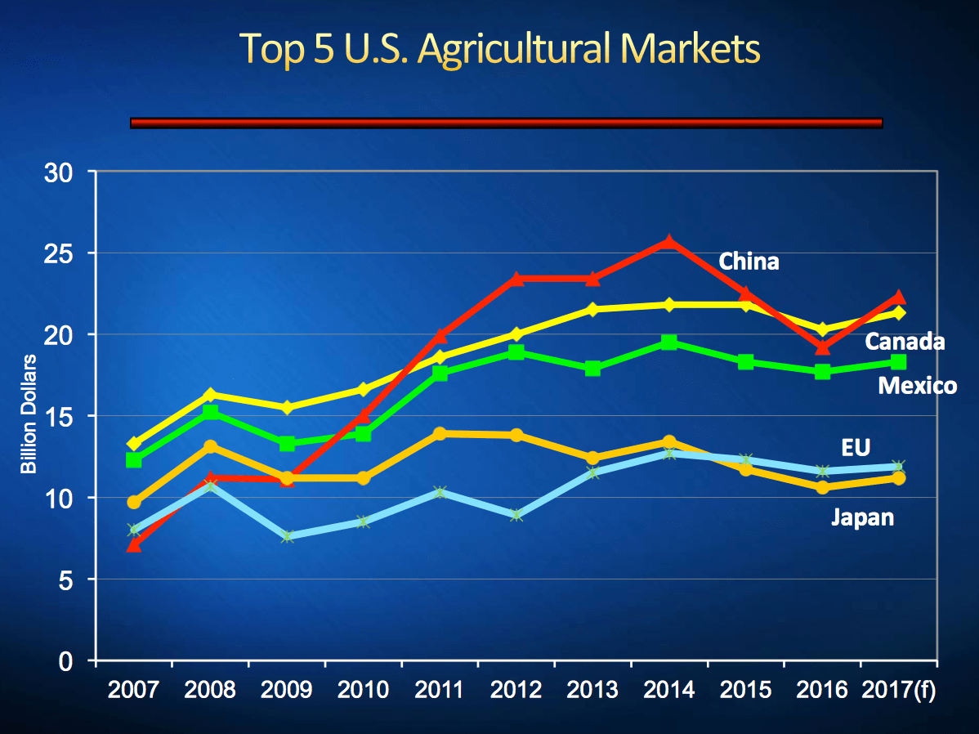
Notes:
12
The total value of U.S. agricultural exports in 2018 was $144 billion, up from $140.2 billion in 2017. Food exports also represent an important driver of the U.S. economy. Farmers now have to factor in the effect of the Trump administration’s trade policies and whether U.S. agricultural commodities will be subject to tariffs imposed in other countries. A report issued in December 2018 by the U.S. Department of Agriculture indicated exports of soybeans and wheat were down by ten percent and sixteen percent, respectively, from 2017.

Slide 13
Notes:
13
David A. Widmar, an agriculture economist at Purdue, explains that the U.S. producers have been diversifying for several decades in order to protect themselves from declining demand or prices for specific commodities:

Slide 14
“It’s also important to recognize that the types of agricultural products the United States exports have shifted through time. In the 1970s a majority – 70 percent or more – of the value of ag exports were bulk exports. They were shipments of commodity wheat, corn, soybeans, etc. ...”
Notes:
14
“It’s also important to recognize that the types of agricultural products the United States exports have shifted through time. In the 1970s a majority – 70 percent or more – of the value of ag exports were bulk exports. They were shipments of commodity wheat, corn, soybeans, etc. ...”

Slide 15
“More recently exports of consumer-oriented agricultural products have grown significantly. Those products – such as meats, dairy products, fruits, nuts and prepared foods – accounted for 47 percent of the value of exports in 2017. Bulk exports accounted for half the value of exports in the 1970s; today they are at 35 percent.”
Notes:
15
“More recently exports of consumer-oriented agricultural products have grown significantly. Those products – such as meats, dairy products, fruits, nuts and prepared foods – accounted for 47 percent of the value of exports in 2017. Bulk exports accounted for half the value of exports in the 1970s; today they are at 35 percent.” [Source: David A. Widmar. “Trade war – Ag exports critical to economy,” Agricultural Economic Insights, 6 March, 2018]

Slide 16
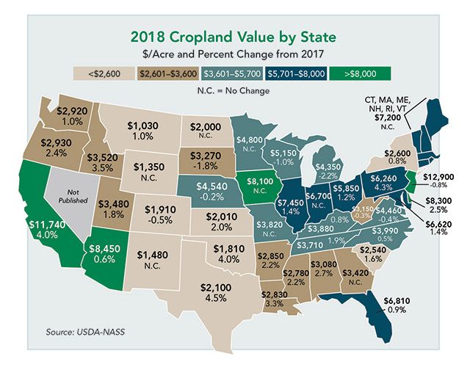
Notes:
16
Agricultural exports continue to be a primary source of income for U.S. farmers. However, increasing production in other countries continues to exert downward pressure on global commodity prices. Chaotic weather across the nation, whether prolonged drought, heat, cold or rain, drives land prices up or down.

Slide 17
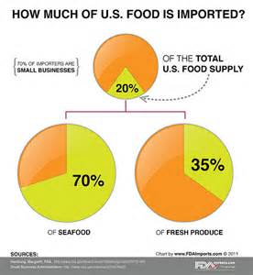
Notes:
17
What few of us appreciate is the fact that we import most of the seafood we consume and over one-third of our fresh produce.

Slide 18
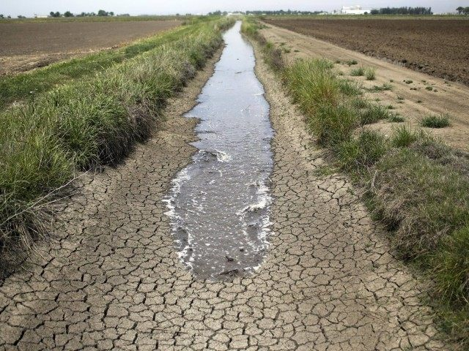
Notes:
18
Californian farmers produce most of the fruits, vegetables and nuts grown in the United States. A major reason is the amount of land watered by irrigation. However, continued water shortages in the Central Valley have brought down farmland prices even as commodity prices (as for almonds) have fallen. An analysis by National Oceanic and Atmospheric Administration indicates that the number of acres affected by drought conditions increase by 48 percent during 2018.

Slide 19
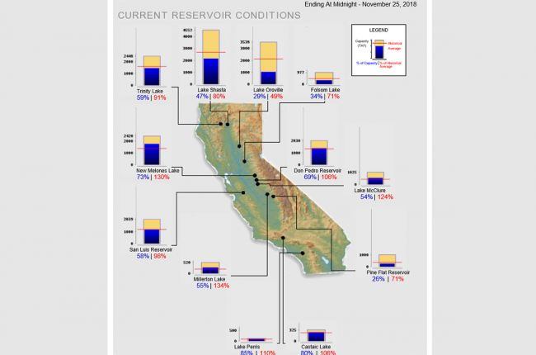
Notes:
19
Perhaps more ominously is the condition of California’s two most important reservoirs, where much of the water for California’s two big federal and state water projects is stored. Shasta Lake, the linchpin of the federal Central Valley Project, is just half full, and at 80 percent of historical average for late December. Lake Oroville, which serves the State Water Project, is 29 percent full, and at 47 percent of historical average.

Slide 20
Notes:
20
The organic food market in the United States hit $45.2 billion in sales in 2017, accounting for 5.5% of the food sold in retail channels in the U.S. Fruits and vegetables continue to be the largest organic food category, totaling $16.5 billion.

Slide 21
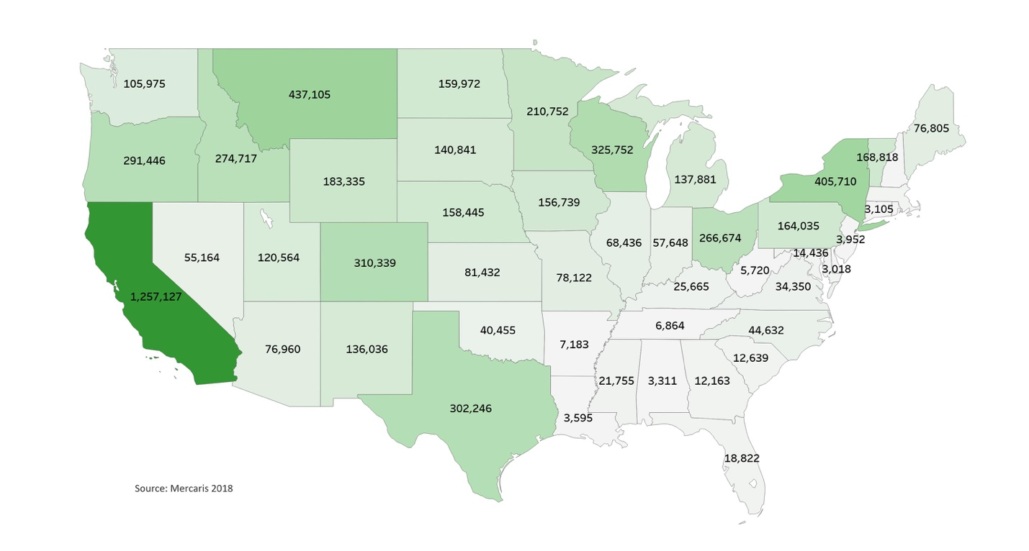
Notes:
21
There are now around 17,700 organic farms in the U.S. with 6.5 million harvested acres.

Slide 22
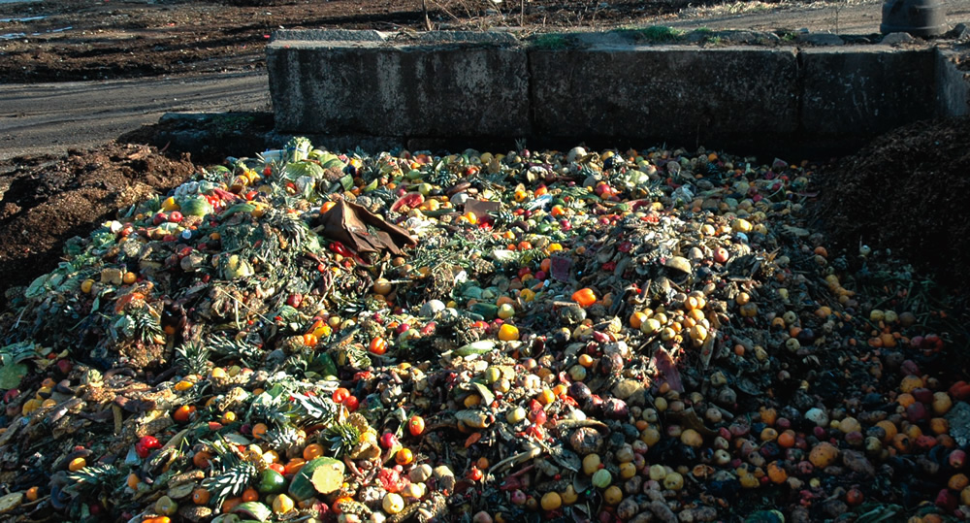
Notes:
22
It is estimated that 40 percent of the food produced is never consumed, is discarded and ends up in land fills. Moreover, one-fourth of all water used in the U.S. is lost due to food waste. And, of course, producing this food consumes a huge amount of fuels that is simply wasted.

Slide 23
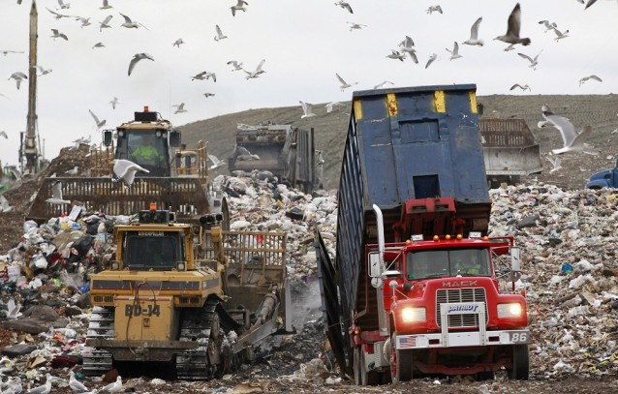
Notes:
23
Too little thought is as yet given to the environmental damage caused by the methane generated by all of the rotting food in our landfills. Every year, the amount of food waste generated is around 38 million tons, only 5 percent of which is diverted away from landfills and incinerators.

Slide 24
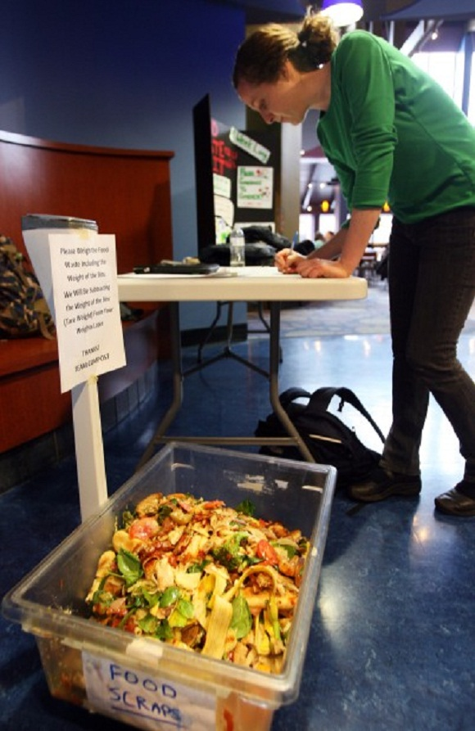
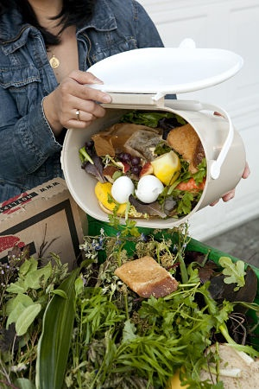
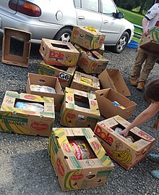
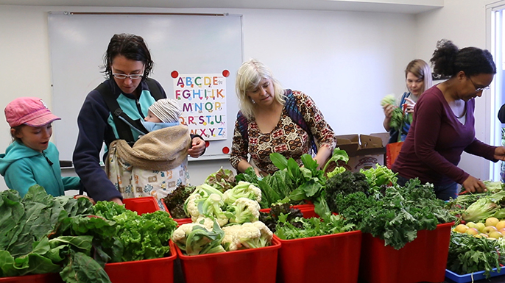
Notes:
24
In response, some cities have adopted ordinances that require restaurants to separate all compostable materials from other waste. Food kitchens providing meals to low income individuals are forming partnerships with restaurants and other organizations to recover unconsumed food. Colleges have started compost programs utilizing cafeteria scraps. Elsewhere, college students are delivering cafeteria leftovers to local food shelters.

Slide 25
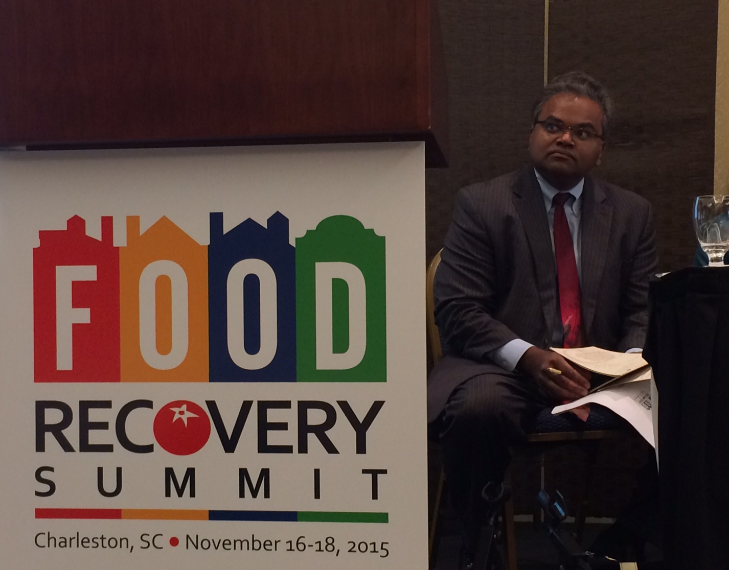
Notes:
25
Another positive development is that at least a few of the world’s largest food companies are measuring and publicly reporting on their food loss and waste. In the United States, Campbell Soup Company, Kellogg Company, Unilever and Walmart all have active food loss and waste reduction programs.

Slide 26
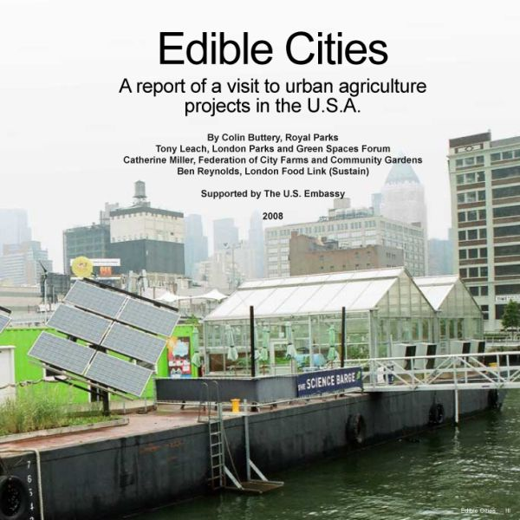
Notes:
26
In many U.S. cities areas have been abandoned by industry and residents. Slowly, some of these areas are being converted into community gardens and urban farms.

Slide 27
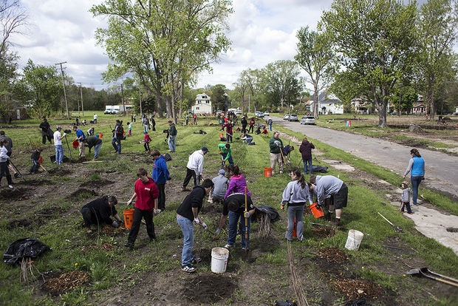
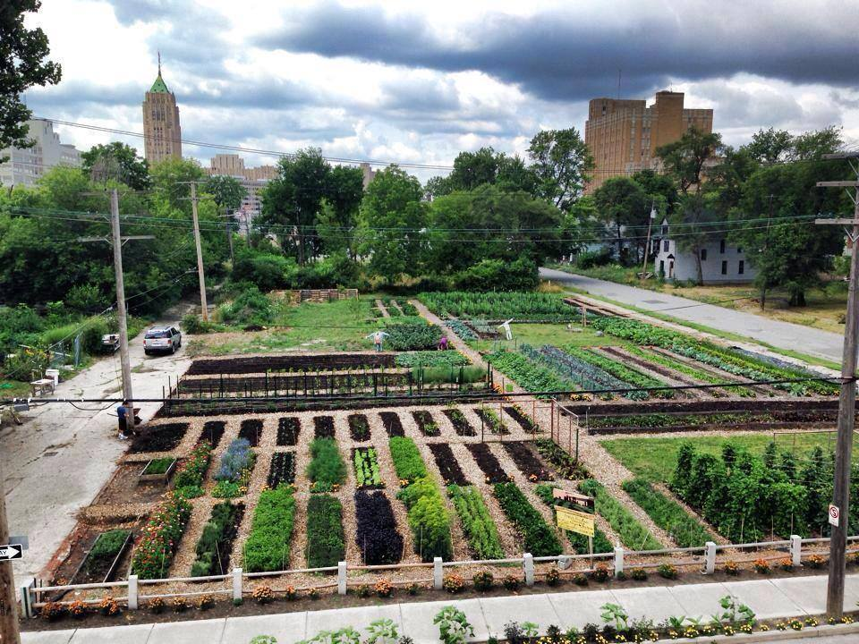
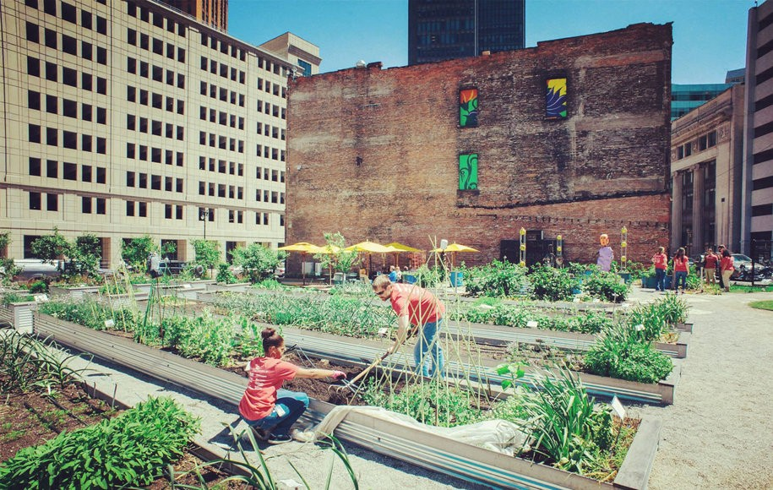
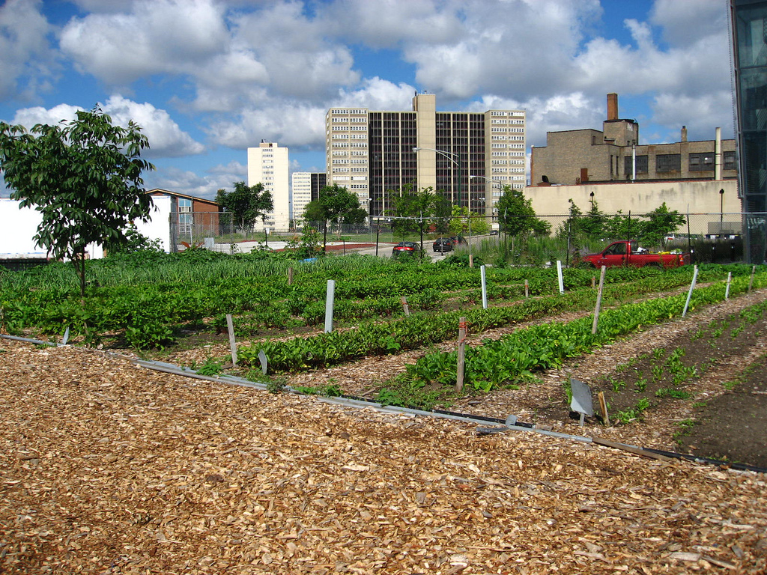
Notes:
27
The City of Detroit, which in 2013 had some 200,000 vacant parcels of land, passed a new urban agriculture ordinance. The result has been the creation of more than 1,350 community gardens.

Slide 28
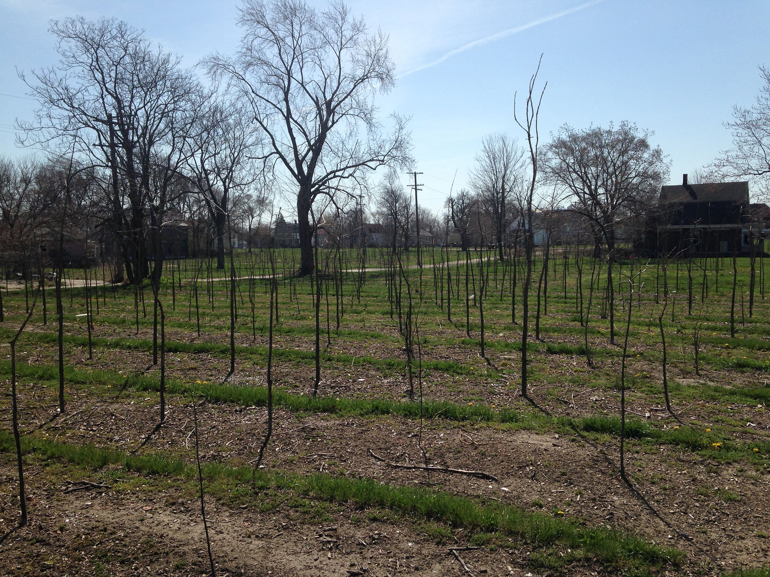
Notes:
28
One company, Hantz Woodlands, owned by Detroit resident John Hantz, acquired 1,500 parcels in 2013 with plans to establish a large urban farm. Opposition from community groups and city officials concerned about one individual gaining control over a large amount of land – even if currently abandoned and having almost no sales value -- forced Hantz to change his plans. He purchased 150 acres of land at $200 per acre from the city. Hantz demolished 50 blighted houses, cleared the land of trash and weeds and began to plant trees with the intent of eventually harvesting the timber.

Slide 29
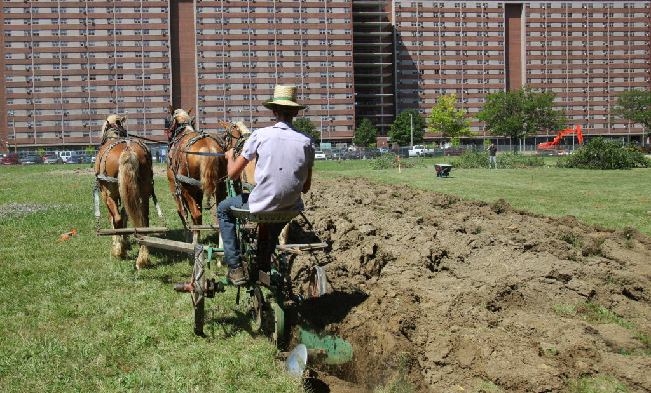
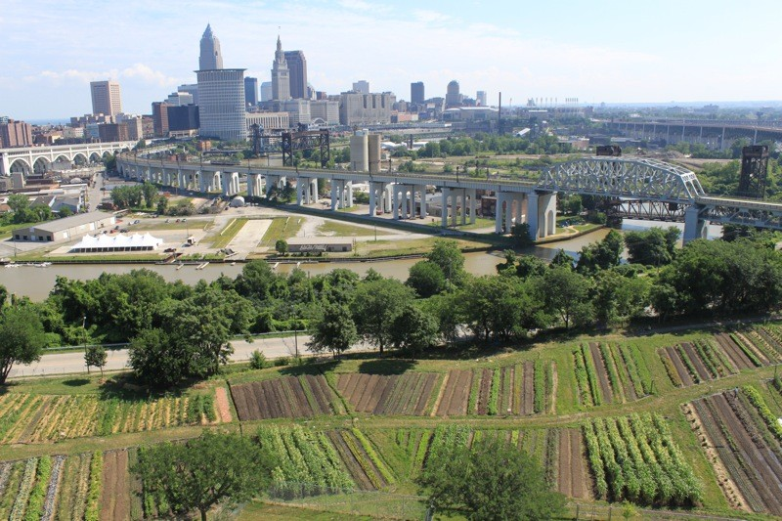
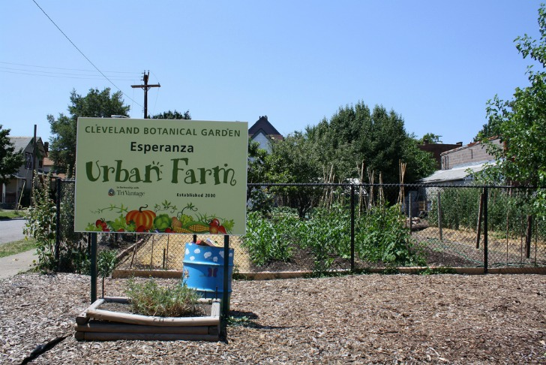
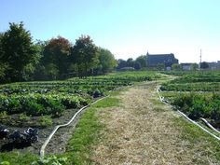
Notes:
29
Another economically distressed northern city, Cleveland, is also undergoing a dramatic expansion of community gardens and urban farming.

Slide 30
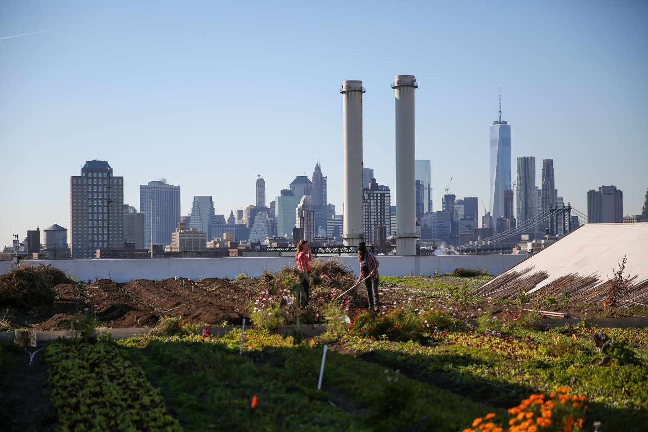
Notes:
30
Even New York City has managed to cultivate vacant land. Brooklyn is home to a gigantic rooftop farm called Brooklyn Grange

Slide 31
Notes:
31
We are a nation that relies heavily on borrowing to acquire much of what we purchase and consume. Our government at all levels also borrows in order to fund the construction of new infrastructure as well as to balance budgets. In short, we are at risk of death by debt strangulation. We will explore these issues next.

Slide 32
End Part 9

