Slide 1
Understanding our Political Economy

Slide 2
INSTRUCTOR
Edward J. Dodson, M.L.A.
email contact:
edod08034@gmail.com

Slide 3
LECTURE 1
Why Political Economy Matters

Slide 4
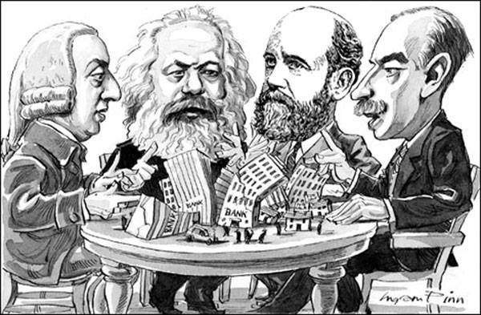
Notes:
Political economy traces is roots to the investigations by moral philosophers – original thinkers such as Adam Smith, Karl Marx, Henry George and John Maynard Keynes -- who sought to explain how societal organization directs how nature is utilized by people to produce the tangible goods we need for survival and for a better quality of life. They offered their ideas on how best to organize ourselves in order to provide all with the goods for a decent human existence. On important questions they often disagreed.

Slide 5
Political
Economy
vs.
Economics
Notes:
Although there are elements of political economy similar to those relied upon in economics, political economy is an interdisciplinary investigation with its roots in moral philosophy.

Slide 6
Anthropology
Cultural Studies
Development Studies
Economics
Education
Human Geography
Law
Political Science
Psychology
Sociology
Notes:
For reasons that will eventually become clear, beginning late in the 19th century, political economy was displaced by the development of the individual social science disciplines. This course resurrects political economy because of the science’s strengths in helping us to understand the real world.

Slide 7
Notes:
We begin by examining the state of the world today and asking what are the prospects for our future. Many of us wonder whether sustainable use of the earth’s resources is still possible. And, for good reason, we wonder whether how we are governed will be based on the protection of individual liberty or the use of coercion by authoritarian regimes.

Slide 8
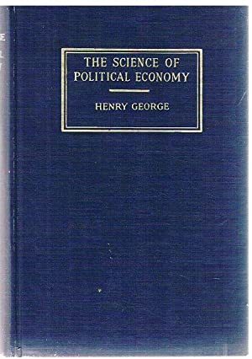
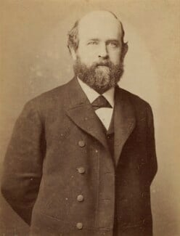
Notes:
The terms, concepts and much of the analysis to be presented comes from the several books written in the late 19th century by the American political economist Henry George. His final book, published in 1897, was titled The Science of Political Economy.

Slide 9
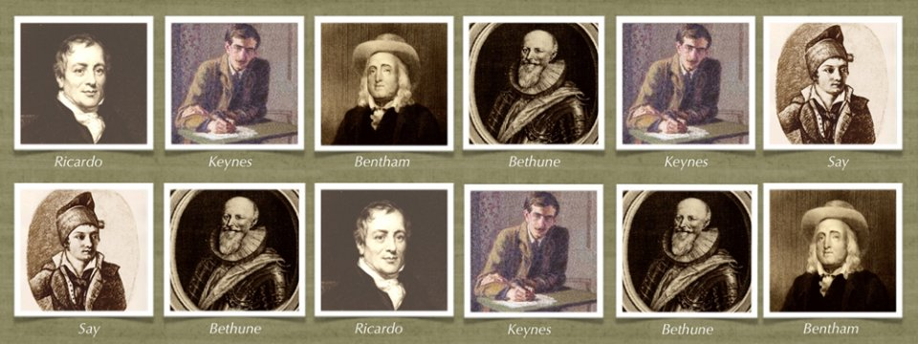
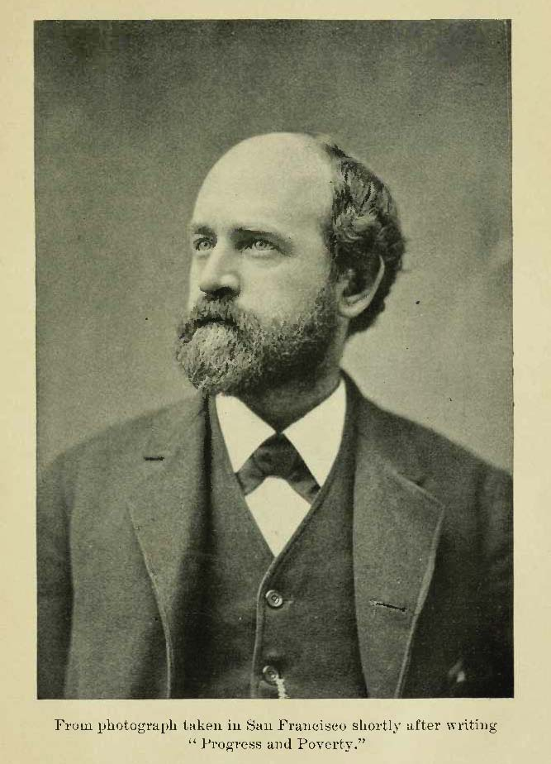
Notes:
Following in the footsteps of some of history’s most important contributors to intellectual thought, Henry George was committed to taking an objective, scientific approach to his investigations, following the facts wherever they might lead. He asked important moral questions concerning how wealth was distributed and practical questions about how wealth is most effectively produced and exchanged.

Slide 10
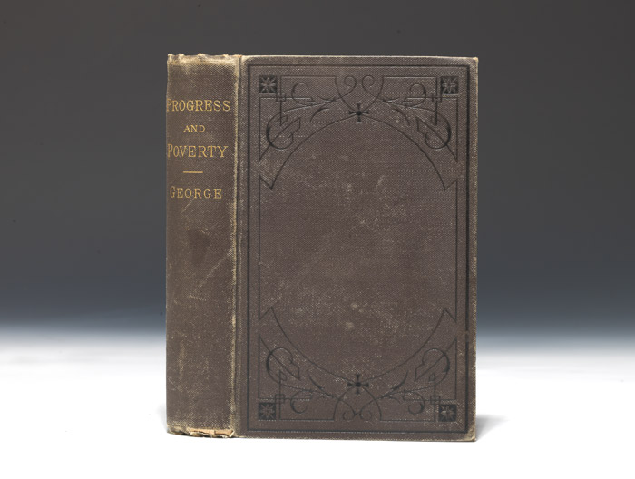
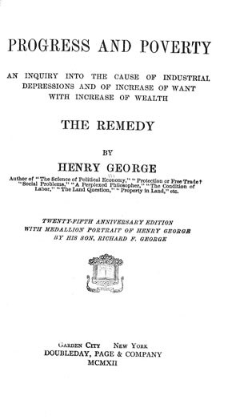
Notes:
In 1879, after two years of research and writing, Henry George’s most widely sold book, titled Progress and Poverty, was published.

Slide 11
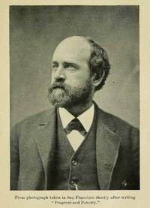
Notes:
Henry George soon left California, where he had gone to as a young man to seek his fortune. He now came to New York City to lecture and promote the book. An inexpensive, paper-covered edition followed in April of 1880, and this printing sold out quickly. At year end, the book was translated into German and sales of this edition grew steadily. Eventually, Progress and Poverty would be translated into most of the world’s major languages.

Slide 12
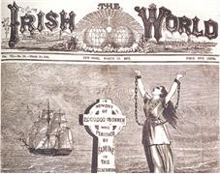
Notes:
Later in the year, he was hired by the Irish World newspaper to travel to Ireland and England to report on the rising tensions between Irish nationals and absentee English landlords and the British government. This was the beginning of a long career of lecturing around the world to huge audiences.

Slide 13
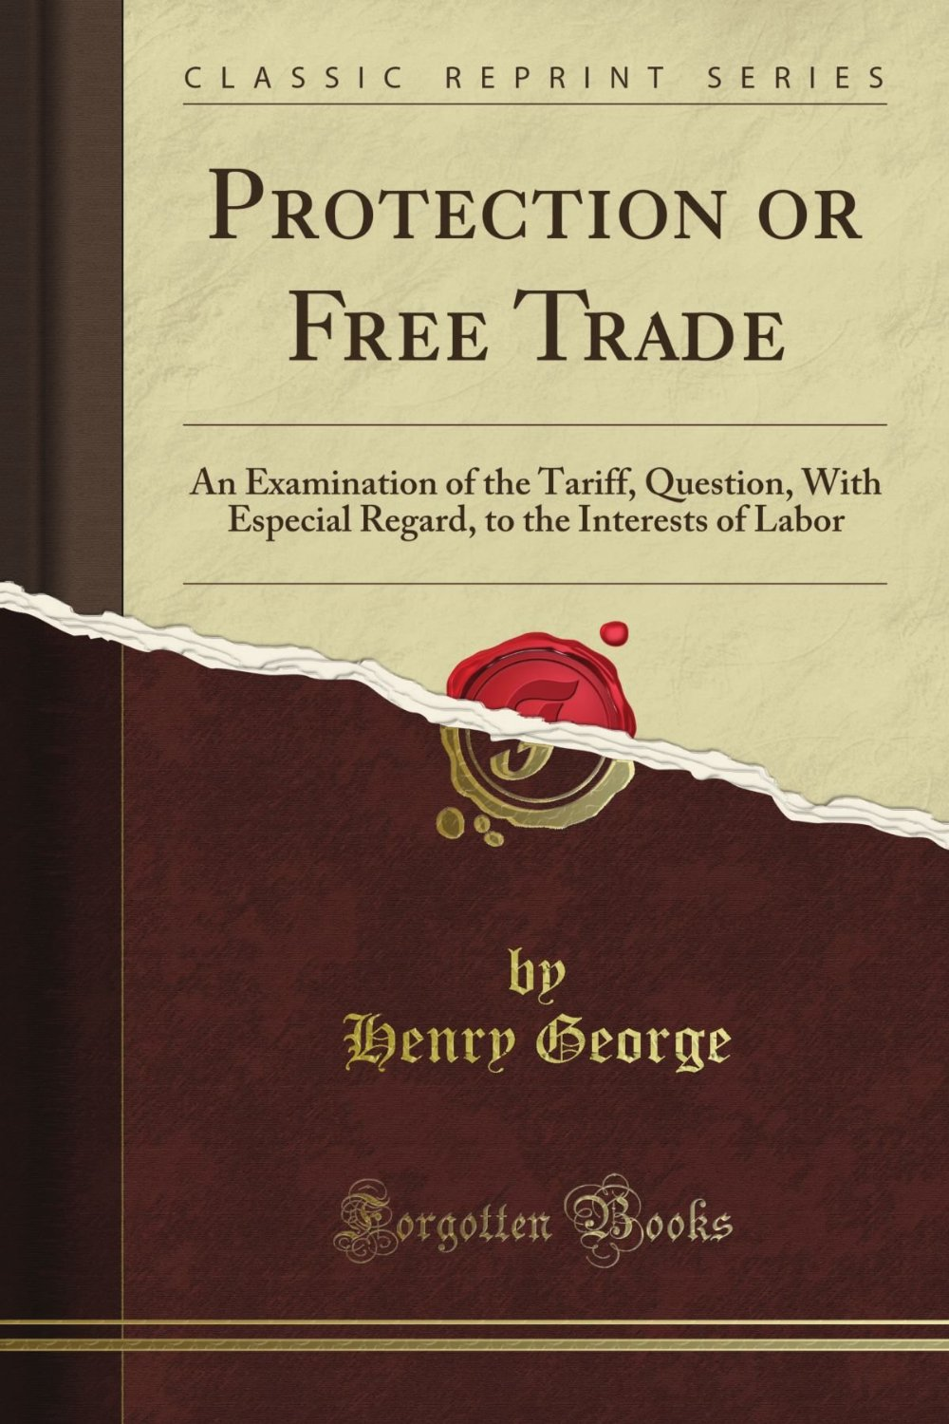
Notes:
He next decided to state his case for free trade and against tariffs, quotas and other restrictions on commerce. The book, titled Protection or Free Trade?, appeared in 1886. His supporters in the United States Congress read the book into the Congressional Record, then used their franking privileges to mail out over a million copies to their constituents.

Slide 14
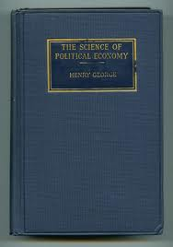
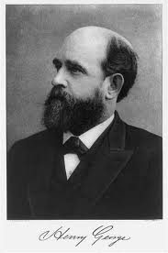
Notes:
Despite failing health, by the Spring of 1897, Henry finished the manuscript for The Science of Political Economy.

Slide 15
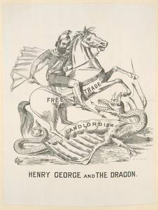
Notes:
He did not live to see this book published. Campaigning a second time for the office of mayor of New York City, he suffered a stroke and died a few days before the election. His epitaph reads:

Slide 16
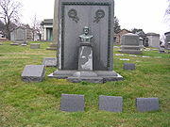
“The truth that I have tried to make clear will not find easy acceptance. If that could be, it would have been accepted long ago. If that could be, it would never have been obscured. But it will find friends – those who will toil for it; suffer for it; if need be, die for it. This is the power of Truth.”
Notes:
“The truth that I have tried to make clear will not find easy acceptance. If that could be, it would have been accepted long ago. If that could be, it would never have been obscured. But it will find friends – those who will toil for it; suffer for it; if need be, die for it. This is the power of Truth.”

Slide 17
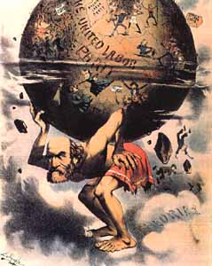
Notes:
These lectures will examine the insights Henry George identified as essential truths. By his efforts there arose a growing movement devoted to changing the course of history. As his own life was coming to an end, he hoped he had done enough to keep the momentum going. Others would step forward to take on leadership roles. What occurred, however, is that the forces aligned in preservation of the status quo and other forces determined to overthrow all existing relations dominated the century to come. Henry George’s campaign would continue but the number of people around the world actively engaged fell off decade by decade.

Slide 18
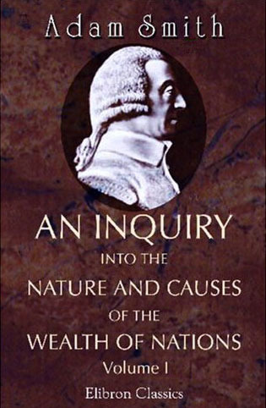
Notes:
In a very real sense, however, Henry George saved political economy from being totally abandoned as a field of scientific investigation. He undertook his investigations in the same spirit as had Adam Smith, the great political economist of the 18th century.

Slide 19
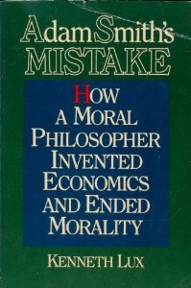
Notes:
The rise of economics presented a direct attack on the strength of political economy. Economics abandoned the “ought” questions to those concerned with moral philosophy. Economists limited themselves as economists to descriptive explanations. Author Kenneth Lux made this controversial point in his 1991 book, “Adam Smith’s Mistake: How A Moral Philosopher Invented Economics and Ended Morality.” Lux wrote:

Slide 20
“Economics is fundamentally different from every other discipline in the academic world, including the other social sciences. No other academic field, unless influenced by economics, teaches and promotes self-interest. All other fields essentially teach knowledge and truth.”
Notes:
“Economics is fundamentally different from every other discipline in the academic world, including the other social sciences. No other academic field, unless influenced by economics, teaches and promotes self-interest. All other fields essentially teach knowledge and truth.”

Slide 21
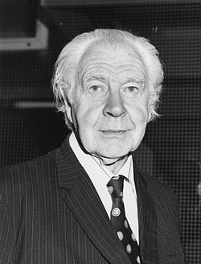
Lionel Robbins
Notes:
One prominent economist of the early-to-mid 20th century, Lionel Robbins, stated what he accepted as the boundaries of his discipline, writing:

Slide 22
“Economics is neutral as between ends. Economics cannot pronounce on the validity of ultimate judgments of value.”
Lionel Robbins. An Essay on the Nature and Significance of Economic Science, 1962, p.147
Notes:
“Economics is neutral as between ends. Economics cannot pronounce on the validity of ultimate judgments of value.”

Slide 23
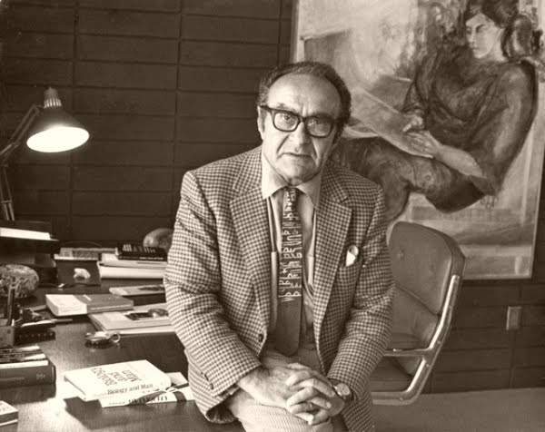
Notes:
Other social scientists saw their role as very different from that of the economist. The mathematician Jacob Bronowski (best remembered, perhaps, for the television series The Ascent of Man) recognized a serious challenge to the establishment of just societies nurtured by cooperative behaivor:

Slide 24
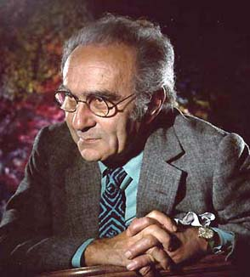
“The problem of values arises only when men try to fit together their need to be social animals with their need to be free men.”
Jacob Bronowski. Science and Human Values, 1965. p.55
Notes:
“The problem of values arises only when men try to fit together their need to be social animals with their need to be free men.”

Slide 25
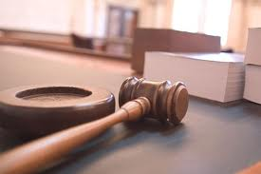
Notes:
What he and others understood is that markets operate within systems of law, and systems of law are open to judgment as to fairness and equity. Do the laws establish equality of opportunity or secure and protect entrenched forms of privilege?

Slide 26
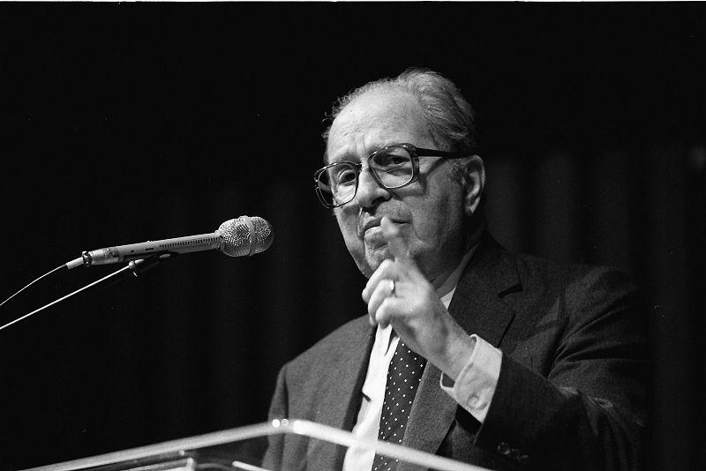
Notes:
The philosopher Mortimer J. Adler provided us with a definition of liberty that requires us to examine law against objectively derived moral principles. This has proven to be incredibly difficult if not impossible. For example, in everyday discourse, we use the terms “liberty” and “freedom” interchangeably. Adler makes a crucial distinction, writing:

Slide 27
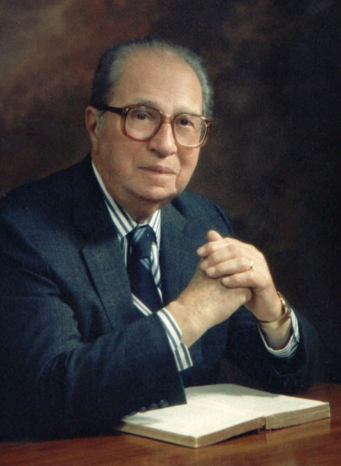
“Liberty is freedom exercised under the restraints of justice so that its exercise results in injury to no one.”
Mortimer J. Adler. The Common Sense of Politics, 1971, p. 125
Notes:
“Liberty is freedom exercised under the restraints of justice so that its exercise results in injury to no one.”

Slide 28
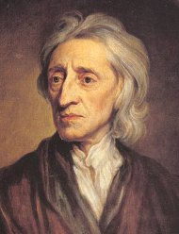
John Locke
Notes:
John Locke explained that when we exceed the bounds of liberty we have entered into the realm of license. And, here, license takes two forms, those that people agreed were criminal in effect and must be prevented or punished, and those that extended to some a degree of privilege resulting in the redistribution of wealth from producers to those the law enabled to take without giving anything in return. Where this second form of license is concerned, much depends on what the laws of a society secure and protect as one’s property:

Slide 29
“The reason why men enter into society is the preservation of their property; and the end why they choose and authorize a legislative is that there may be laws made and rules set as guards and fences to the properties of all the members of the society, to limit the power and moderate the dominion of every part and member of the society;”
Notes:
“The reason why men enter into society is the preservation of their property; and the end why they choose and authorize a legislative is that there may be laws made and rules set as guards and fences to the properties of all the members of the society, to limit the power and moderate the dominion of every part and member of the society;”
Justice requires, then, a definition of what is and is not the legitimate property of the individual as opposed to the property of the community or society.

Slide 30
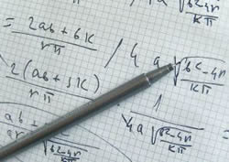
Notes:
The generation of social scientists who began their careers in the 1870s sought to move away from the traditions of political economy. They sought the same level of respect that was coming to those investigating the physical world. The ideal was exhibited in Newtonian mechanics. Their objective was to formulate a model of an economic world that could be described by a solvable system of equations.

Slide 31
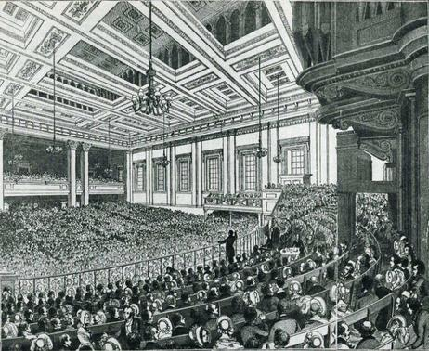
Congress of German Economists
Notes:
Another strong motivation of economists was the growing demand by government for statistics. Militarism and industrial production required an understanding of a nation’s population and its skills, natural resources and productive capabilities. In this era of imperialism, aggressive nation-states also sought similar information on other lands targeted as potential acquisitions. The new generation of economists were only too willing to oblige.

Slide 32
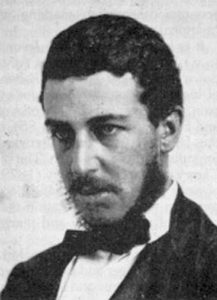
William Stanley Jevons
Notes:
One of the early economics pioneers was William Stanley Jevons, first trained in Britain as a chemist and mathematician. His lasting contribution to economics was the theoretical concept of general equilibrium – the assertion that all relations in an economy are self-regulating, so that any disturbance sets in motion forces tending to restore the balance.

Slide 33
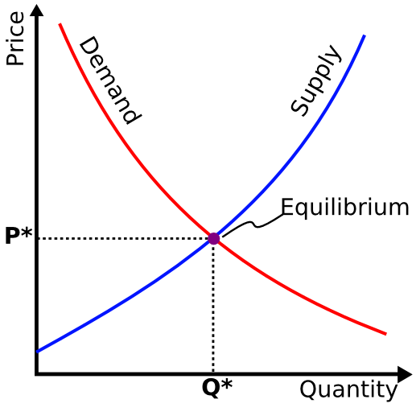
General Equilibrium
Notes:
This is often shown in the simple graphical representation of supply and demand curves. Jevons theorized that in purely competitive markets, the forces of supply and demand interact to bring us back toward a state of general equilibrium. His assertion, of course, is that purely competitive markets could actually exist in the real world.

Slide 34
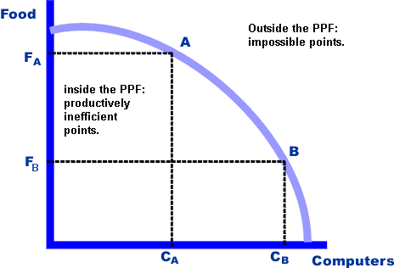
Butter
Guns
The Production Possibilities Curve
Notes:
Economists also built their models on the fact that individuals as well as societies have choices to make. Economics was (and is) accurately described as the study of the allocation of scarce resources. Economists provided advice by gathering and publishing data on scarce resources and analyzing how choices would effect the output of different types of goods. This analysis is displayed graphically as something called “The Production Possibilities Curve.” For militaristic regimes, the key tradeoff is between the output of consumer goods (referred to as “butter”) and the needs of the military (“guns”).

Slide 35
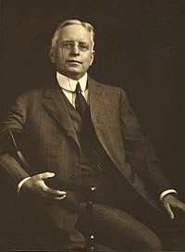
Richard Ely
Notes:
Another early leader of the economics discipline was Richard Ely. Richard Ely received his undergraduate degree from Columbia University, and a doctorate in economics from the University of Heidelberg. From 1881 to 1892 he held the professorship of economics at Johns Hopkins University and was subsequently professor of economics at the University of Wisconsin-Madison. His influence over the theoretical direction of economics continued long after his death.

Slide 36
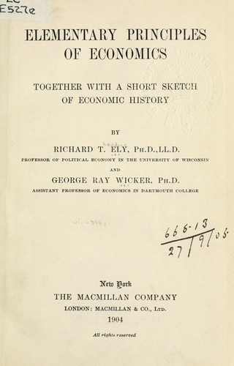
Notes:
Ely struggled to reconcile the system developed by prior generations of political economists with the new economics. In his 1909 textbook on economics, he begins with an observation with which Henry George would fully agree. He writes:

Slide 37
“In the first stage of man’s economic development, nature is the great factor in production. There is little labor and less capital. …It follows … that there was little ownership of land in the sense in which we now regard ownership. … The notion of land ownership develops only when the land itself becomes more useful, and when the fruits of its fertility can be more directly appropriated than could happen when land was used for pasturing.”
Notes:
“In the first stage of man's economic development, nature is the great factor in production. There is little labor and less capital. …It follows … that there was little ownership of land in the sense in which we now regard ownership. ...The notion of land ownership develops only when the land itself becomes more useful, and when the fruits of its fertility can be more directly appropriated than could happen when land was used for pasturing.”

Slide 38
Notes:
However, in his discussion of nature and the claims to the ownership of nature, Ely makes no moral judgment and raises no questions of justice. He merely describes the circumstance as it exists:

Slide 39
“Man does not create these natural treasures nor give direction to nature in their formation. Some nations have deemed it unfair that they should become the property of individuals, and have therefore treated them as a common heritage, exacting a rent or royalty for the opportunity to exploit them. ...”
Notes:
“Man does not create these natural treasures nor give direction to nature in their formation. Some nations have deemed it unfair that they should become the property of individuals, and have therefore treated them as a common heritage, exacting a rent or royalty for the opportunity to exploit them. ...”

Slide 40
“This is perhaps generally the case to-day on the continent of Europe; but English law, with its inclination to the exaggeration of private rights, has long established the principle that he who owns the surface owns downward to the centre of the earth and upward to the sky.”
Notes:
“This is perhaps generally the case to-day on the continent of Europe; but English law, with its inclination to the exaggeration of private rights, has long established the principle that he who owns the surface owns downward to the centre of the earth and upward to the sky.”

Slide 41
Notes:
As far as Ely the economist was concerned, that was the end of the issue. Political action converted the earth, our common heritage, into the realm of private property, and there the planet would remain.

Slide 42
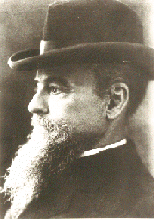
Vilfredo Pareto
Notes:
Vilfredo Pareto was one of a small group of economists who sought to use their teaching and writing to promote progressive changes. In so doing, Pareto risked both ostracism and censure. He believed:

Slide 43
“The man in whose power it might be to find out the means of alleviating the sufferings of the poor would have done a far greater deed than the one who contents himself solely with knowing the exact numbers of poor and wealthy people in society.”
Vilfredo Pareto. “The New Theories of Economics, Journal of Political Economy, volume 5, 1897
Notes:
“The man in whose power it might be to find out the means of alleviating the sufferings of the poor would have done a far greater deed than the one who contents himself solely with knowing the exact numbers of poor and wealthy people in society.”
Pareto may have adopted the methodology of the economist, but he was a political economist at heart.

Slide 44
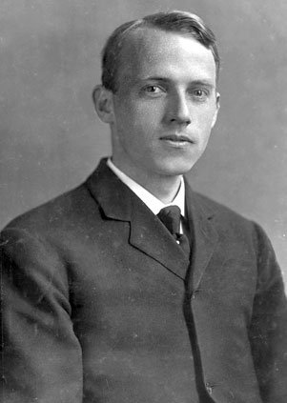
Scott Nearing
Notes:
Another dissenter within his discipline was Scott Nearing, who began his studies at the University of Pennsylvania in 1901 and earned a doctorate in economics in 1909. He then began teaching sociology at the Wharton School, where (as described by his mentor) he “had the largest class in the University — there were 400 in his class — and no one could have done his work better.”

Slide 45
Notes:
Nearing’s undoing was that he became immersed in progressive social causes. He was dismissed in 1915 from the University of Pennsylvania because of his public opposition to child labor and other progressive causes (including his support for Henry George’s “Single Tax” campaign). Nearing charged that academia had sold out to privileged interests. He wrote:

Slide 46
“The liberal and radical forces of American life – the men and women who had sacrificed, suffered, labored and struggled to make America safe for democracy, were brushed aside by the triumphant Patriotic plutocracy; Morgan, Rockefeller, Guggenheim … were the great patriots. All who opposed them were traitors. The plutocracy had always stood and still stands for special privilege in its most vicious form.”
Scott Nearing, The Great Madness: A Victory for the American Plutocracy, 1917
Notes:
“The liberal and radical forces of American life -- the men and women who had sacrificed, suffered, labored and struggled to make America safe for democracy, were brushed aside by the triumphant Patriotic plutocracy: Morgan, Rockefeller, Guggenheim … were the great patriots. All who opposed them were traitors. The plutocracy had always stood and still stands for special privilege in its most vicious form.”

Slide 47
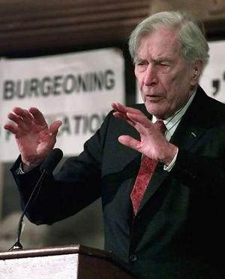
John Kenneth Galbraith
Notes:
As the twentieth century advanced, economists on the Left and the Right began to take sides on the matters of Class Conflict and Wealth Distribution. Those that did so, however, risked criticism from within the discipline’s ranks. Yet, even John Kenneth Galbraith, one of the larger-than-life figures of this era observed:

Slide 48
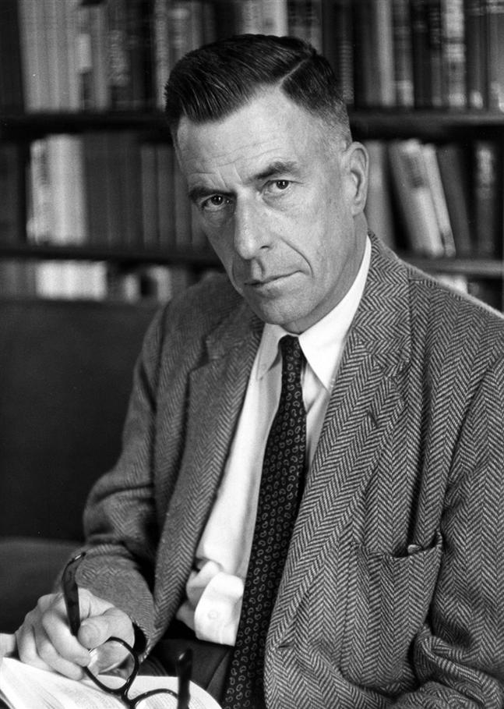
“Things may be less than good, less than fair, even less than tolerable; that is not the business of the economist as an economist. …The economist’s task is to stand apart, analyze, describe and where possible reduce to mathematical formulae, but not to pass moral judgment or be otherwise involved.”
John Kenneth Galbraith. Economics in Perspective, 1987, p.124
Notes:
“Things may be less than good, less than fair, even less than tolerable; that is not the business of the economist as an economist. …The economist’s task is to stand apart, analyze, describe and where possible reduce to mathematical formulae, but not to pass moral judgment or be otherwise involved.”

Slide 49
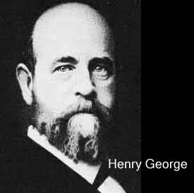
Notes:
Henry George is aptly described as the last of the great political economists and his proposals were at one time thought to be more dangerous to the status quo than those of Karl Marx and communism. The reason is that George campaigned for a market system cleared of monopoly privileges.

Slide 50
John Kenneth Galbraith
Notes:
Of Henry George, John Kenneth Galbraith wrote:

Slide 51
“In his time and even into the 1920s and 1930s, Henry George was the most widely read of American economic writers both at home and in Europe. He was, indeed, one of the most widely read of Americans.”
John Kenneth Galbraith. Economics in Perspective, 1987, p. 166
Notes:
“In his time and even into the 1920s and 1930s, Henry George was the most widely read of American economic writers both at home and in Europe. He was, indeed, one of the most widely read of Americans.”

Slide 52
END OF LECTURE 1

