Slide 1
Understanding our Political Economy

Slide 2
LECTURE 2
Economists Debate Theory and Policy

Slide 3
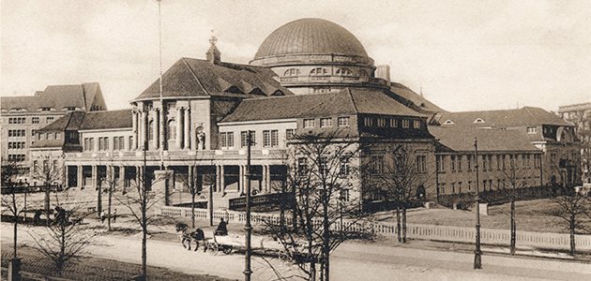
Notes:
As many younger men sought academic credentials in economics from European universities, the older generation of political economists gradually lost their positions and influence back in the United States.

Slide 4
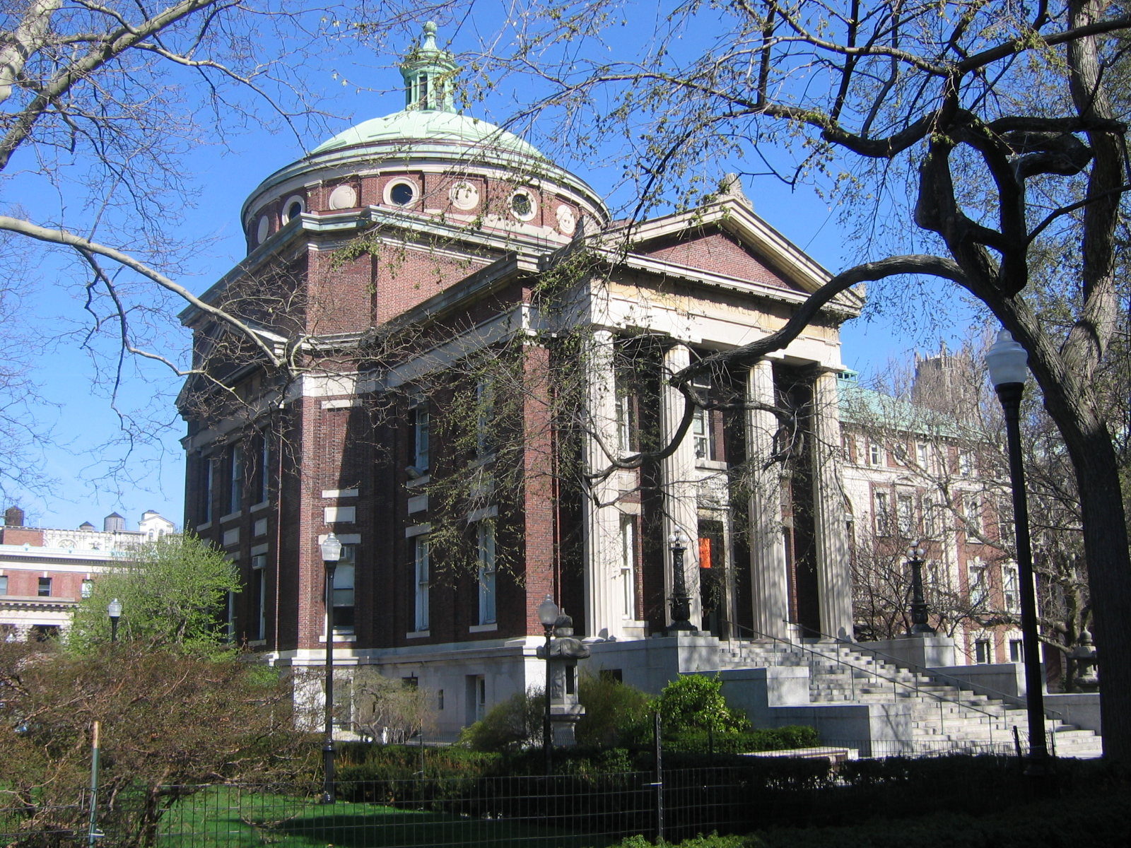
Columbia University
Notes:
Columbia University became center stage for the intellectual and political storm that developed in the United States during the late 1800s.

Slide 5
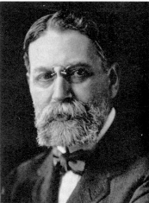
E.R.A. Seligman
Notes:
Columbia’s Chairman of the Department of Economics, E.R.A. Seligman, frequently clashed in public with Henry George. With financial donations from the likes of J.P. Morgan, Columbia University’s economics department grew to become one of the largest in the United States – and its faculty one of the most vigorous in defending the status quo.

Slide 6
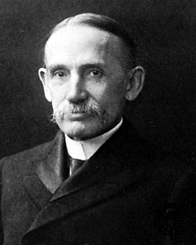
John Bates Clark
Notes:
John Bates Clark, who debated Henry George in 1890 on “the moral basis of property in land,” was recruited in 1895 to teach economics at Columbia.

Slide 7
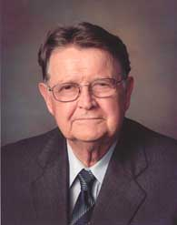
Mason Gaffney
Notes:
Mason Gaffney, a long-time Professor of Economics at the University of California, co-authored with British economist Fred Harrison a rather stinging historical study of his discipline and the organized effort to discredit Henry George’s analysis of political economy. They titled their book, The Corruption of Economics.

Slide 8
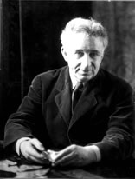
Allen Eaton
Notes:
Gaffney recalls what happened to one professor, Allen Eaton, who was found guilty of championing the system of political economy as developed by Henry George:

Slide 9
“Professor Allen Eaton was fired from the University of Oregon for successfully pushing a series of characteristically [Henry] Georgist measures: municipal ownership of the Eugene waterworks; taxation of waterpower sites; direct election of U.S. Senators; keeping valuable State-owned timberlands from being given to Southern Pacific.”
Mason Gaffney. The Corruption of Economics, 1994, p. 51
Notes:
“Professor Allen Eaton was fired from the University of Oregon for successfully pushing a series of characteristically Georgist measures: municipal ownership of the Eugene waterworks; taxation of waterpower sites; direct election of U.S. Senators; keeping valuable State-owned timberlands from being given to Southern Pacific.”

Slide 10
Neoclassical Economic Theory
Factors of Production: Labor and Capital
LAND
Notes:
John Bates Clark and E.R.A. Seligman, supported by many of their colleagues and the generation of economics professors who graduated from their programs, embraced as their orthodoxy a model of economic systems that came to be referred to as “neo-classical” economics. In their analysis, nature – or Land -- was removed as the first and primary factor or production with its own unique characteristics.

Slide 11
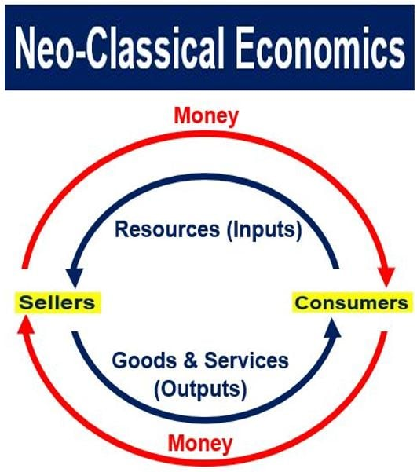
Notes:
By doing so, economists sidestepped a fundamental question; namely, whether to be considered wealth ownable by individuals an asset had to be produced by labor using capital goods (that is, tools and machinery) applied to land. By reclassifying nature as just another form of capital good, any asset that commanded a price in the market could then be included in the definition of wealth. Considerations of the political economist disappears from their analysis.

Slide 12
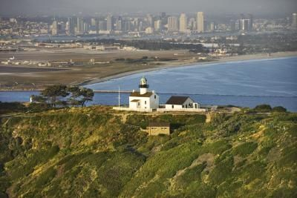
RENT -- the return to the differential quality of land and/or its locational advantage
Notes:
Rent, identified by political economists as the return created by the differential quality of land and/or its locational advantage in a town or city, was redefined in neoclassical economics as any surplus return -- to locations, to labor , to capital goods, or to financial instruments.

Slide 13
Mason Gaffney
Notes:
Mason Gaffney describes how the reclassification by neoclassical economists of land as just another form of capital and rent as surplus income associated with land, labor and capital was used to affect public policy choices:

Slide 14
“[John Bates Clark] did not stop at subsuming land in capital. He also makes a great point that wages are rent, too. The policy implication is that wages would make a good tax base. Seligman carried this forward into the income tax, leading to the present tax system which raises much more from payrolls than property.”
Mason Gaffney. The Corruption of Economics, 1994, p. 59
Notes:
“[John Bates] Clark did not stop at subsuming land in capital. He also makes a great point that wages are rent, too. The policy implication is that wages would make a good tax base. Seligman carried this forward into the income tax, leading to the present tax system which raises much more from payrolls than property.”

Slide 15
C
A
P
I
L
T
A
Notes:
The confusion and distortions have only worsened. In the language of economists today, there is but one factor of production – capital. They write about “natural capital,” “intellectual capital,” human capital,” “financial capital,” and “entrepreneural capital”. And, for all of these categories of capital neoclassical economics asserts that the price mechanism will always clear markets – that is, market forces will determine the price at which both buyers and sellers agree to exchange goods, services, money or credit.

Slide 16
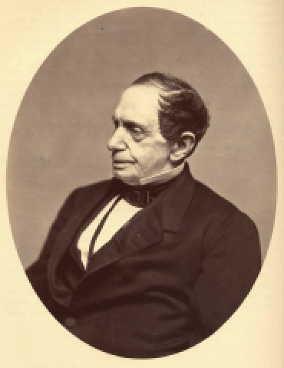
Johns Hopkins
Notes:
Another bastion of neoclassical economics was Johns Hopkins University, established in the early 1870s with the fortune left by Baltimore businessman, Johns Hopkins.

Slide 17
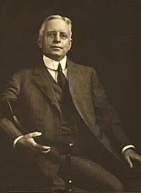
Richard Ely
Notes:
Richard Ely joined the faculty of Johns Hopkins University as its chair in 1881 and remained until 1892. His influence over the discipline was further cemented by his founding of the American Economic Association in 1885, serving as the Association’s President from 1890 to 1901.

Slide 18
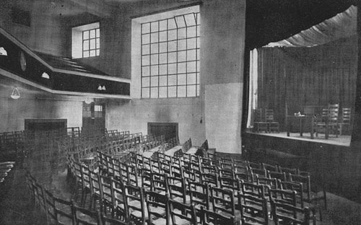
Economics: Science or Something Else?
Notes:
Yet, the early twentieth century was characterized by intense controversy over the direction in which economics was taken by its newly-crowned intellectual leaders. One of the more vocal critics was professor Harry Gunnison Brown.

Slide 19
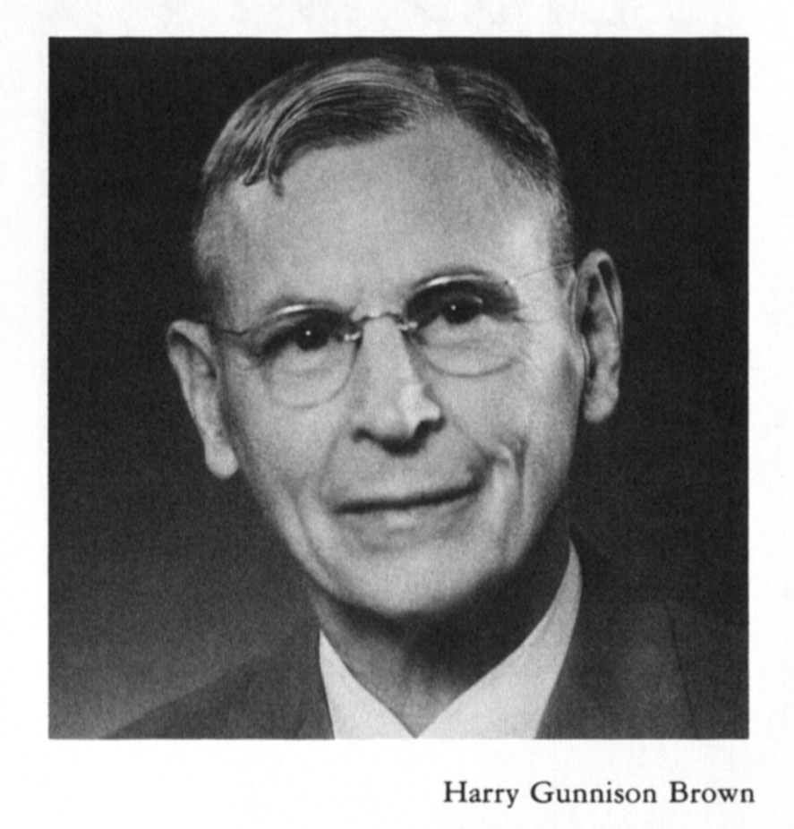
Notes:
Harry Gunnison Brown graduated from Williams College in 1904, then began graduate studies at Ohio State University. He earned his doctorate in economics at Yale in 1909, under Irving Fisher, one of the pioneers in the development of mathematical economics and econometrics. He taught at Yale through 1915, then moved on to the University of Missouri. Throughout his professional life, Brown remained convinced that economics was tainted by bias on behalf of vested interests. He wrote:

Slide 20
“The conclusions reached in economics may, in case they come to be widely understood, seriously affect the interests of various persons and classes. And if these classes are numerous or influential, they are fairly certain to find spokesmen who can give effective expression to their dissent. Such expression may not be scientific but it will often be couched in forceful rhetoric and be reasonably plausible.”
Harry Gunnison Brown. Economic Science and the Common Welfare, 1925, p. 5
Notes:
“The conclusions reached in economics may, in case they come to be widely understood, seriously affect the interests of various persons and classes. And if these classes are numerous or influential, they are fairly certain to find spokesmen who can give effective expression to their dissent. Such expression may not be scientific but it will often be couched in forceful rhetoric and be reasonably plausible.”

Slide 21
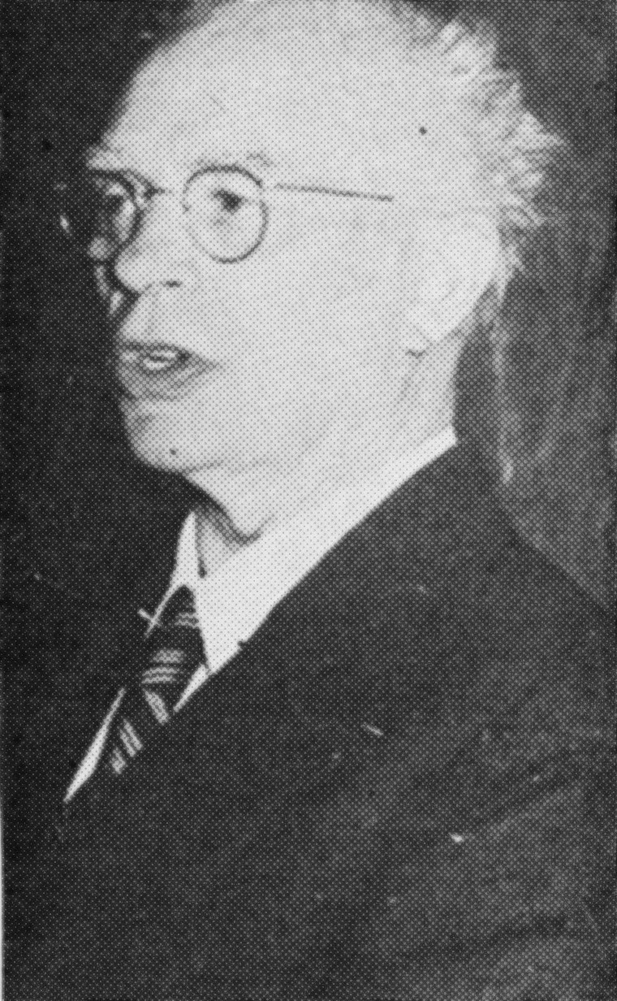
Glenn E. Hoover
Notes:
Another economist fighting to preserve elements of political economy was Glenn E. Hoover. He earned degrees at the University of Washington and the University of Strasbourg (in France). One of Hoover’s most significant accomplishments came as editor of the book, Twentieth Century Economic Thought, published in 1970. Hoover had studied Henry George’s works and embraced George’s analysis of how markets actually functioned. Of the state of economics as a discipline, he wrote:

Slide 22
“The failure to distinguish between land and the products of labor is not, as many believe an ancient error, but is a relatively recent one. …It took a lot of sophistry and obfuscation to make men believe that a free gift of nature should be treated in the same way as are the products of their own labor.”
Glenn E. Hoover, Prof. of Economics, Mills College, Oakland, CA. From a banquet Speech delivered in 1951
Notes:
“The failure to distinguish between land and the products of labor is not, as many believe an ancient error, but is a relatively recent one. …It took a lot of sophistry and obfuscation to make men believe that a free gift of nature should be treated in the same way as are the products of their own labor.”

Slide 23
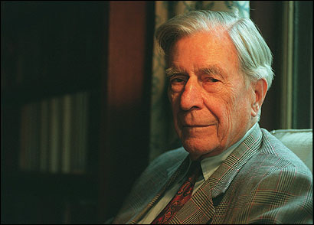
Notes:
By these individuals and others within and outside the economics discipline is raised the question of whether economics as taught today in most colleges and universities is useful or harmful. John Kenneth Galbraith at one point in his career provided this response:

Slide 24
“Economics is extremely useful as a form of employment for economists.”
Notes:
“Economics is extremely useful as a form of employment for economists.”

Slide 25
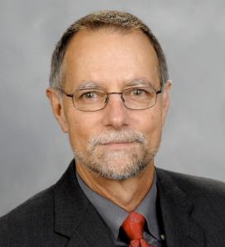
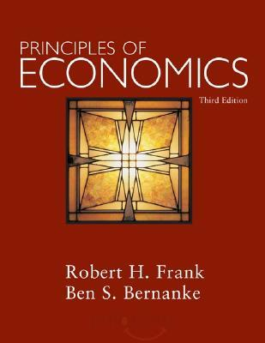
Notes:
What is apparently the case is that few of the tens of thousands of students who take courses in economics absorb much of what is taught. As Robert Frank observed:

Slide 26
“Studies have shown that when students are tested about their knowledge of basic economic principles six months after completing an introductory economics course, they score no better, on average, than those who never took the course.”
Robert H. Frank. “The Dismal Science, Dismally Taught,” The New York Times, August 12, 2007
Notes:
“Studies have shown that when students are tested about their knowledge of basic economic principles six months after completing an introductory economics course, they score no better, on average, than those who never took the course.”

Slide 27
END OF LECTURE 2
Notes:
Our next task is to describe the essential elements of political economy, the essential terms used and how they are defined in the study of how systems of political economy evolve and function.

