Slide 1
Understanding our Political Economy

Slide 2
INSTRUCTOR
Edward J. Dodson, M.L.A.
email contact:
edod08034@gmail.com

Slide 3
LECTURE 8
Money, Currency and Credit
The United States of America
Notes:
The experience in the United States of America is worthy of specific examination. There are important lessons to be learned.

Slide 4
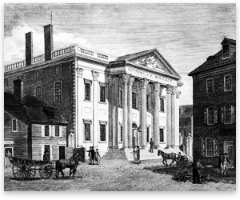
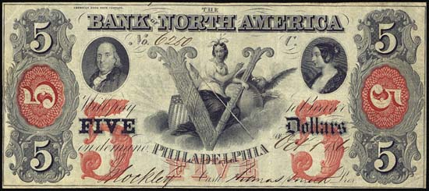
Notes:
Banking came to the newly-formed United States of America in 1781 with the establishment of the Bank of North America.

Slide 5
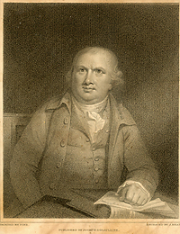
Robert Morris
Notes:
The Bank was chartered by the Congress in response to concerns raised by Robert Morris, Superintendent of Finance. The Bank’s functions and structure were designed by Alexander Hamilton. The bank was capitalized with loans from the Netherlands and France. In 1785, after the war for independence was over, the Bank’s charter was repealed.

Slide 6
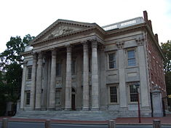
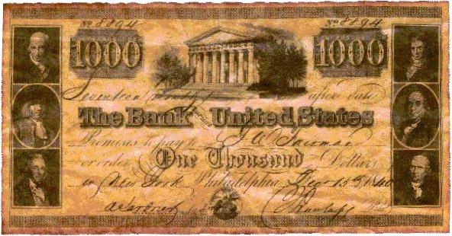
Notes:
In 1791 the First Bank of the United States was chartered (for 20 years). This charter was renewed in 1816 for the Second Bank of the United States . However, …

Slide 7
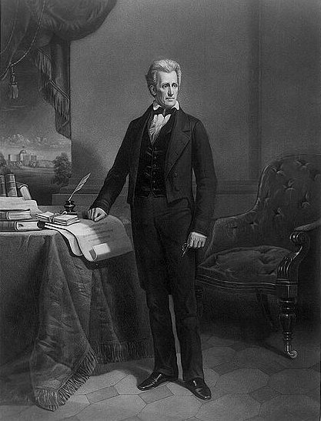
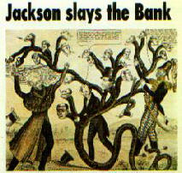
Notes:
… President Andrew Jackson opposed the bank and ordered all federal deposits removed in 1833. The Bank lost its Federal charter in 1836, and ceased operations in 1841. The years to follow were dominated by a decentralized system of state-chartered banks.

Slide 8
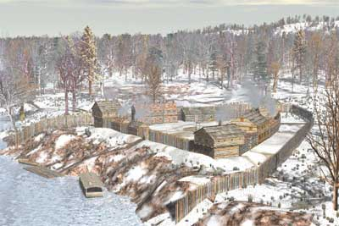
Notes:
People were migrating into the vast North American interior. Currency and credit were desperately needed to meet the needs of the growing economy, and banking interests responded.

Slide 9
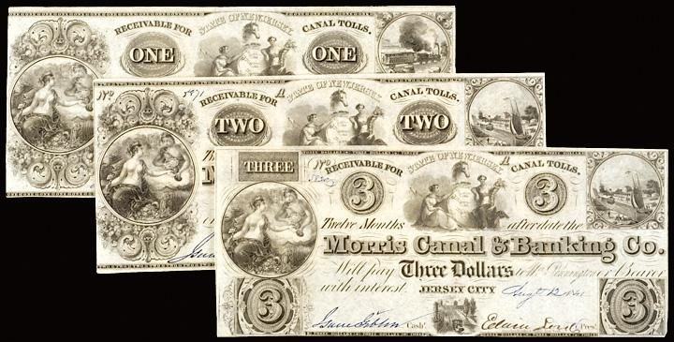
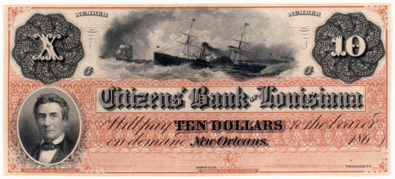
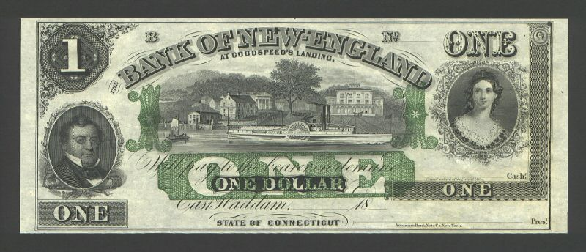
Notes:
After 1816 regulation of banks was left to the states. New banks were subscribed with some specie, but control over issuance of bank notes was often ineffective. Currency issued by the 700+ state banks was discounted anywhere from 0 to 100 percent based on public confidence in and knowledge of the bank.

Slide 10
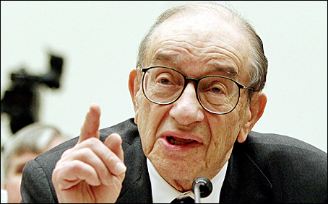
Alan Greenspan
Notes:
Historians disagree on the consequences of this period of minimally-regulated banking. However, some years ago, Alan Greenspan stated in a speech that:

Slide 11
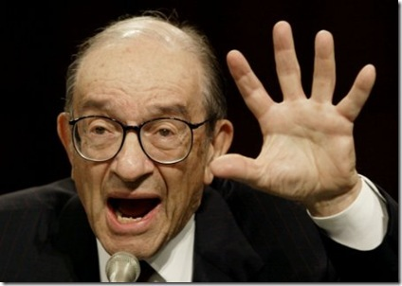
“… more recently, some scholars have suggested that the problems of the free banking period were exaggerated. Retrospective analyses have shown, for example, that losses to bank note holders and bank failures were not out of line with other comparable periods in U.S. banking history.”
Notes:
“… more recently, some scholars have suggested that the problems of the free banking period were exaggerated. Retrospective analyses have shown, for example, that losses to bank note holders and bank failures were not out of line with other comparable periods in U.S. banking history.”

Slide 12
Edward L. Symons, Jr.
Notes:
Even so, the story is one filled with many contradictions. One researcher, Edward L. Symons, wrote in 1984:

Slide 13
“In some states, particularly Michigan Where more than forty banks failed before the system was declared unconstitutional, the system is better characterized as a fiasco than a failure.”
Notes:
"In some states, particularly Michigan where more than forty banks failed before the system was declared unconstitutional, the system is better characterized as a fiasco than a failure."

Slide 14
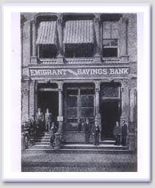
Notes:
As the United States approached mid-century, the momentum for reform and monetary stability increased. By the onset of the Civil War state banks numbered 1,562.

Slide 15
National Banking Acts of 1863 and 1864
Notes:
The National Banking Acts of 1863 and 1864 attempted to assert some degree of federal control over the banking system without the formation of another central bank by creating a system of national banks, a uniform national currency, and an active secondary market for Treasury securities to help finance the Union’s war expenses.

Slide 16
The number of state-chartered banks fell to just 325
Notes:
The result was that by 1870 there were 1,638 national banks and only 325 state banks.

Slide 17
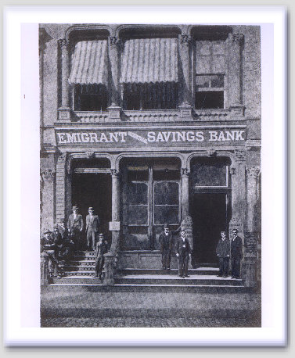
Notes:
Surviving state banks responded by offering customers checking accounts as a substitute for banknotes. As a result, by 1890 only ten percent of the nation's money supply was in the form of currency. Combined with lower capital and reserve requirements, as well as the ease with which states issued banking charters, state banks again became the dominant banking structure by the late 1880's.

Slide 18
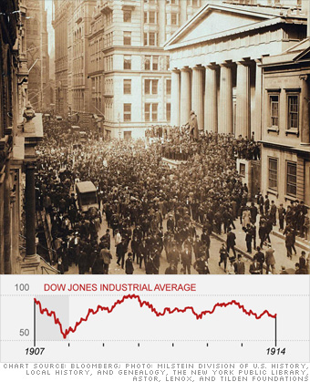
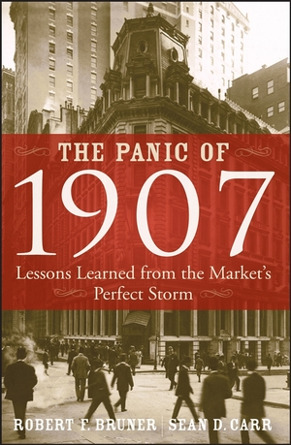
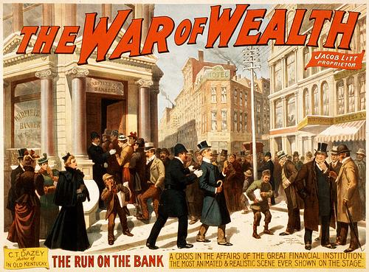
Notes:
The banking system limped along until the Wall Street Panic of 1907. Speculative bubbles in the real estate and the stock markets burst. Several long-standing New York banks failed. The unemployment rate reached 20 percent in the fall of 1907. Millions lost their deposits as thousands of banks collapsed across the nation.

Slide 19
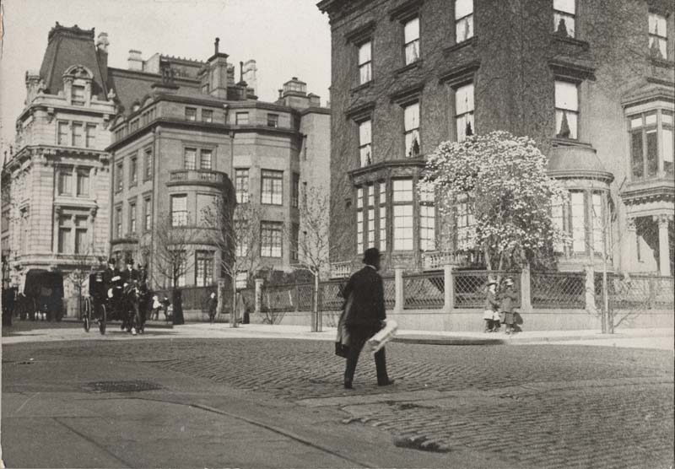
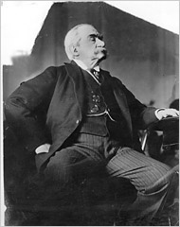
Notes:
The panic ended only after J.P. Morgan intervened. Morgan, personally, made temporary loans to key New York banks and other financial institutions.

Slide 20
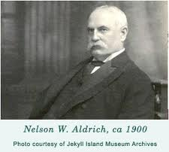
Notes:
In 1908, Senator Nelson W. Aldrich established and chaired a commission to investigate the crisis and propose future solutions.

Slide 21
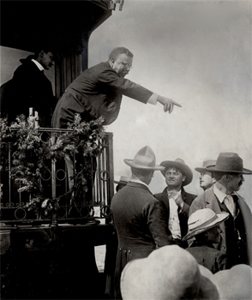
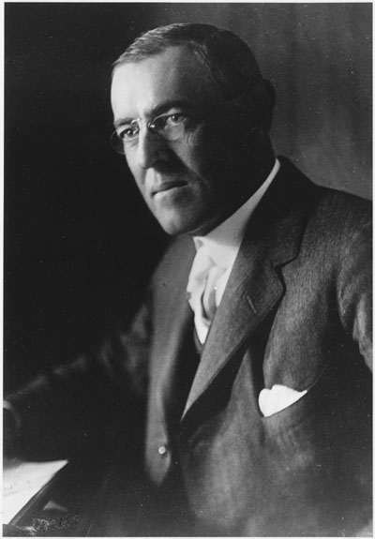
Notes:
Woodrow Wilson won the Democratic party's nomination for President in 1912, defeating Theodore Roosevelt who ran as a Progressive. In his acceptance speech Wilson warned against the "money trusts," and advised that:

Slide 22
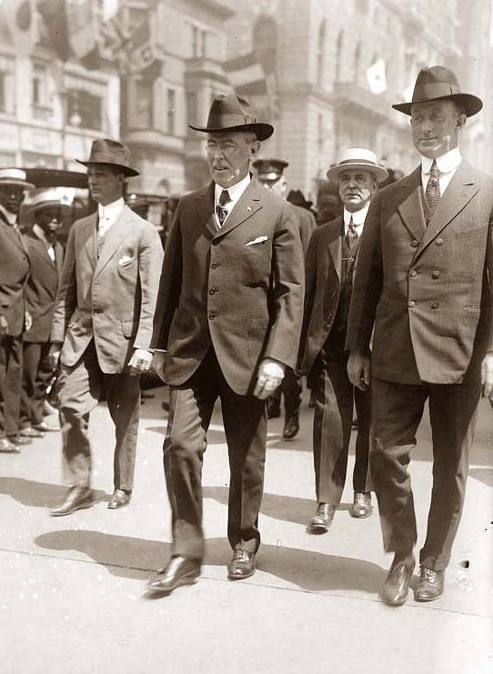
“ … a concentration of the control of credit … may at any time become infinitely dangerous to free enterprise.”
Notes:
"a concentration of the control of credit ... may at any time become infinitely dangerous to free enterprise."

Slide 23
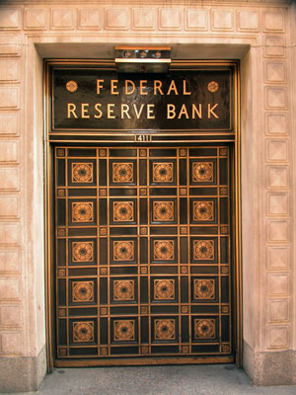
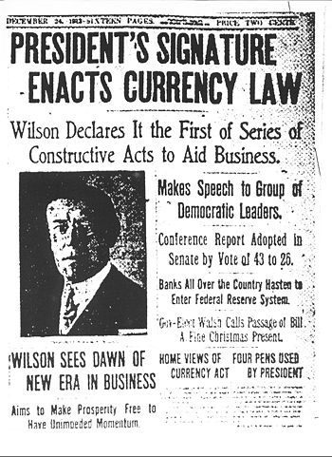
Notes:
After taking office, Wilson signed legislation to reform the nation’s currency system. The Federal Reserve System was the result.

Slide 24
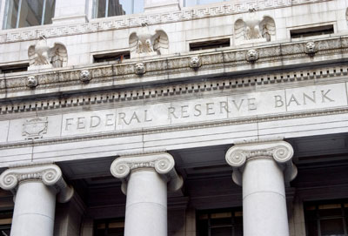
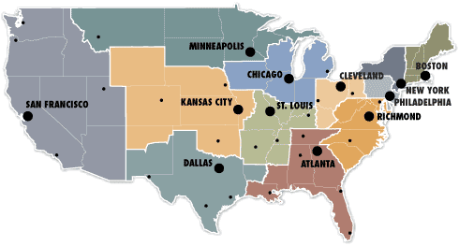
Notes:
Despite Woodrow Wilson’s stated desires, the bankers ensured the new Federal Reserve System was made private and not a government agency. The Federal Reserve Act established a system of eight to twelve mostly autonomous regional Reserve Banks that would be owned by commercial banks and whose actions would be coordinated by a committee appointed by the President.

Slide 25
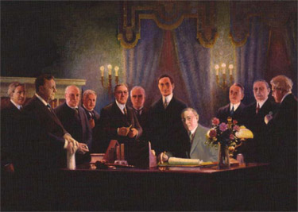
Notes:
From inception, the Federal Reserve System has had its harsh critics, including at the time Congressman Charles Lindberg, who argued:

Slide 26
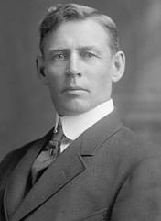
“The Act establishes the most gigantic trust on earth. When the President signs this Bill, the invisible government of the monetary power will be legalized. …The greatest crime of the ages is perpetuated by this banking and currency bill.”
Notes:
“The Act establishes the most gigantic trust on earth. When the President signs this Bill, the invisible government of the monetary power will be legalized. …The greatest crime of the ages is perpetuated by this banking and currency bill.”

Slide 27
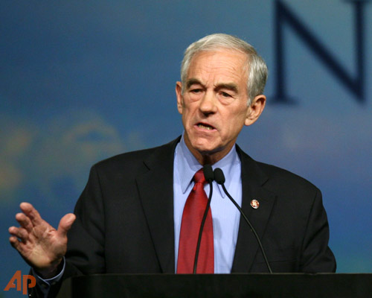
Ron Paul
Notes:
U.S. Representative Ron Paul of Texas has called for its dissolution, writing:

Slide 28
“Since the creation of the Federal Reserve, middle and working-class Americans have been victimized by a boom-and-bust monetary policy. In addition, most Americans have suffered a steadily eroding purchasing power because of the Federal Reserve's inflationary policies. This represents a real, if hidden, tax imposed on the American people.”
Notes:
“Since the creation of the Federal Reserve, middle and working-class Americans have been victimized by a boom-and-bust monetary policy. In addition, most Americans have suffered a steadily eroding purchasing power because of the Federal Reserve's inflationary policies. This represents a real, if hidden, tax imposed on the American people.”

Slide 29
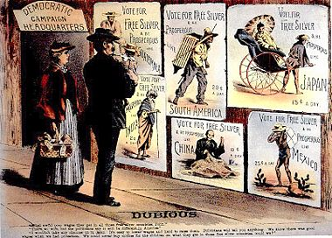
Notes:
Then, there is the debate over whether currency ought to be backed by one or more precious metals – gold, silver or both (bimetallism). This had been a major political issue during the 19th century. Trade with China during the 18th and 19th centuries drained Europe and the U.S. of large quantities of silver. As a result, gold gradually replaced silver as the mandated backing for most currencies.

Slide 30
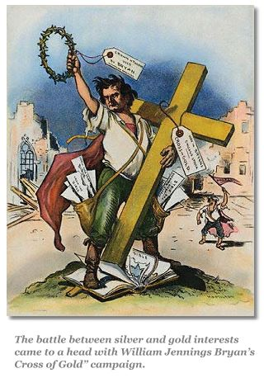
Notes:
Legislation passed in 1873 embraced the gold standard and de-monetized silver. Mining interests and “westerners” fought against this measure because gold was scarce in much of the country.

Slide 31
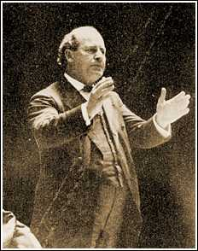
William Jennings Bryan
Notes:
And, the westerners found a champion in William Jennings Bryan.

Slide 32
Notes:
Bryan called for bimetallism. Campaigning for the Presidency in 1896, Bryan delivered his famous “No Cross of Gold” speech, in which he declared:

Slide 33
“…if protection has slain its thousands, the gold standard has slain its tens of thousands.”
Notes:
“…if protection has slain its thousands, the gold standard has slain its tens of thousands.”

Slide 34
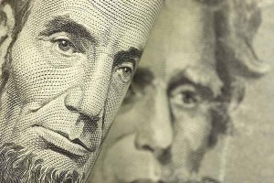
Government issued currency
Versus
Central Bank issued currency
Versus
Private Bank issued currency
Notes:
A major part of the debate over reform is whether the issuance of currency should be fully privatized or made the responsibility of government.

Slide 35
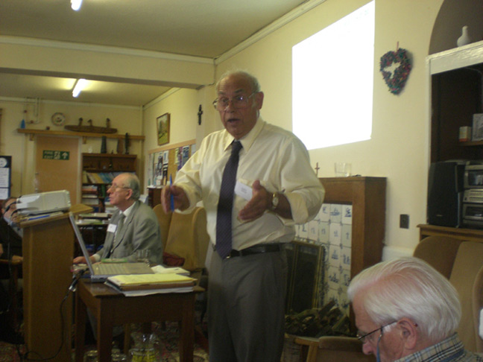
Stephen Zarlenga
Notes:
Stephen Zarlenga, who founded the American Monetary Institute in 1996, extensively researched the history of money and banking and credit. In a speech he delivered in 2004, he pointed to one reason why economists have not made a major contribution to creation of a stable monetary structure:

Slide 36
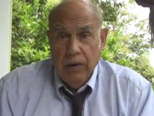
“One reason economists have failed mankind so badly is their poor methodology – an over-reliance on theoretical reasoning. Alexander Del Mar the world’s greatest monetary historian noted: ‘As a rule economists...don’t take the trouble to study the history of money; it is much easier to imagine it and to deduce the principles of this imaginary knowledge.’"
Notes:
One reason economists have failed mankind so badly is their poor methodology – an over-reliance on theoretical reasoning. Alexander Del Mar the world’s greatest monetary historian noted: ‘As a rule economists...don’t take the trouble to study the history of money; it is much easier to imagine it and to deduce the principles of this imaginary knowledge.’"

Slide 37
Notes:
Stephen Zarlenga believed we should:

Slide 38
Nationalize the Federal Reserve System
Reconstitute the Fed within the U.S. Treasury, to become a fourth branch of government
Restrict the creation of money to the Federal government
Notes:
(a) Nationalize the Federal Reserve System; (b) Reconstitute the Fed within the US Treasury, to eventually evolve into a fourth branch of government, on a par with the executive, judicial and legislative branches; and (c) Restrict the creation of money to the Federal government.

Slide 39
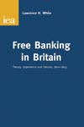
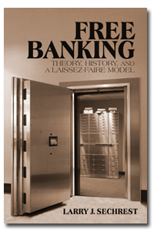
Notes:
At the opposite end of the reform spectrum is the proposal to once again permit “free banking.” Any banking entity could issue its own banknotes. Market forces would be relied upon to control the supply of banknotes and the quantity and form of reserves required to meet demands for cash by depositors. Reserves would be in the form of gold, silver or possibly other scarce commodities with a stable value.

Slide 40
Fred Foldvary
Notes:
Fred Foldvary, who taught economics at Santa Clara University, believed free banking would work very efficiently and with little corruption. He wrote as follows:

Slide 41
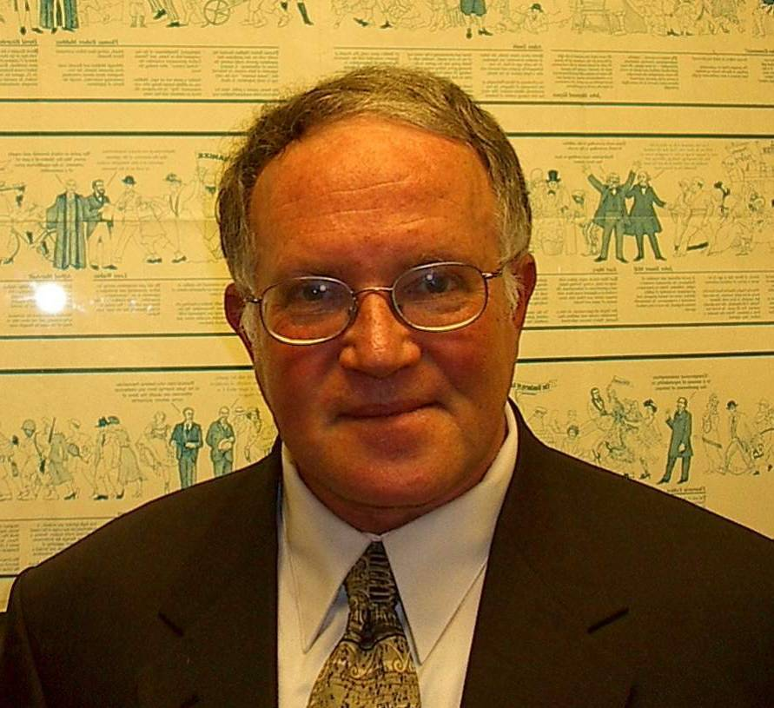
“… The artificial increase in money supply can be halted permanently by implementing free banking. Without a central bank and a national currency imposed on the economy, inflation of the money supply beyond the growth of the economy is no longer feasible, since there is no longer a monopoly of the money supply.”
From: The Science of Economics, Chapter 12
Notes:
“… The artificial increase in money supply can be halted permanently by implementing free banking. Without a central bank and a national currency imposed on the economy, inflation of the money supply beyond the growth of the economy is no longer feasible, since there is no longer a monopoly of the money supply.”

Slide 42
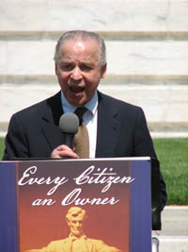
Norman Kurland
Notes:
And, a somewhat different approach was advocated by the Center for Economic and Social Justice, a Washington, DC-based organization headed by Norman Kurland, who was a long-time associate and collaborator with Louis Kelso, the person most responsible for legislation creating Employee Stock Ownership Plans.

Slide 43
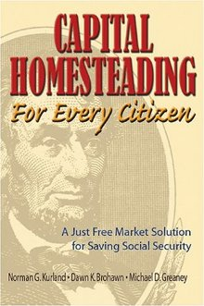
Notes:
What Kurland and others seek is a society where every person derives income from the ownership of shares of stock. To make this a reality, his organization has lobbied for passage of a Capital Homestead Act.

Slide 44
“The Capital Homestead Act's central focus is the democratization of capital (productive) credit. By universalizing citizen access to direct capital ownership through access to interest-free productive credit, it would close the power and opportunity gap between today's haves and have-nots, without taking away property from today's owners.”
Notes:
“The Capital Homestead Act's central focus is the democratization of capital (productive) credit. By universalizing citizen access to direct capital ownership through access to interest-free productive credit, it would close the power and opportunity gap between today's haves and have-nots, without taking away property from today's owners.”

Slide 45
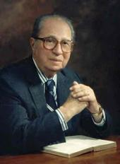
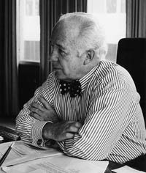
Mortimer J. Adler
Louis Kelso
Notes:
Back in the late 1950s, the philosopher Mortimer J. Adler teamed up with attorney Louis Kelso to write a sharp critique of the American economic system. In two books -- The Capitalist Manifesto and The New Capitalists -- they developed a program of universal capitalism.

Slide 46
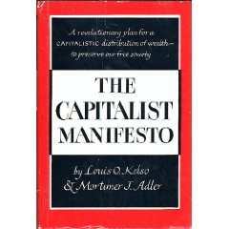
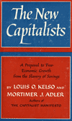
Notes:
In the preface to The Capitalist Manifesto, Mortimer Adler explains that the ideas on economics are those developed by Louis Kelso, but which he came to embrace. His primary concern had been on how to preserve and nurture democracy. He wrote:

Slide 47
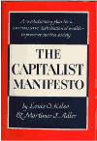
“In the twenty years or more in which I have been developing a theory of democracy as the only perfectly just form of government, I slowly came to realize that political democracy cannot flourish under all economic conditions. ...”
Notes:
“In the twenty years or more in which I have been developing a theory of democracy as the only perfectly just form of government, I slowly came to realize that political democracy cannot flourish under all economic conditions. ...”

Slide 48
“Democracy requires an economic system which supports the political ideals of liberty and equality for all. Men cannot exercise freedom in the political sphere when they are deprived of it in the economic sphere.”
Notes:
“Democracy requires an economic system which supports the political ideals of liberty and equality for all. Men cannot exercise freedom in the political sphere when they are deprived of it in the economic sphere.”

Slide 49
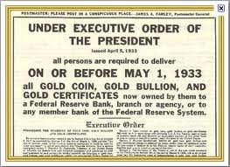
Notes:
One way for government to try to stabilize its economy is to exert direct control over the monetary system. In 1933, the United States government took the dramatic step of closing down the gold market and ending its commitment to redeem gold certificates.

Slide 50
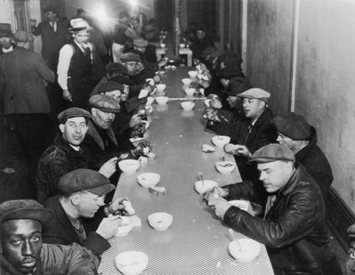
Notes:
Which leads us into a discussion of the causes of economic recessions and depressions. Monetary reformers have focused on the roles played by money, banking and credit. However, as we will soon discuss, Henry George concluded the causes were even more basic.

Slide 51
Notes:
A fundamental question is whether that portion of the economy engaged in financial transactions adds to the production of actual wealth or merely results in its redistribution. Is there a loser for every winner?

Slide 52
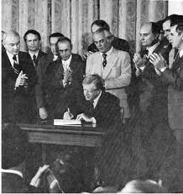
Notes:
Beginning in the 1970s, political leaders in the United States and their economic advisers committed the nation to a long process of deregulation of the financial services sector and a reliance on supposed competitive forces to discipline the activities of individual players.

Slide 53
Notes:
Now that the global economy is struggling to emerge from yet another deep crisis, an almost endless list of analysts have offered their interpretation of what happened and why.

Slide 54
THE ECONOMY
Notes:
The widespread fraud that characterized the subprime mortgage business of the late 1990s and early 2000s became apparent when borrowers failed to make even the first payment due on their loans. The nation’s property markets had again overheated and then crashed. They were credit-fueled and speculation driven. The Federal Reserve’s response was textbook: do all that could be done to convince investor and potential buyers that property prices would recover and climb to new heights. Reducing mortgage interest rates to less than 3 percent did the trick.

Slide 55
Notes:
And, here is the perfect metaphor for where this has brought us!

Slide 56
END OF LECTURE 8

