Slide 1
Understanding our Political Economy

Slide 2
INSTRUCTOR
Edward J. Dodson, M.L.A.
email contact:
edod08034@gmail.com

Slide 3
LECTURE 9
Idle Land: The Root Cause of Economic Depressions
Notes:
Let’s now take a look at the root cause of economic depressions.

Slide 4
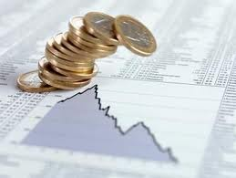
Notes:
We now come to the insights economists should revisit from the theoretical contributions of Henry George -- his analysis of the causes of economic cycles. On this subject, Henry George points to land monopoly as the primary destabilizing force, writing:

Slide 5
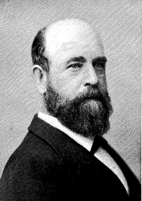
“As population grows and technology advances, land values rise. This steady increase leads to speculation, as future increases are anticipated. ...”
Notes:
“As population grows and technology advances, land values rise. This steady increase leads to speculation, as future increases are anticipated. …”

Slide 6
“Land Values are carried beyond the point at which labor and capital would receive their customary returns. Production, therefore, begins to stop.”
Progress and Poverty, p.145
Notes:
“Land Values are carried beyond the point at which labor and capital would receive their customary returns. Production, therefore, begins to stop.”

Slide 7
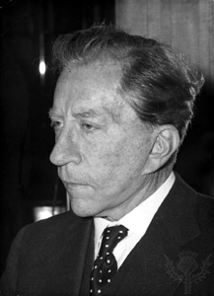
J. Paul Getty
Notes:
And, to add credibility to what Henry George wrote, here was the advice from one who knew how things worked and how to maximize profits, J. Paul Getty, who said:

Slide 8
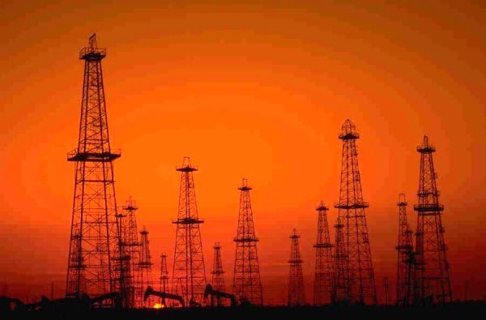
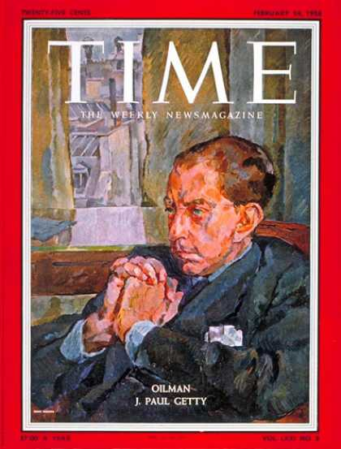
“If you want to get rich, buy land.”
Notes:
“If you want to get rich, buy land.”

Slide 9
Notes:
But, not just any land will make you really rich. Beginning in 1949, Getty paid Ibn Saud $9.5 million in cash and $1 million a year for a 60-year concession to a tract of land near the border of Saudi Arabia and Kuwait. From 1953 onward, Getty's gamble produced 16 million barrels a year, which contributed greatly to the fortune which made him one of the richest people in the world. In essence, what Getty paid to the Saudis was far below the full annual rental value of the oil-rich lands he controlled.

Slide 10
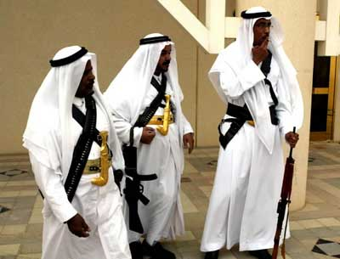
Notes:
Even more important is the ethical question of to whom the oil beneath the surface belongs. To the Saudi princes? To the Saudi people? Or, the people of the globe as a whole?

Slide 11
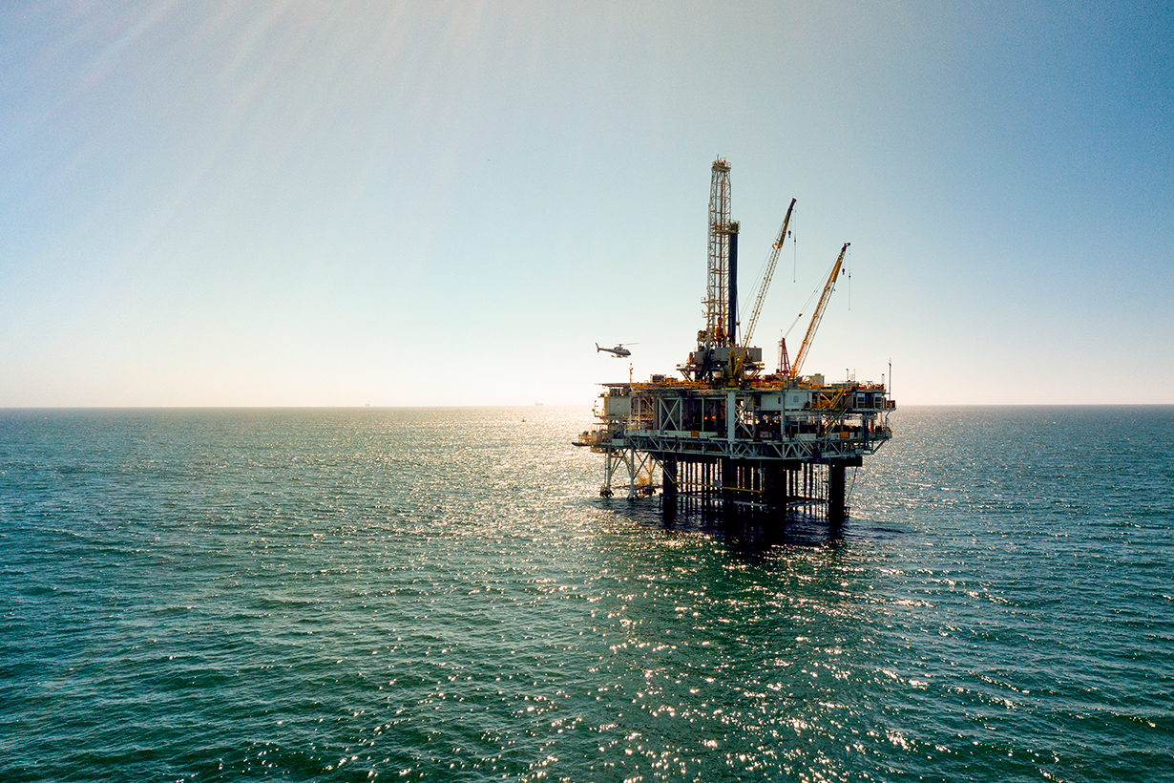
Notes:
To the Saudi princes? To the Saudi people? Or, the people of the globe as a whole? Our world system of nation-states leaves only the open seas as a potential source for rents to be captured and shared globally.

Slide 12
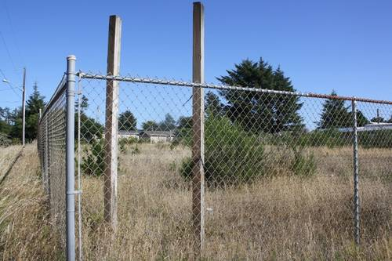
Notes:
In more recent times, the governments of oil-exporting nations realized that their long-term interests rest on raising the price of oil extracted by limiting the supply – that is, by keeping some oil-rich lands idle or reducing production. This practice is not unique; rather, those who have control over land in all its forms know that holding some land idle will raise the value of other lands with a similar potential use.

Slide 13
Notes:
Henry George thought deeply about this connection. He studied history and observed the contemporary evidence. In the end, he concluded:

Slide 14
“ The only thing that can explain why people are forced to stand idle when they would willingly work to supply their wants is that labor is denied access to land. … It is not that all land is in use. …”
Notes:
“The only thing that can explain why people are forced to stand idle when they would willingly work to supply their wants is that labor is denied access to land. … It is not that all land is in use. …”

Slide 15
“What prevents labor from using this land? Simply that land has been monopolised. It is held at speculative prices, based not on present value, but on value that will come with future population growth.”
Progress and Poverty, pp. 150, 151-152
Notes:
“What prevents labor from using this land? Simply that land has been monopolised. It is held at speculative prices, based not on present value, but on value that will come with future population growth.”

Slide 16
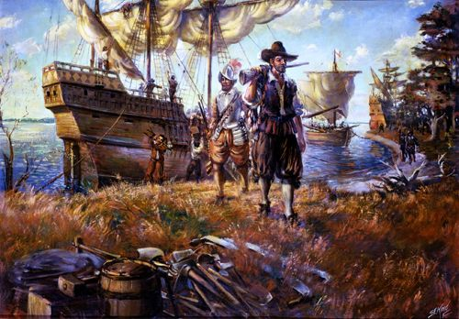
Notes:
Remember that much of the land area of the European continent remained unoccupied and undeveloped even as the people of Europe found it necessary to board ships for other continents in search of a better life.

Slide 17
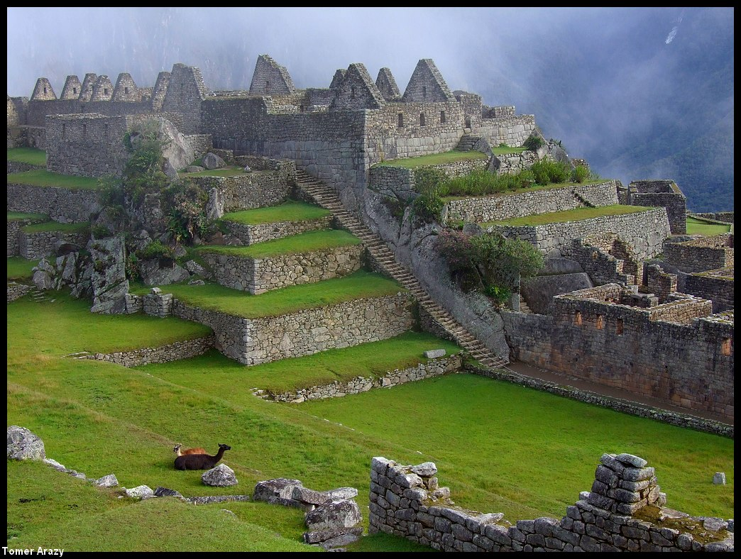
Notes:
Several hundred years was required to accomplish the European conquest of the Americas and the displacement of the continent’s earlier peoples.

Slide 18
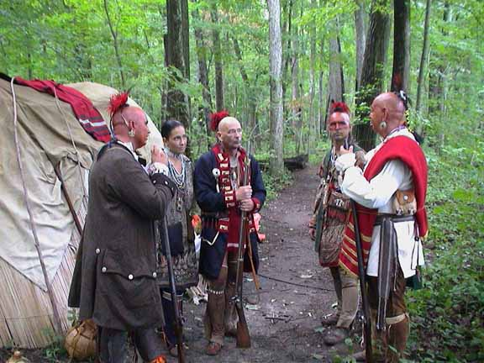
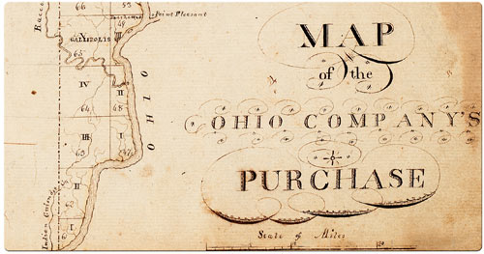
Notes:
Once the conquest by European peoples secured the Atlantic coastal regions of North America, frontiersmen were followed by settlers and land speculators into the interior where many hoped to amass huge landed estates or acquire and hold land in anticipation of population increases and the establishment of towns, roadways and markets. The Ohio Company, of which George Washington was a principal, is just one example followed by many others as European-Americans subdued the continent.

Slide 19
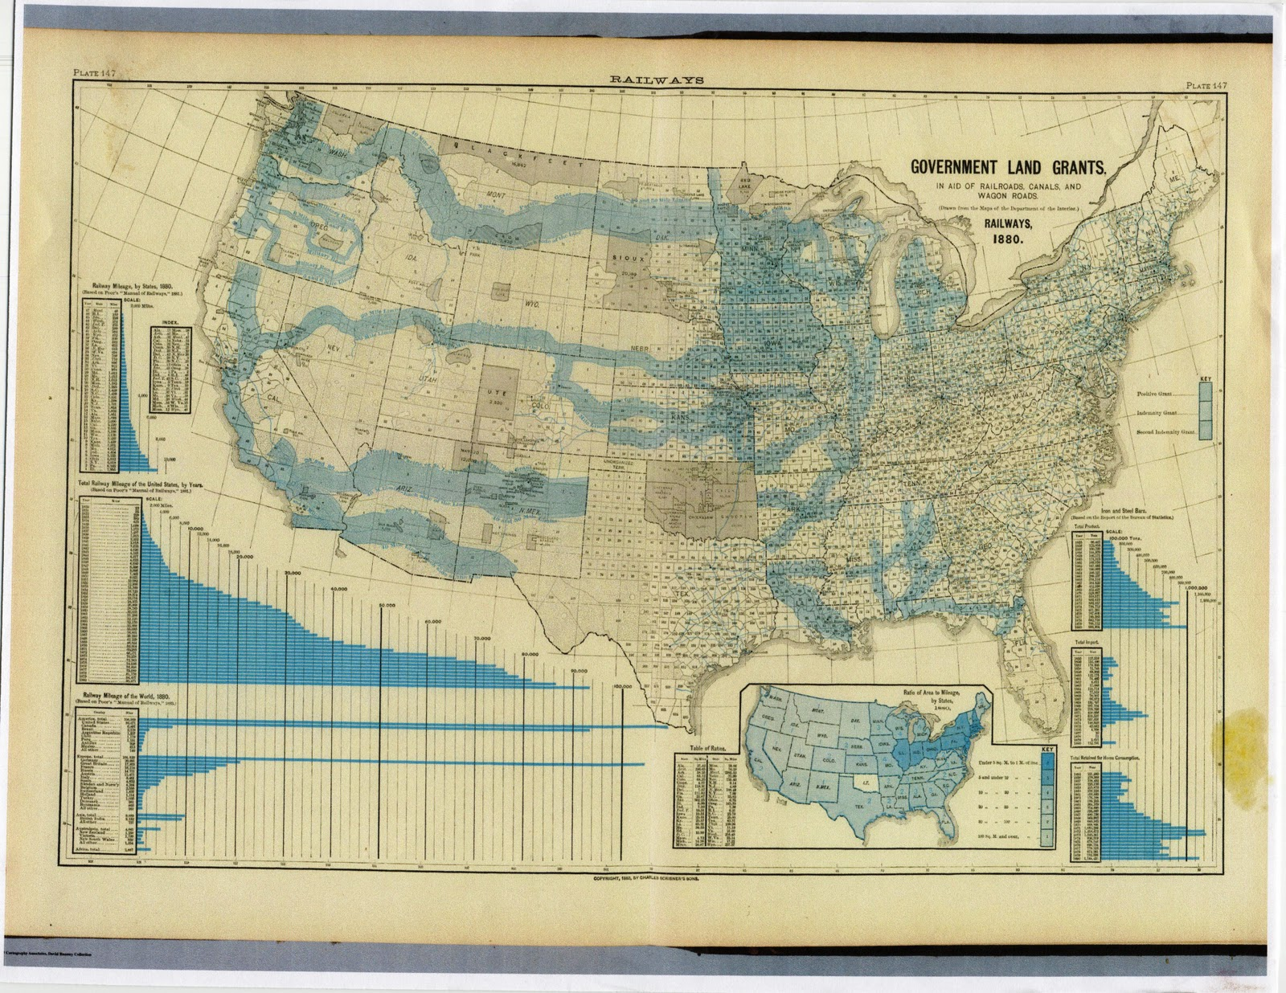
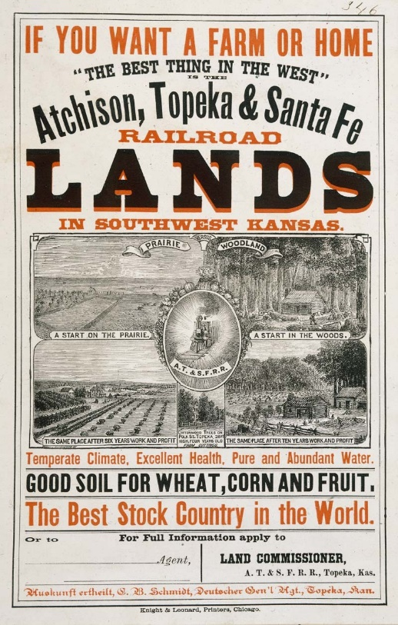
Notes:
As the nineteenth century advanced, a financially-weak government of the new United States of America cheaply disposed of much of the public domain to speculators and later to the railroad companies as part of the bargain for rapid population migration across the continent.

Slide 20
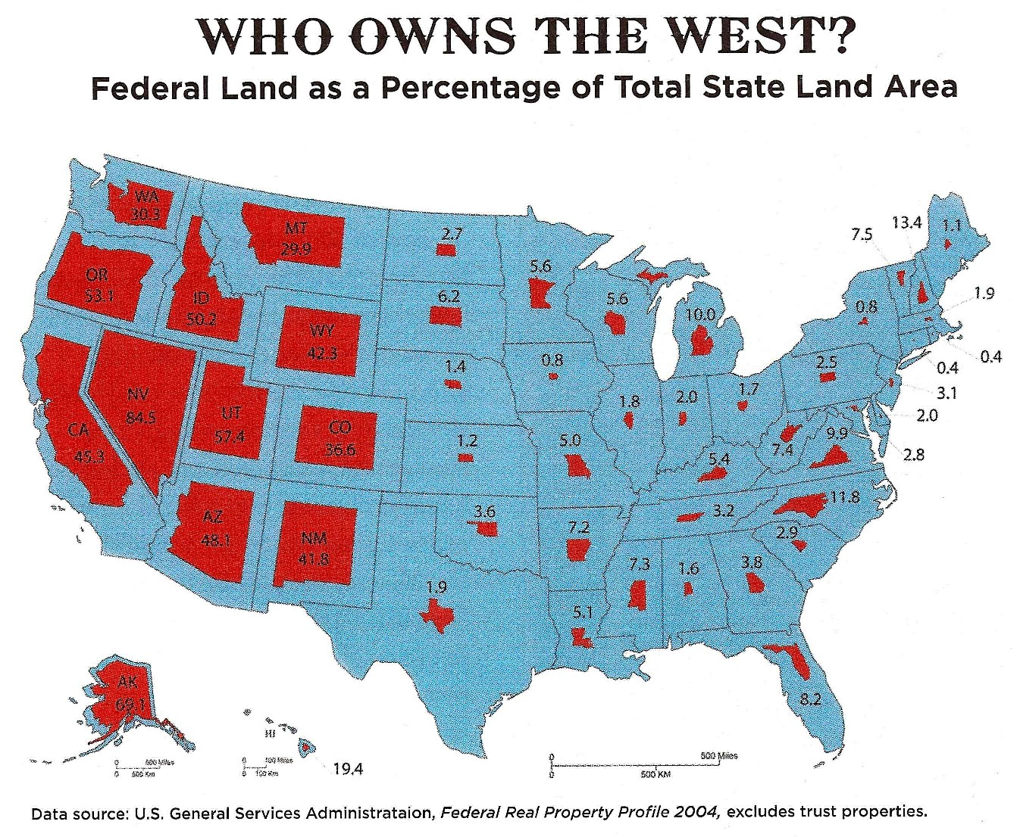
Notes:
Despite the huge land grants and sales, the Federal government today still controls 29% of the nation's land area, with most of the land held concentrated in the western states and Alaska.

Slide 21
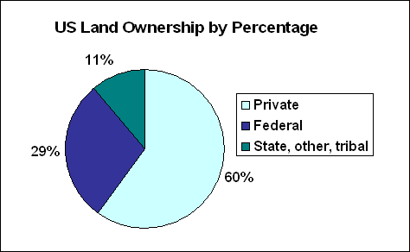
Notes:
State and local governments control another 9%. Trust lands for the tribes of First Americans account for roughly 2%. This leaves over 60% of the land -- 1.4 billion acres -- in private hands. Remember, however, that this is just land area, not land value.

Slide 22
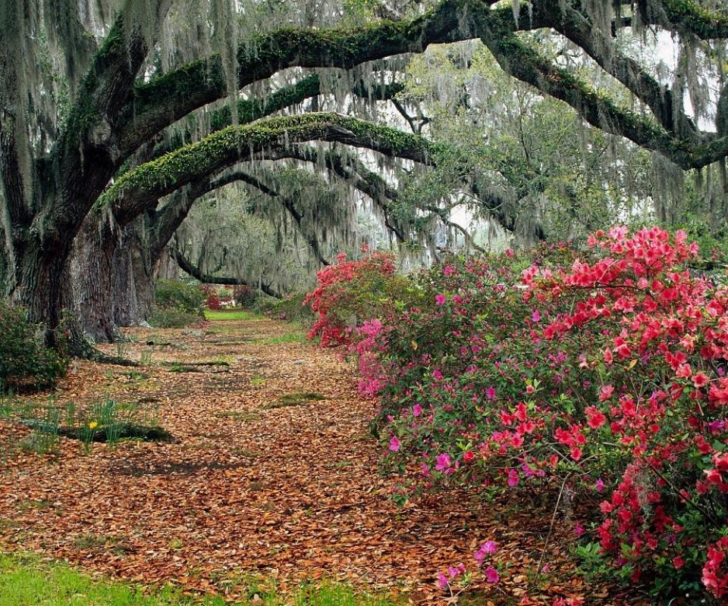
Notes:
Over the last two hundred years, much of the land area held by the nation’s wealthiest families has of course changed hands. Even so, the ownership of land in the United States is highly concentrated and becoming more so each year. Today, just 50 individuals and families own around 31 million acres of land scattered across the United States.

Slide 23
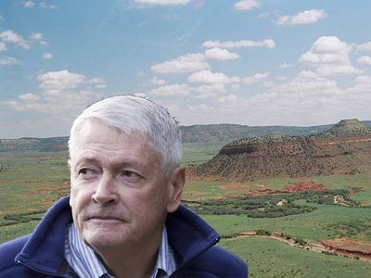
Notes:
John Malone, who has served in executive positions in the telecommunications industry now holds over 2.2 million acres of land. In 2011 he purchased a million acres of woods in Maine and New Hampshire, after acquiring the 290,000-acre Bell Ranch in New Mexico the previous year.

Slide 24
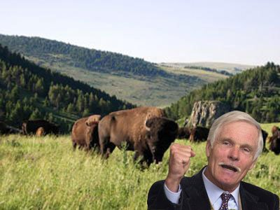
Notes:
Ted Turner, founder of the Turner Broadcasting System, owns around 2 million acres in 12 states. He also owns land outside of the United States.

Slide 25
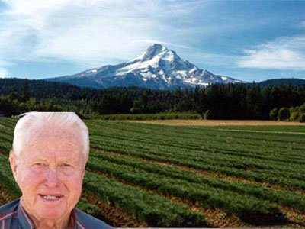
Notes:
Red Emmerson is president of Sierra Pacific Industries, a family-run lumber manufacturing business that ranks as California's largest private landowner. He owns over two million acres of forestland in California and Washington.

Slide 26
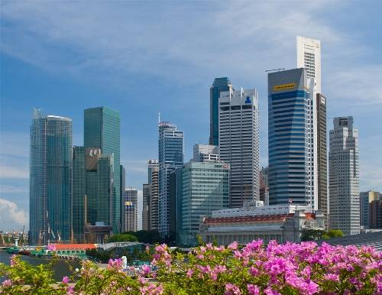
Notes:
As impressive as the above landholdings are, think about where the most valuable land is in the United States, or any other country. It is in our cities and towns, where land is valued not by the acre but by the square foot.

Slide 27
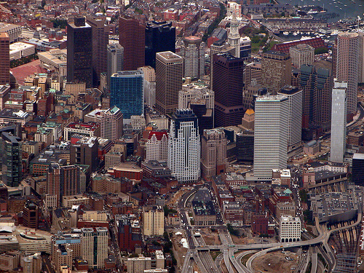
Notes:
There is no publicly-available data on the ownership of land in our cities and towns. What we do know is that the ownership of commercial real estate is highly concentrated. The largest 25 real estate companies own a combined total of around 4 billion square feet of commercial real estate in the United States and overseas, an area considerably greater in size than the City of Boston.

Slide 28
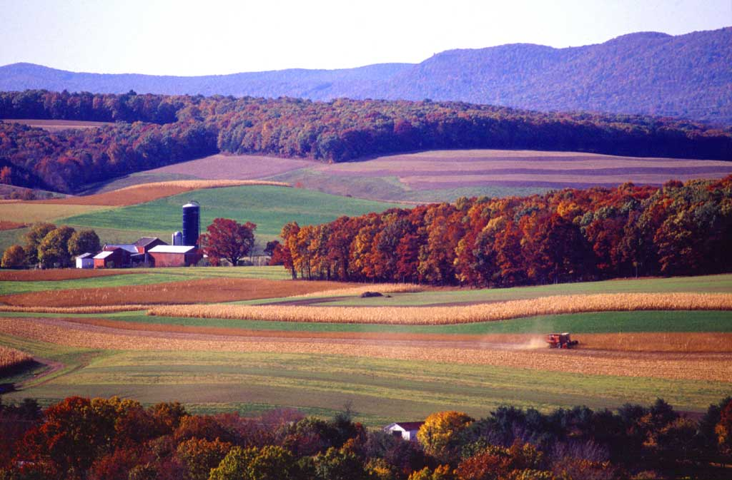
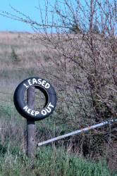
Notes:
Of the 3 million owners of farmland in the United States, only half actually farm all or most of the land they hold. Some 44 percent of owners are what political economists referred to as members of the “rentier” class, leasing out the land to actual farmers at market rents. More troubling is that the ownership of farmland by members of this rentier class is highly concentrated, with just 8 percent of the group owning over half the acreage owned.

Slide 29
Notes:
Somewhat surprisingly, however, is that individuals still own more than two-thirds of all farm acreage. The 32,500 non-family-held corporations own just 5 percent of all farmland in the United States.

Slide 30
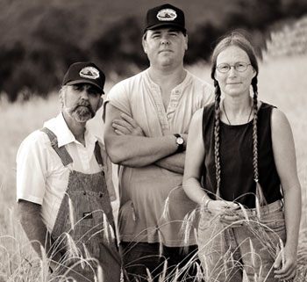
comprise 96% of the owners
hold 97% of the land value
hold 98% of the total acres
Notes:
If we look at just the privately-owned agricultural land in the U.S, we find that Whites account for 96% of the owners, 97% of the value, and 98% of the acres.

Slide 31
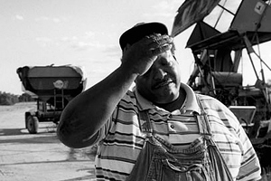
Notes:
Today, 45,000 out of 3.4 million farmers in the U.S. identify as Black, owning just 2 percent of the nation’s agricultural land.

Slide 32
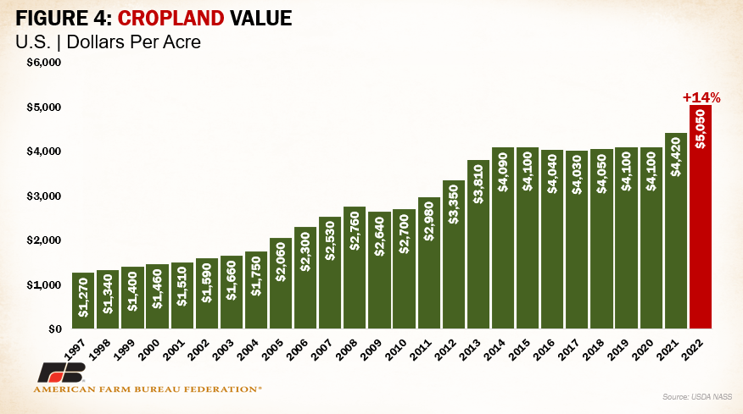
Notes:
Prices for agricultural land have increased year after year across the nation. The average increase between 2021 and 2022 was 14 percent, rising to $5,050 per acre.

Slide 33
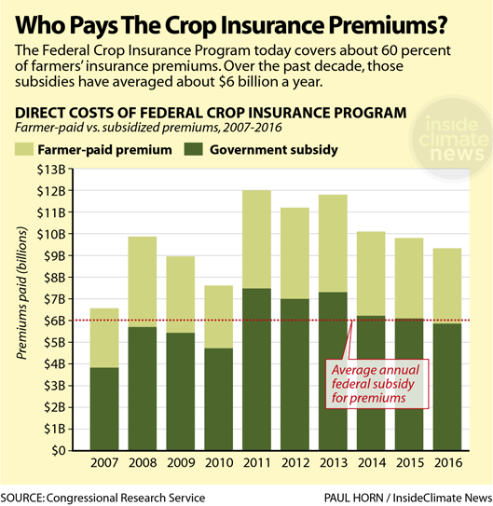
Notes:
One reason is that U.S. taxpayers have provide around $6 billion annually in subsidies to pay for premiums under the federal crop insurance program.

Slide 34
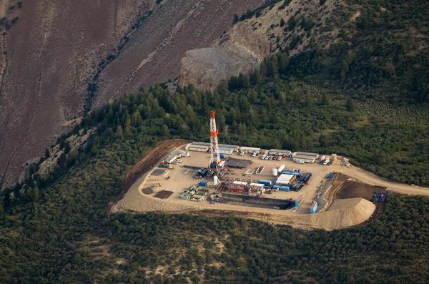
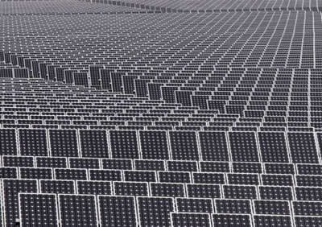
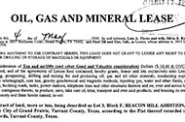
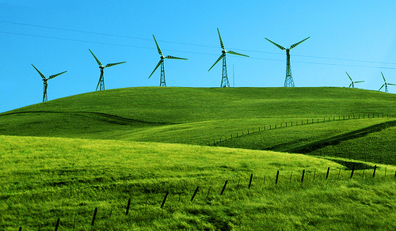
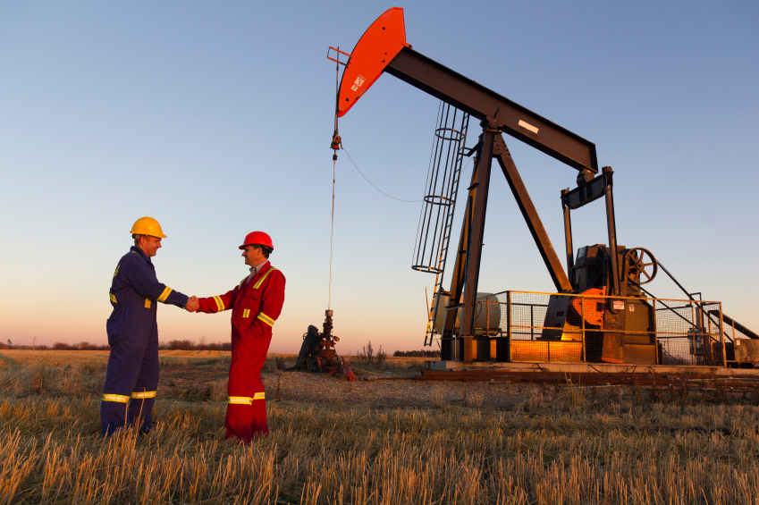
Notes:
A more recent but significant factor in the attractiveness of owning land is the potential to lease the land for oil and gas exploration, or for solar or wind farms.

Slide 35
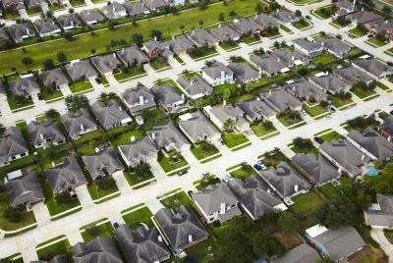
Notes:
Yet, for most of us the only land we are likely to ever own is the land beneath our primary residence, our home. With so much land seemingly undeveloped all around us, we ought to wonder why land prices are so high. Political economy provides an important answer: reduce the supply of any asset as demand is increasing and the price will rise.

Slide 36
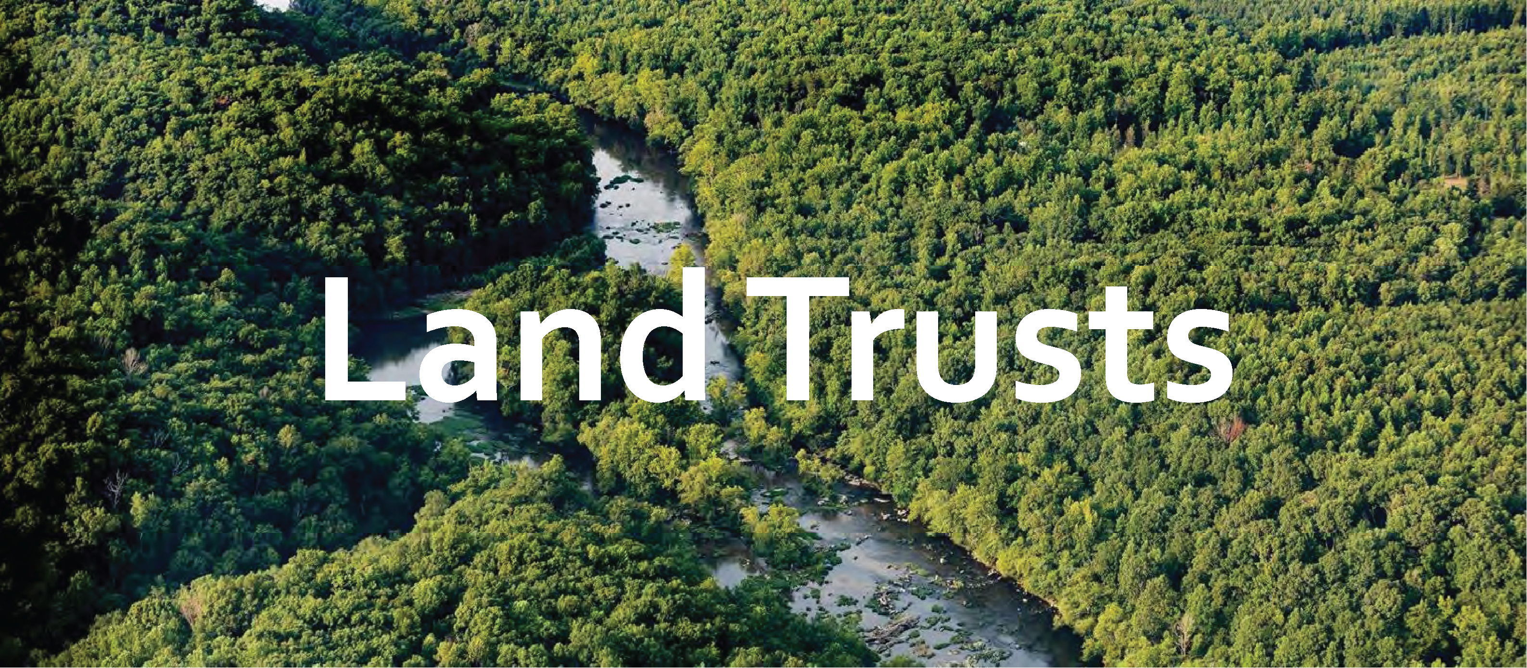
Notes:
There are also many efforts to protect land from future development by putting the ownership of land into preservation trusts. Around 1,900 land trusts nationwide now control and manage about 56 million acres of land.

Slide 37
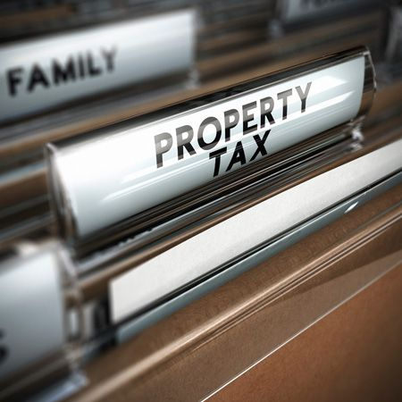
Notes:
Local, state and federal laws in the United States also exempt from taxation the value of land – and buildings – owned by religious organizations, educational institutions and charities. However, the presence of these institutions in a community has the effect of increasing the value of other land in the same way as do the presence of public improvements and amenities.

Slide 38
END OF LECTURE 9
Notes:
Let’s now take a look at the root cause of economic depressions.

