Slide 1
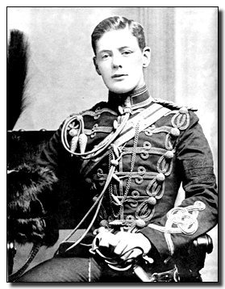
Winston Churchill, The Liberals and The Land Question
1895
Written and Narrated by Edward J. Dodson, M.L.A.
Notes:
This is a presentation on the history of the 20th century struggle by members of the Liberal Party in Britain to bring about a peaceful solution to the age-old land question that created a nation of haves and have nots. At the center of this struggle during the first decades of the century was none other than Winston Churchill.

Slide 2
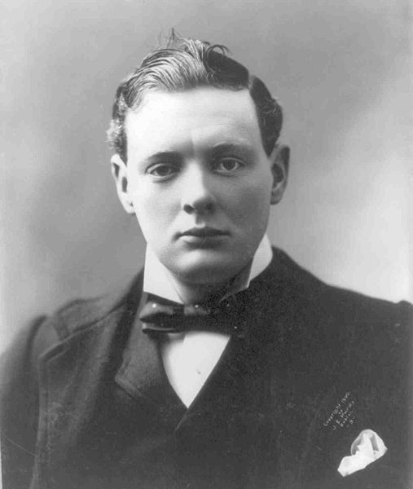
Notes:
Winston Churchill returned to Britain from Egypt in 1898, resigned his commission in the army and almost immediately entered into politics, as a member of the Conservative Party.

Slide 3
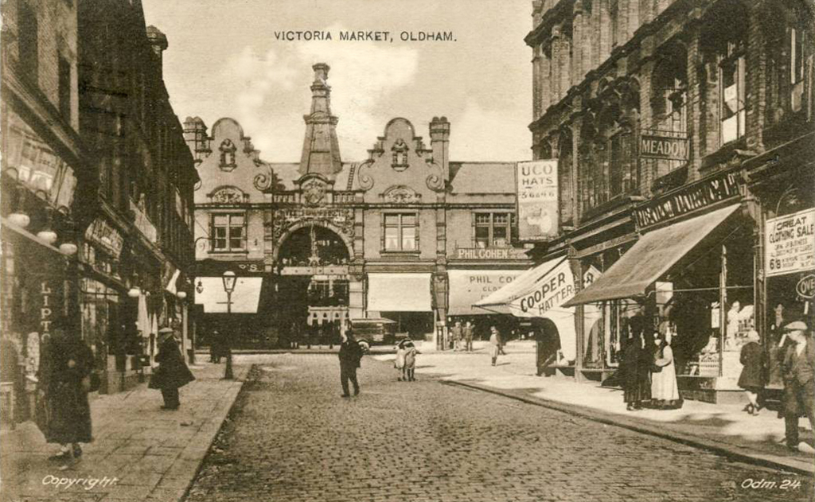
Notes:
His first campaign was in Oldham, a constituency in the industrial region of Lancashire. He unexpectedly opposed his party’s position on a Tithes bill, after which the prominent Conservative Arthur Balfour said of him:

Slide 4
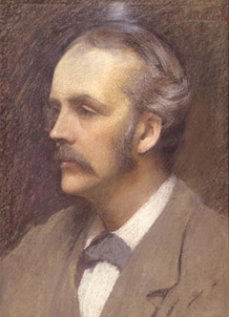
“I thought he was a young man of promise, but it appears he is only a young man of promises.”
Arthur Balfour
Notes:
“I thought he was a young man of promise, but it appears he is only a young man of promises.”
Winston’s opponent won by more than a thousand votes, but he was neither dismayed nor deterred.

Slide 5
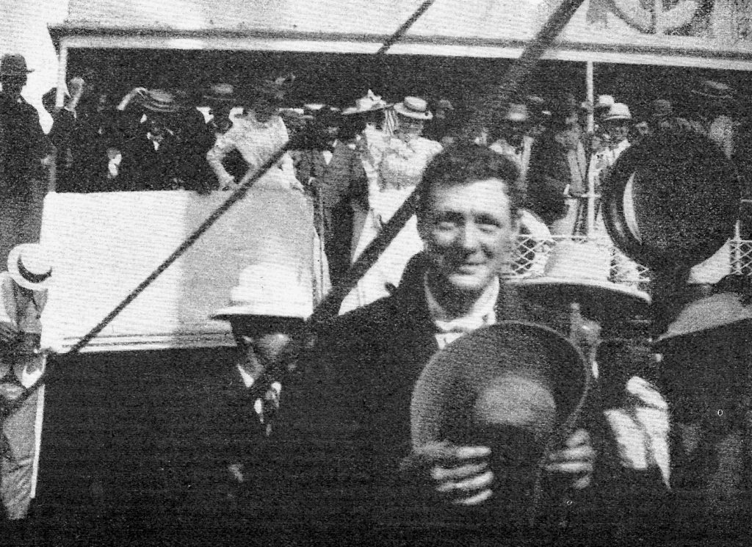
Notes:
By late 1899 he was on a ship destined for South Africa, where he would report on the Boer War as a special correspondent of the Morning Post. He was not yet twenty-five years old.

Slide 6
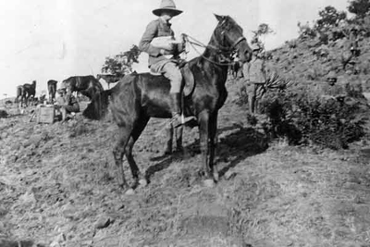
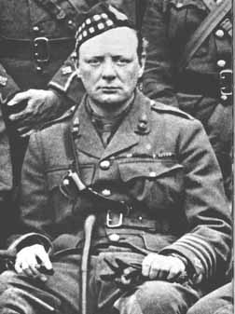
Notes:
At the front, Churchill was caught in a fierce fire fight and forced to surrender after losing his own weapon.

Slide 7
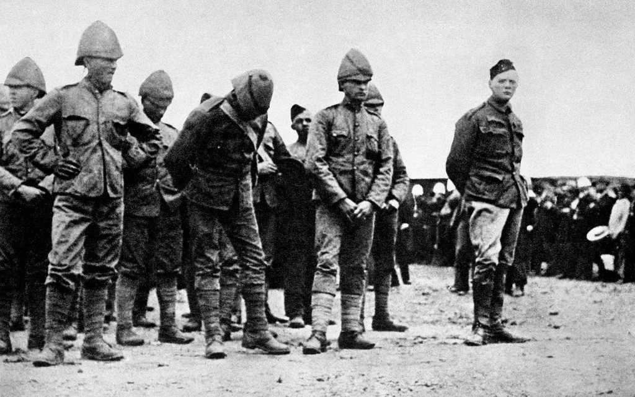
Notes:
He was then imprisoned at Pretoria, and, after three weeks he began to plan his escape.

Slide 8
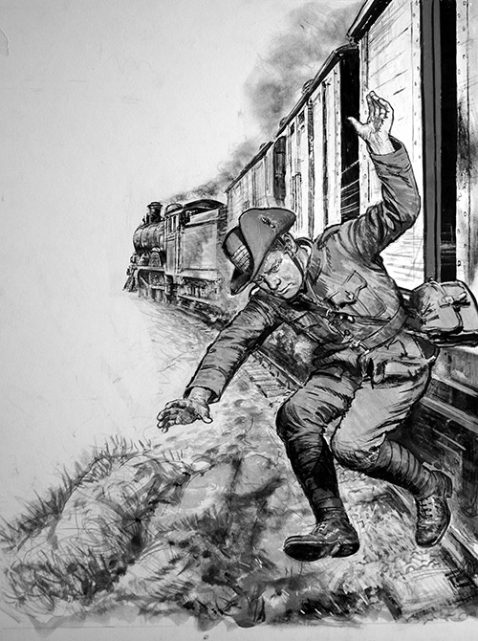
Notes:
One night in December he made his way over the prison wall and boldly walked into Pretoria and found his way to the railway line where he boarded a moving freight train. Hiding by day, walking at night, he came by pure chance to the home of an Englishman who fed him and hid him in a mine. The Boers offered a 25 pound reward for his capture. He was described as follows:

Slide 9
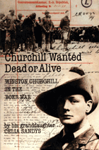
“Englishman, 25 years old, about 5 ft. 8 in. tall, indifferent build, walks with a forward stoop, pale appearance, red-brownish hair, small and hardly noticeable moustache, talks through his nose and cannot pronounce the letter “s” properly.”
Notes:
“Englishman, 25 years old, about 5 ft. 8 in. tall, indifferent build, walks with a forward stoop, pale appearance, red-brownish hair, small and hardly noticeable moustache, talks through his nose and cannot pronounce the letter “s” properly.”

Slide 10
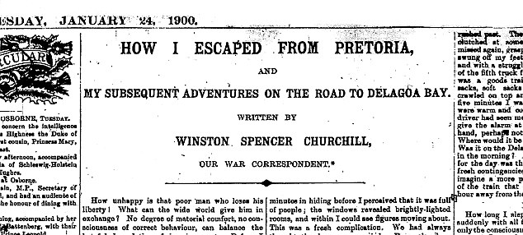
Notes:
Churchill was hidden between bales of wool on a freight. Some sixteen hours later the train crossed the frontier into Portuguese territory.

Slide 11
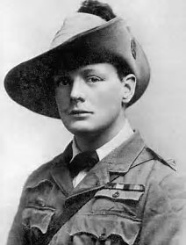
Notes:
He was now famous, and managed to secure a commission in the army, serving well in several engagements, including the release of his former fellow-prisoners of war.

Slide 12
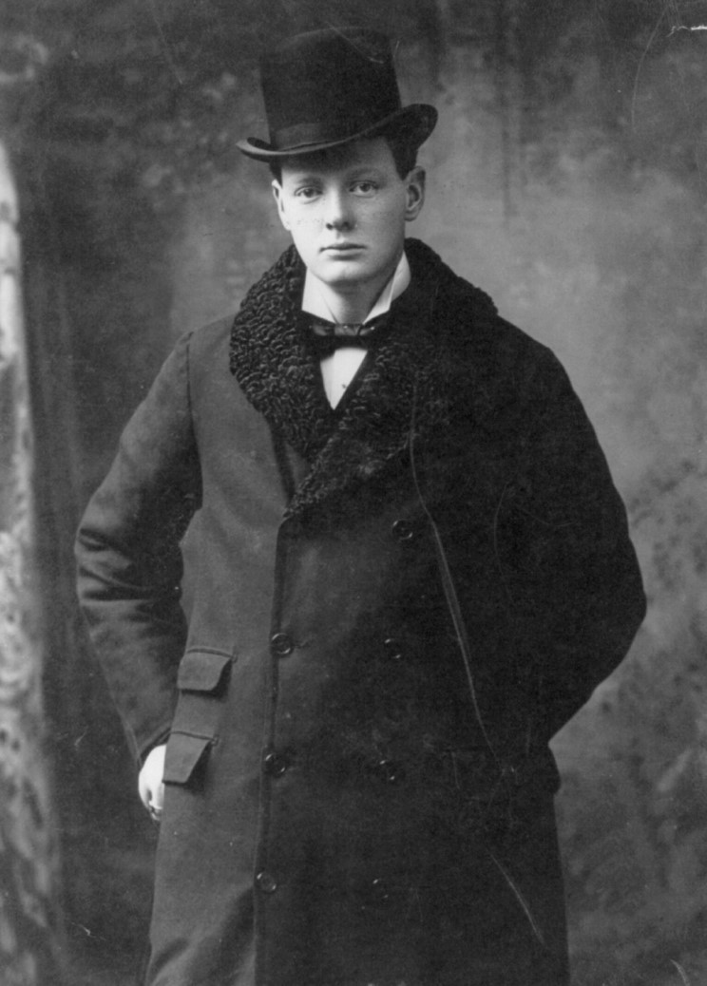
Notes:
Late in the summer of 1900, Churchill returned home to England. A general election was underway, and Churchill entered the campaign. No fewer than eleven constituencies sought him out to be their candidate. This time, Oldham elected him to Parliament. On the Boer war, he declared:

Slide 13
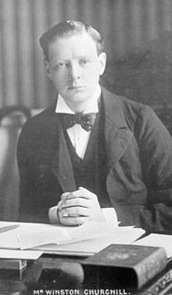
“I was nearly a peace-at-any-price man up to the time of the declaration of the war. After that I was a victory at any-price man.”
Notes:
“I was nearly a peace-at-any-price man up to the time of the declaration of the war. After that I was a victory at any-price man.”
Conservative leader Joseph Chamberlain came to Oldham to support Churchill in the campaign. Chamberlain said of young Winston:

Slide 14
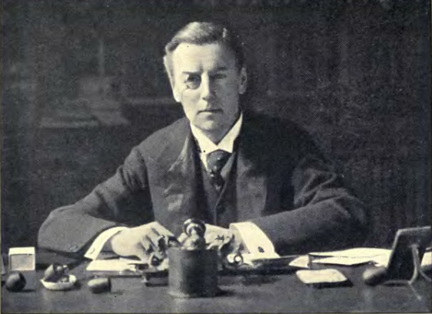
“I think that Lord Randolph’s son has inherited some of the great qualities of his father – his originality and his courage.”
Joseph Chamberlain
Notes:
“I think that Lord Randolph’s son has inherited some of the great qualities of his father – his originality and his courage.”

Slide 15
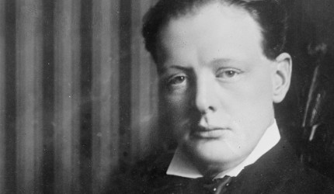
Notes:
Churchill was elected, but only by the slim margin of 222 votes. Yet, he was exuberant, as were the leaders of the Conservative Party.

Slide 16
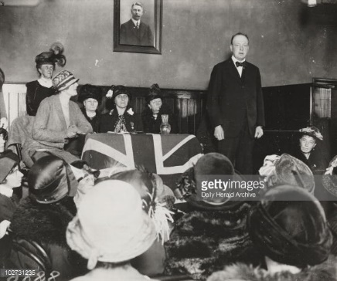
Notes:
Before taking his seat in Parliament, Winston started a lecture tour throughout Britain, then traveled to the United States and to Canada.

Slide 17
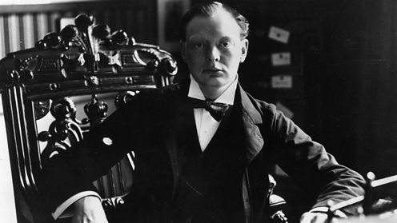
Notes:
Once in the House of Commons, he awaited his opportunity to speak. He rose and expressed his views on what ought to come out of the Boer War:

Slide 18
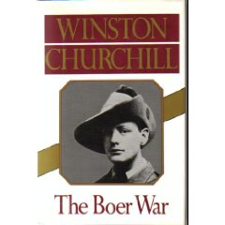
“From what I saw of the war in South Africa, and I saw something of it, I believe that as compared with other wars, especially those in which a civil population took part, it has been on the whole conducted with unusual humanity and generosity. ...”
Notes:
“From what I saw of the war in South Africa, and I saw something of it, I believe that as compared with other wars, especially those in which a civil population took part, it has been on the whole conducted with unusual humanity and generosity. …”

Slide 19
“The immediate policy of the Government should be to make it easy and honorable for the Boers to surrender and painful and perilous for them to continue in the field.”
Notes:
“The immediate policy of the Government should be to make it easy and honorable for the Boers to surrender and painful and perilous for them to continue in the field.”
He then commented on the role his father played over his long Parliamentary service:

Slide 20
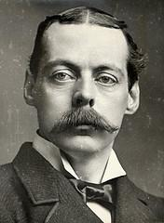
“I cannot sit down without saying how grateful I am for the kindness and patience with which the House has heard me. It has been extended to me, I well know, not on my own account, but because of a splendid memory which many old members still preserve.”
Randolph Churchill
Notes:
“I cannot sit down without saying how grateful I am for the kindness and patience with which the House has heard me. It has been extended to me, I well know, not on my own account, but because of a splendid memory which many old members still preserve.”

Slide 21
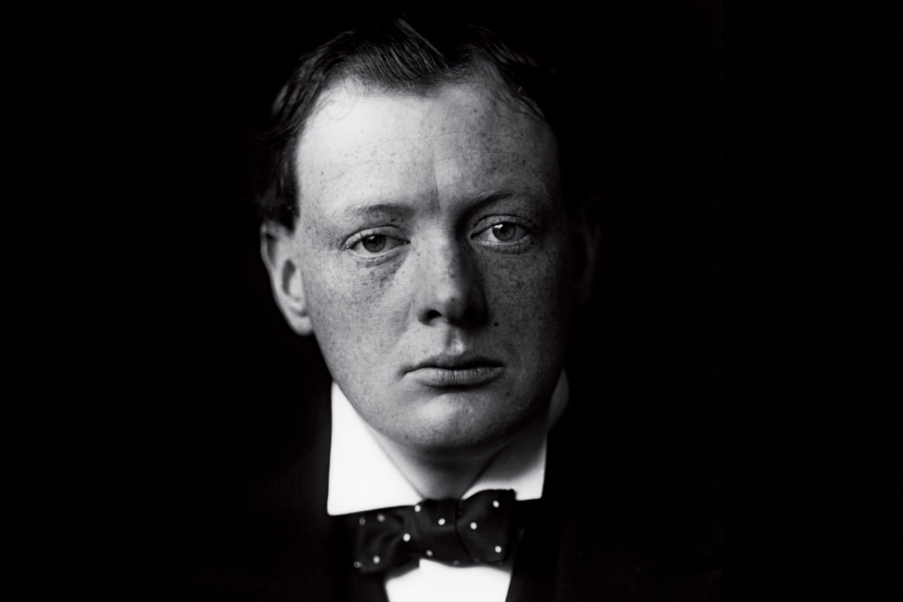
Notes:
Winston’s speech was, in a sense, his declaration of independence from any strict adherence to the party line. He urged sending more troops to South Africa to bring the Boer War to an end. Then, he supported measures to reform the army and reduce expenditures on the military.

Slide 22
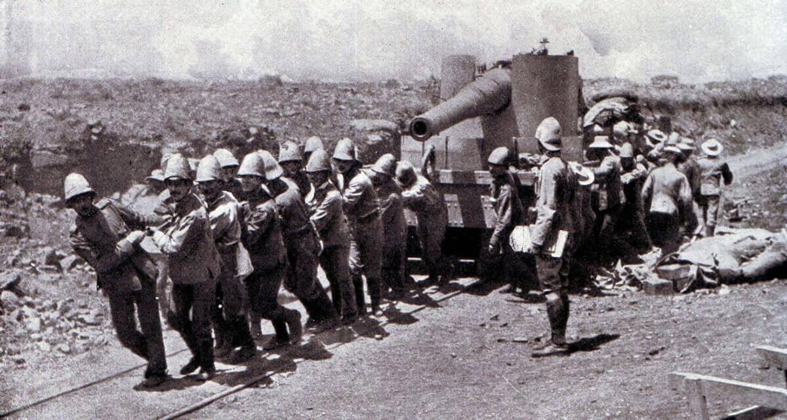
Notes:
Winston’s own experiences, even as a young man, taught him valuable lessons regarding the defense of empire and the risks of modern war:

Slide 23
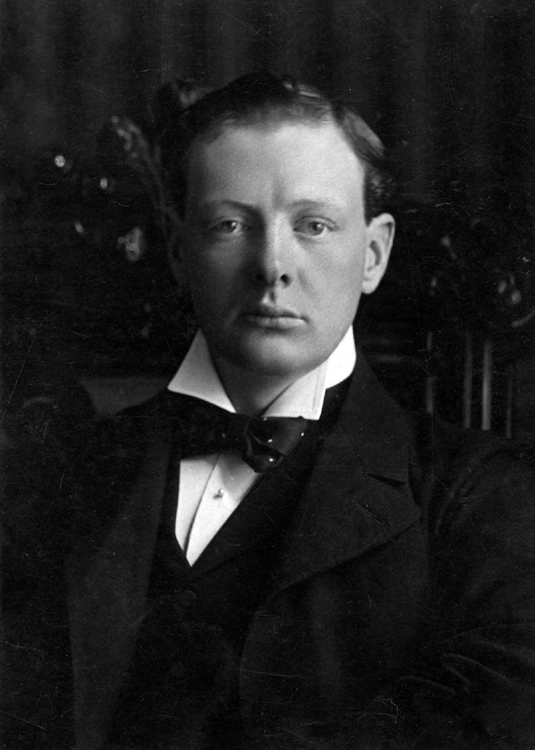
“The enormous and varied frontiers of the Empire, and our many points of contact with barbarous peoples, will surely in the future … draw us into frequent little wars. …But we must not expect to meet the great civilised Powers in this easy fashion. ...”
Notes:
“The enormous and varied frontiers of the Empire, and our many points of contact with barbarous peoples, will surely in the future, as in the past, draw us into frequent little wars. …But we must not expect to meet the great civilised Powers in this easy fashion.” He added:

Slide 24
“…A European war cannot be anything but a cruel, heartrending struggle, which, if we are ever to enjoy the bitter fruits of victory, must demand, perhaps for several years, the whole manhood of the nation, the entire suspension of peaceful industries, and the concentrating to one end of every vital energy in the community.”
Notes:
“…A European war cannot be anything but a cruel, heartrending struggle, which, if we are ever to enjoy the bitter fruits of victory, must demand, perhaps for several years, the whole manhood of the nation, the entire suspension of peaceful industries, and the concentrating to one end of every vital energy in the community.”

Slide 25
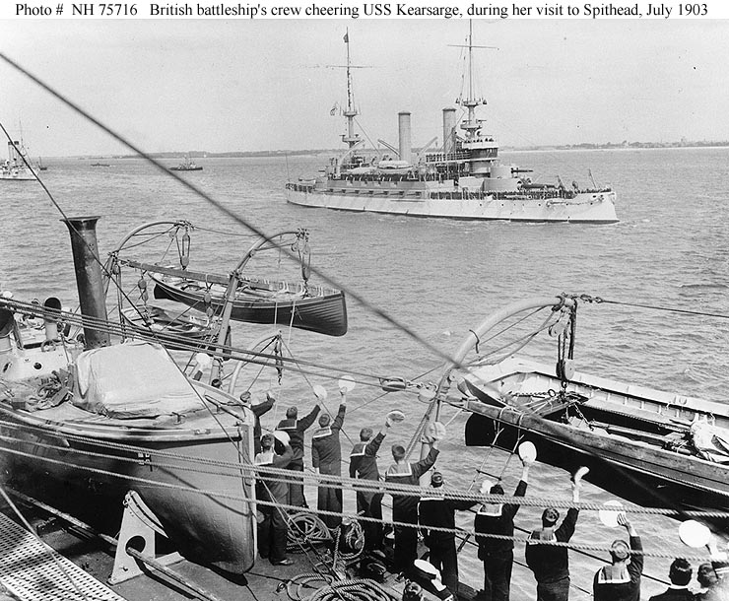
Notes:
To defend the one empire about which he was concerned, that of the British people, Winston declared the absolute necessity of a strong, modern Navy. This was the subject of his second speech:

Slide 26
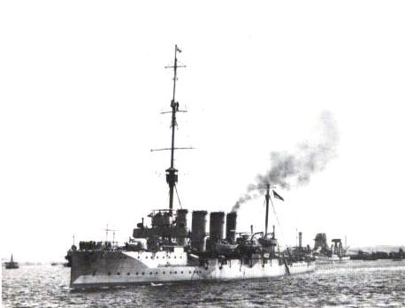
“Without a supreme Navy, whatever military arrangements we may make, whether for foreign expeditions or home defence, must be utterly vain and futile. With such a Navy we may hold any antagonist at arm’s length and feed ourselves in the meantime, until, if we find it necessary, we can turn every city in the country into an arsenal, and the whole male population into an army.”
Notes:
“Without a supreme Navy, whatever military arrangements we may make, whether for foreign expeditions or home defence, must be utterly vain and futile. With such a Navy we may hold any antagonist at arm’s length and feed ourselves in the meantime, until, if we find it necessary, we can turn every city in the country into an arsenal, and the whole male population into an army.”

Slide 27
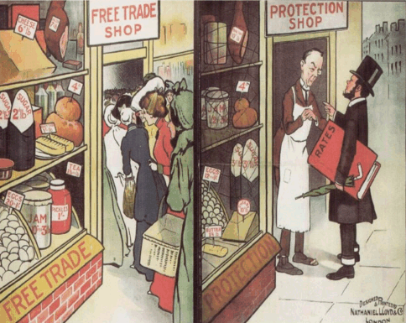
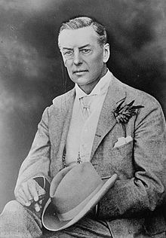
Joseph Chamberlain
Notes:
Churchill became increasingly at odds with the entrenched leadership of his party. His crisis of conscience came in 1903, when Joseph Chamberlain began to push for the abandonment of Britain’s free trade policies in favor of imperial preference. As Churchill biographer Lewis Broad states:

Slide 28
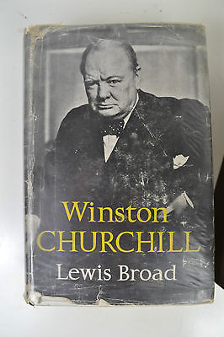
“As the Liberals coalesced [to fight for a cause on which all Liberals were agreed] the Conservative Party disintegrated.”
Notes:
“As the Liberals coalesced [to fight for a cause on which all Liberals were agreed] the Conservative Party disintegrated.”

Slide 29
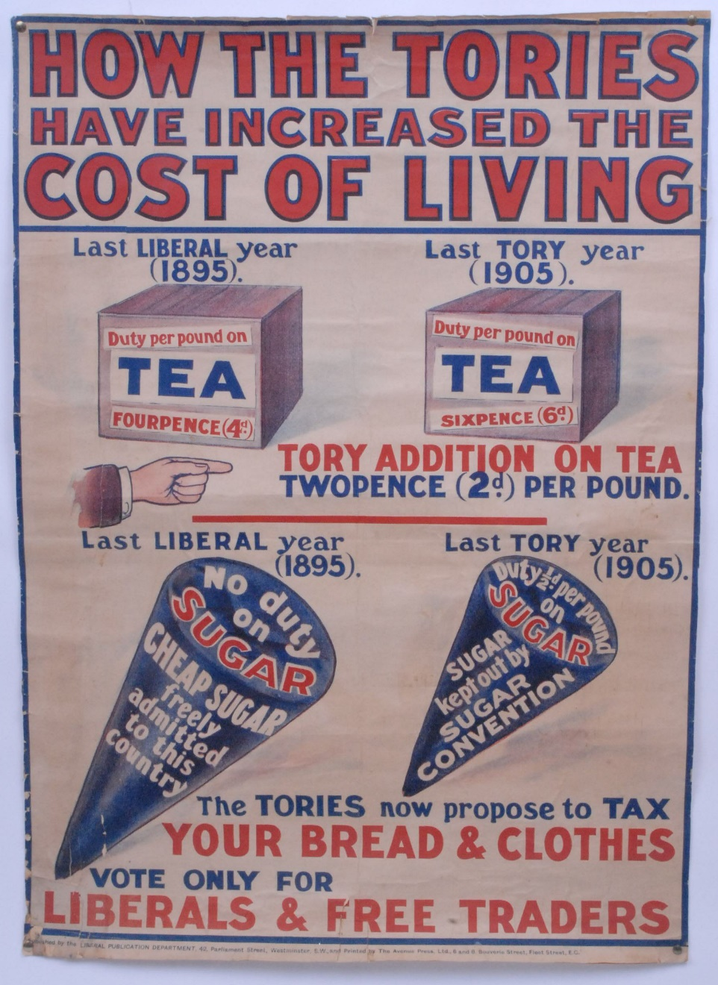
Notes:
Churchill understood well the significance of the Conservative Party’s abandonment of long-standing free trade policies. He declared:

Slide 30
“This move means a change not only in historic English parties but in conditions of our public life. The old Conservative Party with its religious convictions and constitutional principles will disappear, and a new party will arise – rigid, materialistic and secular – whose opinions will turn on tariffs and who will cause the lobbies to be crowded with the touts of protected industries.”
Notes:
“This move means a change not only in historic English parties but in conditions of our public life. The old Conservative Party with its religious convictions and constitutional principles will disappear, and a new party will arise – rigid, materialistic and secular – whose opinions will turn on tariffs and who will cause the lobbies to be crowded with the touts of protected industries.”

Slide 31
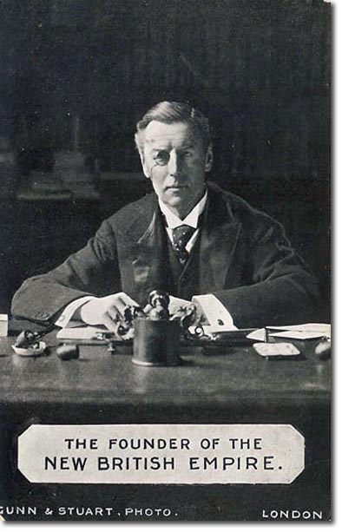
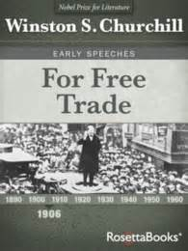
Notes:
Winston followed Joseph Chamberlain around the country, countering his every pro-imperial preference speech with a defense of free trade. Conservative free traders resigned from the government ministries.

Slide 32
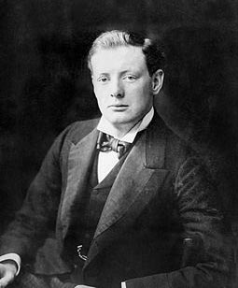
Notes:
Winston broke with the party but retained his seat in Parliament, crossing over to the opposition. In 1905, he was brought into the new Liberal ministry as Parliamentary Secretary for the Colonies. He was age thirty-one.

Slide 33
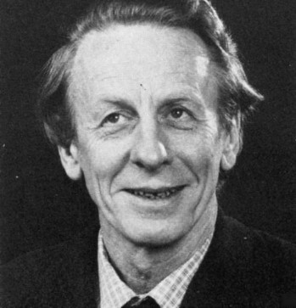
Roy Douglas
Notes:
Historian Roy Douglas wrote a detailed history of the struggles in Britain to solve the land question. He notes that during the general election of 1906, the proponents of Henry George’s solution to the land question readily joined forces with Liberals embracing free trade. Douglas writes:

Slide 34
“The overwhelming majority of keen land reformers supported the Liberal Party, and most of those land reformers who were not Liberals were included among … a body which was soon to be reconstituted as the Labour Party.”
Notes:
“The overwhelming majority of keen land reformers supported the Liberal Party, and most of those land reformers who were not Liberals were included among … a body which was soon to be reconstituted as the Labour Party.”

Slide 35
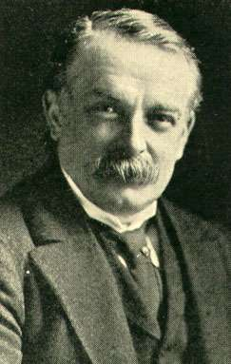
Henry Campbell-Bannerman
Notes:
Britain now had a new prime minister, Henry Campbell-Bannerman. He set down the land reform objectives of his government in a speech delivered on 21 December 1905:

Slide 36
“We wish to make the land less of a pleasure-ground for the rich, and more of a treasure-house for the nation.”
Notes:
“We wish to make the land less of a pleasure-ground for the rich, and more of a treasure-house for the nation.”

Slide 37
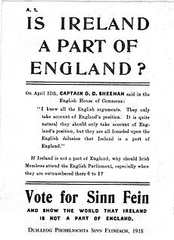
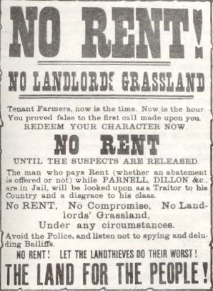
Notes:
The issue of land reform also applied to Ireland, where the Irish sought an end to absentee landlordism and and ultimate independence from the United Kingdom.

Slide 38
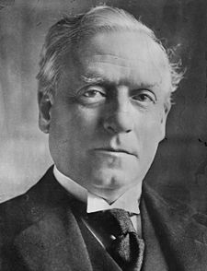
Herbert Asquith
Notes:
Illness brought the resignation of Henry Campbell-Bannerman in 1908, and he was succeeded by Chancellor of the Exchequer, Herbert Asquith.

Slide 39
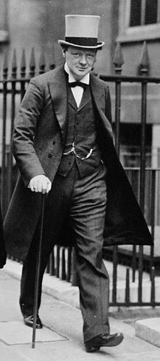
Notes:
Churchill joined the Cabinet as President of the Board of Trade. However, Churchill was required to stand for election and he was narrowly defeated. So, in typical British fashion, Churchill was invited to stand for election in Dundee, Scotland, where he emerged with a solid victory.

Slide 40
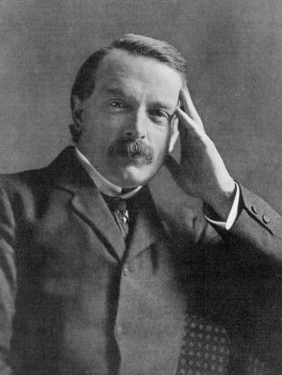
David Lloyd George
Notes:
David Lloyd George was now the new Chancellor of the Exchequer. Winston was now hopeful of great change in Britain. As Lewis Broad explains:

Slide 41
“It was under the inspiration of Lloyd George that Churchill turned social reformer.”
Notes:
“It was under the inspiration of Lloyd George that Churchill turned social reformer.”

Slide 42
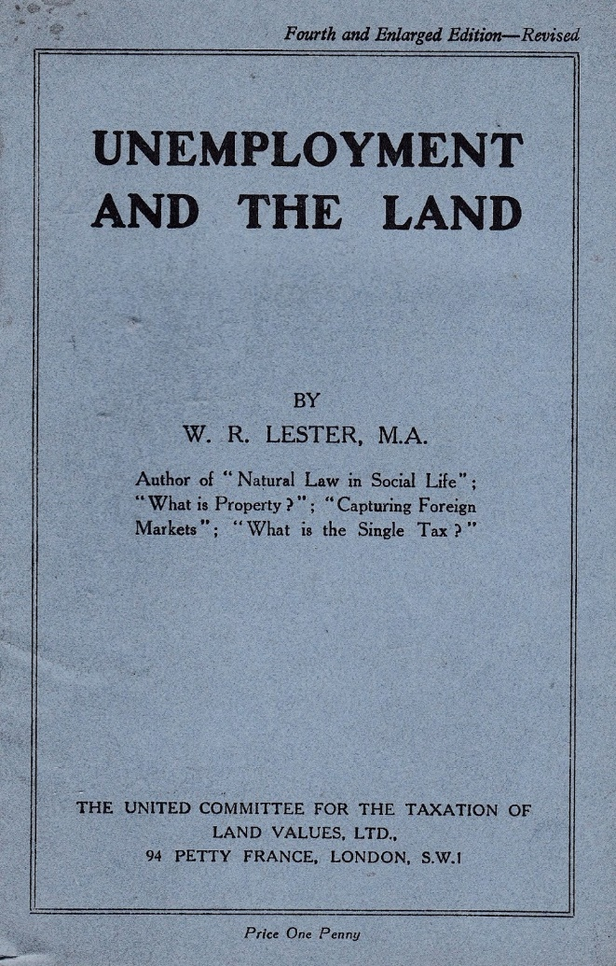
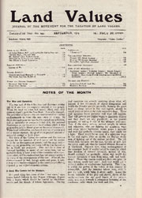
Notes:
Britain’s proponents of Henry George’s proposals for the public collection of the rent of land came together in 1907 as The United Committee for the Taxation of Land Values. They embarked on a public education campaign involving the circulation of over fifty million leaflets over four years beginning that first year.

Slide 43
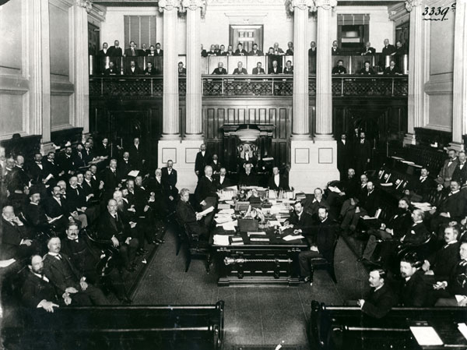
Notes:
Some 250 Members of Parliament signed a petition urging that the taxation of land values be adopted in the next budget. David Lloyd George knew this measure would never get past the House of Lords:

Slide 44
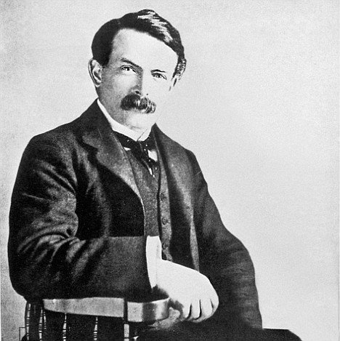
“It would be impossible to secure the passage of a separate Valuation bill … owing to the opposition of the Lords, and therefore the only possible chance which the Government have of redeeming their pledges … is by incorporating proposals involving land valuation in a Finance Bill.”
David Lloyd George
Notes:
“It would be impossible to secure the passage of a separate Valuation bill … owing to the opposition of the Lords, and therefore the only possible chance which the Government have of redeeming their pledges … is by incorporating proposals involving land valuation in a Finance Bill.”

Slide 45
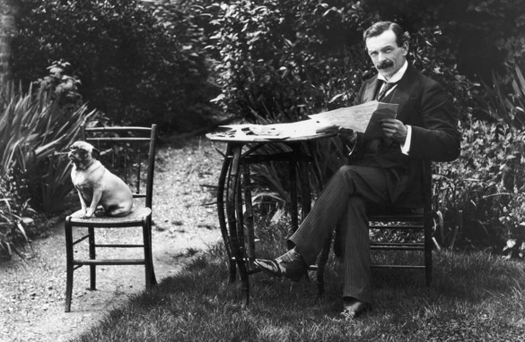
Notes:
What David Lloyd George went on to propose was two forms of land taxation. First, an annual tax of 0.4 percent on the market value of land. Second was a 20 percent tax on any increase in the price of land when sold.

Slide 46
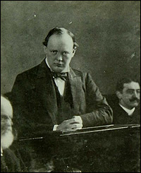
Notes:
Winston stood beside him and the other Liberals on the land question, writing that land taxation was:

Slide 47
“… the most important and certainly the most fundamental part of constructive Liberal social policy.”
Notes:
“… the most important and certainly the most fundamental part of constructive Liberal social policy.”

Slide 48
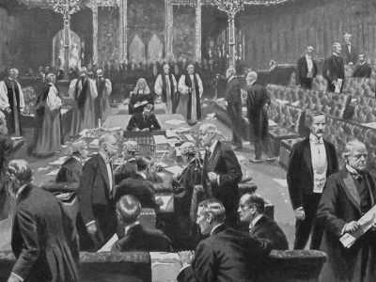
Notes:
However, so long as the Lords held the power of veto over measures passed by the House of Commons, reform measures – and those that attacked the monopolization of Britain’s land -- had little chance of adoption.

Slide 49
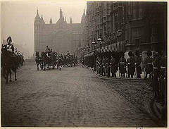
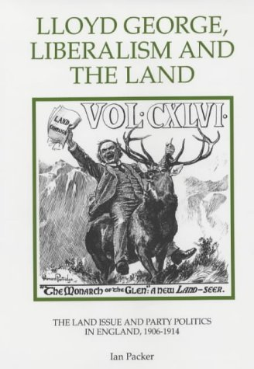
Notes:
David Lloyd George decided on a strategy that would make it impossible for Conservatives to accept his proposed budget. He convinced the King to agree to create a large enough number of new peerages, to be given to Liberals, to enable them to outvote Conservatives. As a result, a bill passed through Parliament and the Lords were finally deprived of their veto power.

Slide 50
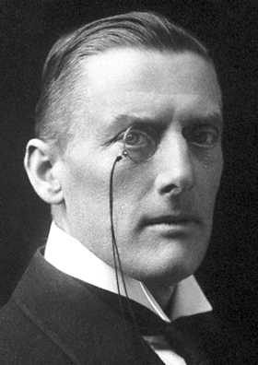
Austen Chamberlain
Notes:
Now, the contest returned to the House of Commons and a strategy developed by the Conservatives, as expressed by Austen Chamberlain:

Slide 51
“It is certain that if we do nothing the Radical Party will sooner or later establish their national [land] tax, and once established in that form any Radical Chancellor in need of money … will find it an easy task to give a turn of the screw. …On the other hand if this source of revenue … is once given to municipalities, the Treasury will never be able to put its finger in the pie again.”
Notes:
“It is certain that if we do nothing the Radical Party will sooner or later establish their national [land] tax, and once established in that form any Radical Chancellor in need of money … will find it an easy task to give a turn of the screw. …On the other hand if this source of revenue … is once given to municipalities, the Treasury will never be able to put its finger in the pie again.”

Slide 52
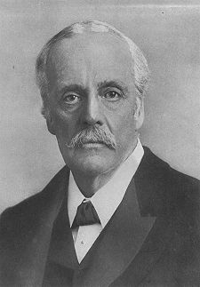
Arthur Balfour
Notes:
When Arthur Balfour attempted in the House of Commons on the 4th of May 1909 to defend the existing system by which the Government raised its revenue, Winston rose in response:

Slide 53
The immemorial custom of nearly every modern State, the mature conclusions of many of the greatest thinkers, have placed the tenure, transfer, and obligations of land in a wholly different category from other classes of property. ...”
Notes:
“The immemorial custom of nearly every modern State, the mature conclusions of many of the greatest thinkers, have placed the tenure, transfer, and obligations of land in a wholly different category from other classes of property. …”

Slide 54
“The mere obvious physical distinction between land, which is a vital necessity of every human being and which at the same time is strictly limited in extent, and other property is in itself sufficient to justify a clear differentiation in its treatment, and in the view taken by the State of the conditions which should govern the tenure of land from that which should regulate traffic in other forms of property.”
Notes:
“... The mere obvious physical distinction between land, which is a vital necessity of every human being and which at the same time is strictly limited in extent, and other property is in itself sufficient to justify a clear differentiation in its treatment, and in the view taken by the State of the conditions which should govern the tenure of land from that which should regulate traffic in other forms of property.”

Slide 55
Notes:
He followed this up with a speech during July in Edinburgh, Scotland:

Slide 56
“It is quite true that land monopoly is not the only monopoly which exists, but it is by far the greatest of monopolies -- it is a perpetual monopoly, and it is the mother of all other forms of monopoly. …”
Notes:
“It is quite true that land monopoly is not the only monopoly which exists, but it is by far the greatest of monopolies - it is a perpetual monopoly, and it is the mother of all other forms of monopoly. …”

Slide 57
“It is quite true that unearned increments in land are not the only form of unearned or undeserved profit which individuals are able to secure; but it is the principal form of unearned increment which is derived from processes which are not merely not beneficial, but which are positively detrimental to the general public. …”
Notes:
“It is quite true that unearned increments in land are not the only form of unearned or undeserved profit which individuals are able to secure; but it is the principal form of unearned increment which is derived from processes which are not merely not beneficial, but which are positively detrimental to the general public. …”

Slide 58
“… Land, which is a necessity of human existence, which is the original source of all wealth, which is strictly limited in extent, which is fixed in geographical position. Land, I say, differs from all other forms of property in these primary and fundamental conditions.”
Notes:
“Land, which is a necessity of human existence, which is the original source of all wealth, which is strictly limited in extent, which is fixed in geographical position. Land, I say, differs from all other forms of property in these primary and fundamental conditions.”

Slide 59
Notes:
Under the 1909 Budget Bill, the key to making the taxation of land values meaningful was a nationwide land valuation. Yet, nothing much happened, and in mid-1911, nearly 200 MPs signed a petition demanding that the Government proceed.

Slide 60
Notes:
David Lloyd George essentially ignored their demands, fearful the Liberals might lose power in the next election.

Slide 61
Notes:
A comprehensive Land Bill finally emerged in 1909, which mandated the compulsory sale of rural land to tenant farmers and compensation for improvements made on leased land. However, absent under the budget of Lloyd George’s new government was a bill calling for the taxation of land values.

Slide 62
Josiah Wedgwood
Notes:
Josiah Wedgwood, an ardent land taxer in the House of Commons, openly expressed his dismay:

Slide 63
“… the valuation could be completed in a year if the Government were in earnest. …There are many in the Liberal Party who have had about enough of this.”
Notes:
“… the valuation could be completed in a year if the Government were in earnest. …There are many in the Liberal Party who have had about enough of this.” [GO TO NEXT SLIDE]

Slide 64
Notes:
Liberal land-taxers campaigned vigorously explaining their vision of land reform. The Liberals found themselves now competing with candidates from the Labour Party in many constituencies, opening the door for Conservatives to capture enough votes to take these seats.

Slide 65
Notes:
Fearful of losing the votes of moderates, Lloyd George actually repudiated assertions that he was a “Single Taxer.” Many Liberals felt betrayed.

Slide 66
Notes:
Lloyd George took all this criticism in, and in February of 1914 made this announced:

Slide 67
“The Government has already … accepted the principle of the rating of site values, and intend to give effect to it by legislation. …Some desire the whole burden to be transferred from the structure to the site.”
Notes:
“The Government has already … accepted the principle of the rating of site values, and intend to give effect to it by legislation. …Some desire the whole burden to be transferred from the structure to the site.”

Slide 68
1914
Notes:
He stated he felt this proposition was impracticable. The Government’s Land Enquiry Committee came out against the imposition of a national land value tax and instead recommended granting to local authorities the option of developing pilot schemes for either land nationalisation or land value taxation. The 1914 Budget included funding for the valuation of land and improvements separately for local purposes.

Slide 69
Roy Douglas
Notes:
Historian Roy Douglas describes what happened next:

Slide 70
“Then, with dramatic suddenness, came the most unnecessary and disastrous war in the history of man. …”
Notes:
“Then, with dramatic suddenness, came the most unnecessary and disastrous war in the history of man. …” Douglas adds:

Slide 71
“The Land Campaign, along with all other questions which were likely to evoke public controversy, was thrust aside as expeditiously as possible in the interest of ‘national unity’.”
Notes:
“The Land Campaign, along with all other questions which were likely to evoke public controversy, was thrust aside as expeditiously as possible in the interest of ‘national unity’.”

Slide 72
Notes:
One leading land-taxer, C.P. Trevelyan, resigned from the Government in protest against Britain’s entrance into war. Josiah Wedgwood entered military service.

Slide 73
Notes:
Winston Churchill became First Lord of the Admiralty.

Slide 74
Gallipoli
Notes:
After the disaster at Gallipoli, Winston resigned as First Lord and went on to fight with the army in France, returning to Britain and the House of Commons in the autumn of 1916.

Slide 75
William Legge
Notes:
As the war came to an end, the nation’s leaders – and some major landowning lords – began to give thought to needed reforms. One, William Legge (the Earl of Dartmouth), wrote to Josiah Wedgwood that meaningful changes would require:

Slide 76
“… sacrifices of some kind from us all, but as it is inconceivable that after all that has passed we should go back to the old extremes of wealth and poverty, the old suspicion and prejudice, the continued warfare between class and class, employer and employed – it means, especially, that those who have most will have to make the largest sacrifices…”
Notes:
“… sacrifices of some kind from us all, but as it is inconceivable that after all that has passed we should go back to the old extremes of wealth and poverty, the old suspicion and prejudice, the continued warfare between class and class, employer and employed – it means, especially, that those who have most will have to make the largest sacrifices…”

Slide 77
Notes:
A General Election occurred shortly after the war. Labour withdrew its support for the coalition government. As a result, the Conservatives won a huge victory and returned with a clear majority in the House of Commons. As Roy Douglas observes:

Slide 78
“The results were an unqualified disaster to the land-taxers not only because most of the Government supporters were hostile to their cause, but also because no alternative administration could be discerned on the Opposition side of the House.”
Notes:
“The results were an unqualified disaster to the land-taxers not only because most of the Government supporters were hostile to their cause, but also because no alternative administration could be discerned on the Opposition side of the House.”

Slide 79
Notes:
Josiah Wedgwood ran as an “Independent Radical” and was returned. Some land-taxers were re-elected; others rejected by voters. Liberals were driven apart based on who supported or opposed the Coalition government.

Slide 80
R.L. Outhwaite
Notes:
A a growing number of land-taxers were drawn to the Labour Party. This association proved to be difficult, and many, led by R.L. Outhwaite and J.W. Graham Peace, broke away to form the Commonwealth Land Party in 1919. Their outreach organ was a newspaper called “The Commonweal”.

Slide 81
Notes:
What emerged from the Government was a bill to expedite the public purchase of land, in part to provide small farmsteads and housing for war veterans.

Slide 82
Austen Chamberlain
Notes:
An immediate technical and political problem arose: how to establish the value of land for acquisition – or, for that matter, taxation – purposes. Remarkably, David Lloyd George remained silent as Conservative leader Austen Chamberlain called for the abolition of existing land value duties and the entire process of land valuation.

Slide 83
Herbert Asquith
Notes:
Herbert Asquith, returned to the House of Commons in 1920, challenged David Lloyd George and his Government to recommit to resolving the ancient land question:

Slide 84
“I still believe … in the necessity, first of all, of the valuation, and next, as a consequence of that valuation, … the taxing for public purposes, both imperial and local, of the site value of land. … [And] that it should be taxed and rated at the same price at which the owner is willing to sell it to the community, when the community wants to purchase it.”
Herbert Asquith
Notes:
“I still believe … in the necessity, first of all, of the valuation, and next, as a consequence of that valuation, … the taxing for public purposes, both imperial and local, of the site value of land. … [And] that it should be taxed and rated at the same price at which the owner is willing to sell it to the community, when the community wants to purchase it.”

Slide 85
Stanley Baldwin
Notes:
The Conservative Government formed in 1923 was headed by Stanley Baldwin, who embraced new policies of protectionism and imperial preference. Baldwin called for an election to obtain public support for his policies. The Liberals united in opposition.

Slide 86
Notes:
Winston entered the campaign in West Leicester against a Socialist and pacifist candidate. In a speech delivered on the 16th of November, 1923, Winston took Stanley Baldwin to task:

Slide 87
“I am forced to ask: when did Mr. Baldwin reach this extraordinary conclusion that the free import of foreign goods into the home market is the cause of existing unemployment? …We have evidently witnessed a sudden mystic process of almost miraculous conversion.”
Notes:
“I am forced to ask: when did Mr. Baldwin reach this extraordinary conclusion that the free import of foreign goods into the home market is the cause of existing unemployment? …We have evidently witnessed a sudden mystic process of almost miraculous conversion.”

Slide 88
Notes:
Again, Churchill was challenging the Conservative leadership on the basis of long-standing principles in support of free trade. The Conservative leadership ignored Churchill and the Liberals, instead trying to convince the British public that voting for Labour would usher in socialism and destroy the nation.

Slide 89
Notes:
The campaign was rough on Winston, with constant disruptions by Socialists, and when the votes came in Winston was rejected. The Liberals made something of a comeback at the expense of the Conservatives, but Labour again held the second highest number of seats in Parliament. Winston, who had been ill throughout the campaign, summed up his situation, stating that he was:

Slide 90
“… without an office, without a seat, without a party, and without an appendix.”
Notes:
“… without an office, without a seat, without a party, and without an appendix.”

Slide 91
Notes:
As no party obtained a majority, some time was required before a compromise was reached and Labour Party leader, Ramsay MacDonald, was called upon to form a Government.

Slide 92
James Ramsay MacDonald
Notes:
MacDonald’s Government proved unable to move any initiatives without a solid majority in the House of Commons. Land-taxes could feel good about only one appointment, that of Philip Snowden, to the cabinet as Chancellor of the Exchequer. Snowden was a committed supporter of the taxation of land values.

Slide 93
“There never was a time when the need was greater than it is today for the application of the philosophy and principles of Henry George to the economic and political conditions which are scourging the whole world. …So long as land is a monopoly, and men are denied free access to it to apply their labor to its uses, poverty and unemployment will exist. …”
Notes:
“There never was a time when the need was greater than it is today for the application of the philosophy and principles of Henry George to the economic and political conditions which are scourging the whole world. …So long as land is a monopoly, and men are denied free access to it to apply their labor to its uses, poverty and unemployment will exist. …”

Slide 94
“I am of the opinion that (economic) rent belongs to society and that no single person has the right to appropriate and enjoy what belongs to society.”
Notes:
“I am of the opinion that (economic) rent belongs to society and that no single person has the right to appropriate and enjoy what belongs to society.”

Slide 95
Notes:
Although Winston and Philip Snowden held the same views regarding how to deal with the problem of land monopoly, Winston believed that Snowden’s positions on other societal issues were danagerous. Winston elaborated on Snowden in a 1932 book titled Great Contemporaries:

Slide 96
“For nearly forty years Philip Snowden steadily and consistently built up the Socialist Party. …He was no more a doctrinaire Socialist than Ramsay MacDonald, but he revolted from Socialism at a different angle. …His heart was filled with an equal measure of disgust and pity when he contemplated the true-blue Conservative or the green-eyed Socialist. …”
Notes:
“For nearly forty years Philip Snowden steadily and consistently built up the Socialist Party. …He was no more a doctrinaire Socialist than Ramsay MacDonald, but he revolted from Socialism at a different angle. …His heart was filled with an equal measure of disgust and pity when he contemplated the true-blue Conservative or the green-eyed Socialist. …”

Slide 97
“The solitary new teacher whom [Snowden and other Radicals] will admit very suspiciously to their mental parlours is Mr. Henry George.”
Notes:
“The solitary new teacher whom [Snowden and other Radicals] will admit very suspiciously to their mental parlours is Mr. Henry George.”

Slide 98
“Snowden's rigidity of doctrine was otherwise impenetrable. Free imports, no matter what the foreigner may do to us; the Gold Standard, no matter how short we run of gold; austere repayment of debt, no matter how we have to borrow the money; high progressive direct taxation, even if it brings creative energies to a standstill; the 'Free breakfast-table,' even if it is entirely supplied from outside the British jurisdiction!”
Notes:
“Snowden's rigidity of doctrine was otherwise impenetrable. Free imports, no matter what the foreigner may do to us; the Gold Standard, no matter how short we run of gold; austere repayment of debt, no matter how we have to borrow the money; high progressive direct taxation, even if it brings creative energies to a standstill; the 'Free breakfast-table,' even if it is entirely supplied from outside the British jurisdiction! ”

Slide 99
Notes:
For Winston, the decision by the Liberal Party leadership to support Ramsay MacDonald brought him to break for good with the Liberal Party. His next move was to try to regain a seat in the House of Commons. Announcing his candidacy and his change in party, he declared:

Slide 100
“My candidature is in no way hostile to the Conservative party or its leaders. On the contrary I recognize that that party must now become the main rallying ground for the opponents of the Socialist party. …Indeed anyone can see that a large measure of Liberal support must be won by the Conservatives if there is to be an effective resistance in the big struggle that is coming and coming soon.”
Notes:
“My candidature is in no way hostile to the Conservative party or its leaders. On the contrary I recognize that that party must now become the main rallying ground for the opponents of the Socialist party. …Indeed anyone can see that a large measure of Liberal support must be won by the Conservatives if there is to be an effective resistance in the big struggle that is coming and coming soon.”

Slide 101
Notes:
Winston ran as an independent, a Constitutionalist. His principles remained that of the classic Liberal, but he now felt the party had abandoned its those principles. Winston was once again rejected by the voters. Yet, he had sparked a growing reaction to the threat of Socialism.

Slide 102
Winston Churchill, the new Chancellor of the Exchequer, 1924
Stanley Baldwin
Notes:
The new Government had little chance of survival, and elections were called at the end of 1924. The Conservatives emerged victorious, and Winston was among those elected. Stanley Baldwin brought Winston into the cabinet as his Chancellor of the Exchequer. Winston, fearful that Britain could suffer the fate of violent upheaval, of class war, turned to the right. Lewis Broad describes his state of mind:

Slide 103
“Alarmed by the fear that the states of Europe might follow Russia into the abyss, he found cause to praise Mussolini and the Italian Fascists – ‘the necessary antidote to the Russian poison’.”
Notes:
“Alarmed by the fear that the states of Europe might follow Russia into the abyss, he found cause to praise Mussolini and the Italian Fascists – ‘the necessary antidote to the Russian poison’.”

Slide 104
Notes:
Winston contributed to domestic unrest by his most significant economic policy decision: restoring Britain to the gold standard at the pre-war value of sterling. He had followed the advice of Treasury experts and London’s finance capitalists, with disastrous results.

Slide 105
Notes:
Britain’s producers were already experiencing stiff competition, and a stronger currency made matters worse. The labor cost component of production could be forced down somewhat, displaced by investment in machinery; but, land costs, absent Henry George’s fiscal solution, could be reduced only by moving production facilities to where land costs were much lower.

Slide 106
John Maynard Keynes
Notes:
John Maynard Keynes, the British economist whose fame was rising, responded with a critical analysis, The Economic Consequences of Mr. Churchill. Winston, Keynes explained, had:

Slide 107
“…no instinctive judgement to prevent him from making mistakes'. … [L]acking this instinctive judgement, he was deafened by the clamorous voices of conventional finance; and, most of all . . he was misled by his experts.”
John Maynard Keynes
Notes:
“…no instinctive judgement to prevent him from making mistakes'. … [L]acking this instinctive judgement, he was deafened by the clamorous voices of conventional finance; and, most of all . . he was mislead by his experts.”

Slide 108
Notes:
The almost immediate consequence of returning to the pre-war price for gold was the threat of a nationwide strike by coal miners. This forced the Government to subsidize the coal industry to prevent a fall in wages. The miners decided to strike anyway, and other trades unions joined them.

Slide 109
Notes:
Churchill assumed the role of propagandist for the Government, which issued its own newspaper, The British Gazette.

Slide 110
Notes:
Members of the House of Commons, including David Lloyd George, attacked Winston for the gross distortions that filled the pages of the government newspaper. Nonetheless, the Government outlasted the striking workers, although at the cost of lost external markets and other industrial dislocations.

Slide 111
Notes:
Domestic stability required that the Government find new sources of revenue to soften the hardships of unemployment, while somehow controlling rising expenditures. Winston and Philip Snowden engaged frequently in debate over financial matters in the House of Commons. As Snowden later recalled:

Slide 112
“The debates between us became quite a Parliamentary entertainment. They were regarded as the best show in London. When it was expected that we should both be speaking, the public galleries were invariably crowded.”
Notes:
“The debates between us became quite a Parliamentary entertainment. They were regarded as the best show in London. When it was expected that we should both be speaking, the public galleries were invariably crowded.”

Slide 113
Notes:
There was no further discussion of raising needed revenue by a higher tax on land values. Between 1925 and 1928, the highest rate of taxation on incomes was lowered, but this was countered by increased pension contributions. Other measures included a tax on wagers at race tracks, the re-allocation of road funds for general purposes, taxes placed on wines, motor tires and tobacco.

Slide 114
Notes:
Then, in 1928, Churchill announced there would be a restructuring of the system of property rating for tax purposes. Louis Broad explains:

Slide 115
“The object was to readjust rating burdens as between productive industries – which were unjustly burdened – and the distributing trades – which escaped their just dues. Relief was to be given by reducing the rates on all premises used for production and on freight-carrying railways, docks and canals. Agricultural land would be freed of the last remaining 25 per cent liability for rates.”
Notes:
“The object was to readjust rating burdens as between productive industries – which were unjustly burdened – and the distributing trades – which escaped their just dues. Relief was to be given by reducing the rates on all premises used for production and on freight-carrying railways, docks and canals. Agricultural land would be freed of the last remaining 25 per cent liability for rates.”

Slide 116
Notes:
For Winston, just getting through this period of economic unrest without social upheaval seemed to be a victory. However, Britain’s voters decided they had had enough and voted in the Labour Party.

Slide 117
Notes:
Many Conservatives clamored for protectionism and imperial preferences; to them, Winston’s actions had only worsened the economic situation. There would be no place for Winston in the next Conservative Government.

Slide 118
Notes:
In April of 1929, Ramsey MacDonald promised leading land-taxers that his government would begin to tax land values. Liberals pressed for the funding of new roads by means of a “betterment” tax on the increase in land values created by new public investment. However, within a few months came the stock market crash in the United States.

Slide 119
Notes:
In the face of worsening economic conditions, MacDonald sought to reach agreement on policies with both David Lloyd George and Stanley Baldwin. Despite a petition signed by 165 Labour and Liberal M.P.s, Snowden did not include the taxation of land values in the 1930 budget. Snowden merely called for land valuation.

Slide 120
Notes:
The measures became victim of the internal power struggle between parties. MacDonald was forced to form a national, or coalition, government; and, a General Election resulted in a Conservative majority. Snowden was replaced by Neville Chamberlain, a staunch opponent of land reform.

Slide 121
Neville Chamberlain
Notes:
Neville Chamberlain pressed for suspension of the land valuation, ostensibly to save costs. Without the valuation, imposition of a land value tax would then be impossible.

Slide 122
Neville Chamberlain
Notes:
With what most politicians and the public saw as more global and pressing economic and foreign policy issues to face, any further consideration to the land question disappeared. As Roy Douglas wrote:

Slide 123
“For the remainder of the 1930s, the chief preoccupation of statesmen lay at first with industrial unemployment and later with international questions. Arguably, the land problem really stood at the root of both of these issues; but whether this be true or false, most men did not see things that way.”
Notes:
“For the remainder of the 1930s, the chief preoccupation of statesmen lay at first with industrial unemployment and later with international questions. Arguably, the land problem really stood at the root of both of these issues; but whether this be true or false, most men did not see things that way.”

Slide 124
Notes:
Britain’s voters decided at the end of the Second World War that their deeper interests would be best served by a government led by Labour. Out of 627 seats Labour increased its number from 164 to 393, giving the party its first independent majority of 159 seats over all other parties. The Conservatives and their allies secured 213 seats, the Liberals 10 and other parties 11. Winston resigned as prime minister.

Slide 125
Clement Attlee
Notes:
Labour formed the new Government, headed by Clement Attlee. The party’s official statement on the land question read as follows:

Slide 126
“Labour believes in Land Nationalisation and will work towards it, but, as a first step, the State and local authorities must have wider and speedier powers to acquire land for public purposes wherever the public interest so requires. In this regard and for the purposes of controlling land use under town and country planning, we will provide for fair compensation, but we will also provide for public funds from ‘betterment.”
Notes:
“Labour believes in Land Nationalisation and will work towards it, but, as a first step, the State and local authorities must have wider and speedier powers to acquire land for public purposes wherever the public interest so requires. In this regard and for the purposes of controlling land use under town and country planning, we will provide for fair compensation, but we will also provide for public funds from ‘betterment.”

Slide 127
Notes:
Winston, returned as Prime Minister in 1951, remained silent on the land question until November of 1952, when he rose in the House of Commons to speak on a bill relating to town planning:

Slide 128
“ I remember the old days, … when the taxation of land values and of unearned increments in land was a foremost principle and a lively element in the programme of the Radical Party to which I then belonged. But what is the situation which presents itself to us to-day? …”
Notes:
" I remember the old days, … when the taxation of land values and of unearned increments in land was a foremost principle and a lively element in the programme of the Radical Party to which I then belonged. But what is the situation which presents itself to us to-day? …”

Slide 129
“In those days we had the spectacle of valuable land being kept out of the market until the exact moment for its sale was reached, regardless of the fact that its increased value was due to the exertions of the surrounding community. …”
Notes:
“In those days we had the spectacle of valuable land being kept out of the market until the exact moment for its sale was reached, regardless of the fact that its increased value was due to the exertions of the surrounding community. …”

Slide 130
“Then we had the idea that, if those obstructions could be cleared out of the way, free enterprise would bound forward and small people would have a chance to get a home, or to improve their existing homes, and many other things besides.”
Notes:
“Then we had the idea that, if those obstructions could be cleared out of the way, free enterprise would bound forward and small people would have a chance to get a home, or to improve their existing homes, and many other things besides.”

Slide 131
Notes:
Sometime later, one of the handful of stalwart land-taxers in Britain reminded Churchill of his early campaigning to rid the nation of landed privilege. His response was that when the land-taxers mustered the public support – the votes – he would again sing the land song. His general position on how government ought to raise needed revenue came down to this:

Slide 132
“For a nation to try to tax itself into prosperity is like a man standing in a bucket and trying to lift himself up by the handle.”
Notes:
“For a nation to try to tax itself into prosperity is like a man standing in a bucket and trying to life himself up by the handle.”

Slide 133
George L. Pepler, author of the Town and Country Planning Act of 1947
Notes:
The opportunity for reform of the British system of land tenure has seemingly passed. History and the efforts of reformers had turned in a different direction. The Labour Party put its faith in planning, passing the Town and Country Planning Act in 1947. The Act was supported by the Liberal Party, which alienated remaining Liberals who continued to fight for the taxation of land values.

Slide 134
Notes:
A small group of Liberals formed the Liberal Liberty League as a pressure group inside the party, but others orchestrated changes in the party rules so League members could no longer be affiliated with the Party. After some time the Liberal Liberty League merged with the Land Value Taxation League.

Slide 135
Notes:
Churchill had suffered a mild stroke in mid-1949. He experienced another more severe stroke in June of 1953, and finally left office in April 1955. After another stroke in mid-January 1965 he lingered on for nine days, dying on the morning of the 24rth of January.

Slide 136
Harold Wilson -- 1964
Notes:
Labour returned to power in 1964, with a government formed under Harold Wilson as the new Prime Minister. The government created a Land Commission to acquire land the government planners sought for development. Private developers were then charged a “betterment levy” of forty percent above the government’s cost of acquisition. This measure lasted until the return of the Conservatives in 1971.

Slide 137
Michael Foot
Harold Wilson
Notes:
In 1974, British voters returned a Labour Government to power, which passed the Community Land Act of 1975, providing broad powers for compulsory land acquisition. This was followed by the Development Land Tax Act of 1976 which provided for the taxation of development values. None of these measures attacked the real problem of land monopoly and the private appropriation of the rental value of land.

Slide 138
Notes:
Britain’s economy was heavily stressed by the rising cost of oil coming from OPEC-dominated Middle East producers. Remarkably, recession failed to dampen Britain’s speculation-driven land markets. As Fred Harrison wrote in his 1983 book, The Power in the Land:

Slide 139
“Following the 1973/74 collapse at the end of the previous cycle, land values recovered rapidly, reaching their 1973 speculative peaks within five years and during a period of on-going recession.”
Fred Harrison
Notes:
“Following the 1973/74 collapse at the end of the previous cycle, land values recovered rapidly, reaching their 1973 speculative peaks within five years and during a period of on-going recession.”

Slide 140
Notes:
Few analysts other than Fred Harrison recognized that Britain’s domestic land markets and not OPEC had triggered the national recession. Tracking the price of crude oil, Harrison noted:

Slide 141
“OPEC was quickly singled out as the ‘fall guy’, but this interpretation is implausible on timing. …”
Notes:
“OPEC was quickly singled out as the ‘fall guy’, but this interpretation is implausible on timing. …”

Slide 142
“In fact, since the major price rise early in 1974, the cost of oil in relation to manufactured goods had declined. From 1976 onwards, UK consumers were paying less for crude oil, in real terms.”
Notes:
“In fact, since the major price rise early in 1974, the cost of oil in relation to manufactured goods had declined. From 1976 onwards, UK consumers were paying less for crude oil, in real terms.”

Slide 143
1909
Notes:
Winston Churchill may not have fully grasped the connection between land rent monopoly and the inevitability of economic recessions, but at least some of his Liberal colleagues did. Writing in 1909, C. H. Chomley and R. L. Outhwaite put their case before the public:

Slide 144
“Proposals to tax land values are always and everywhere strenuously resisted by those in possession of them, who regard as sacred a form of property which enriches them without effort on their own part and lays the work of the world under tribute. …”
Notes:
“Proposals to tax land values are always and everywhere strenuously resisted by those in possession of them, who regard as sacred a form of property which enriches them without effort on their own part and lays the work of the world under tribute. ...”

Slide 145
“The landowners have long been a privileged class holding an undue proportion of wealth influence and power in the country, able thereby to remove most of the public burdens from their own to other shoulders and they fiercely resent any attempt to make them pay for the privileges they enjoy, by taxing the value of the land they hold.”
Notes:
“The landowners have long been a privileged class holding an undue proportion of wealth influence and power in the country, able thereby to remove most of the public burdens from their own to other shoulders and they fiercely resent any attempt to make them pay for the privileges they enjoy, by taxing the value of the land they hold.” Still, the land question remains unanswered.

